Slide 1
Information Literacy + Blackboard = a great way to reach on and off campus students. Jane Verostek Associate Librarian SUNY College of Environmental Science and Forestry Moon Library jmveros@esf.edu online @ SUNY ESF’s TV Channel http://tinyurl.com/Library411

Slide 2
Blackboard Overview - Timeline

Slide 3
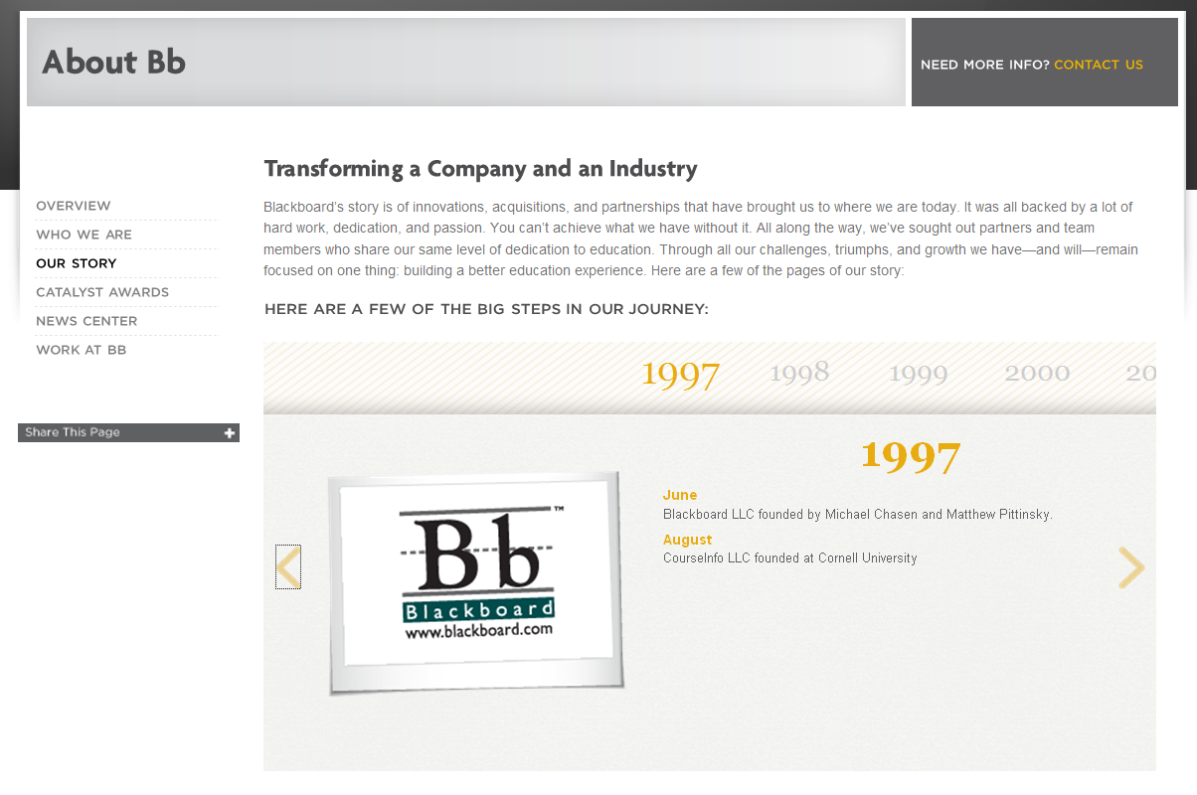
Blackboard – Our Story http://www.blackboard.com/About-Bb/Our-Story.aspx

Slide 4
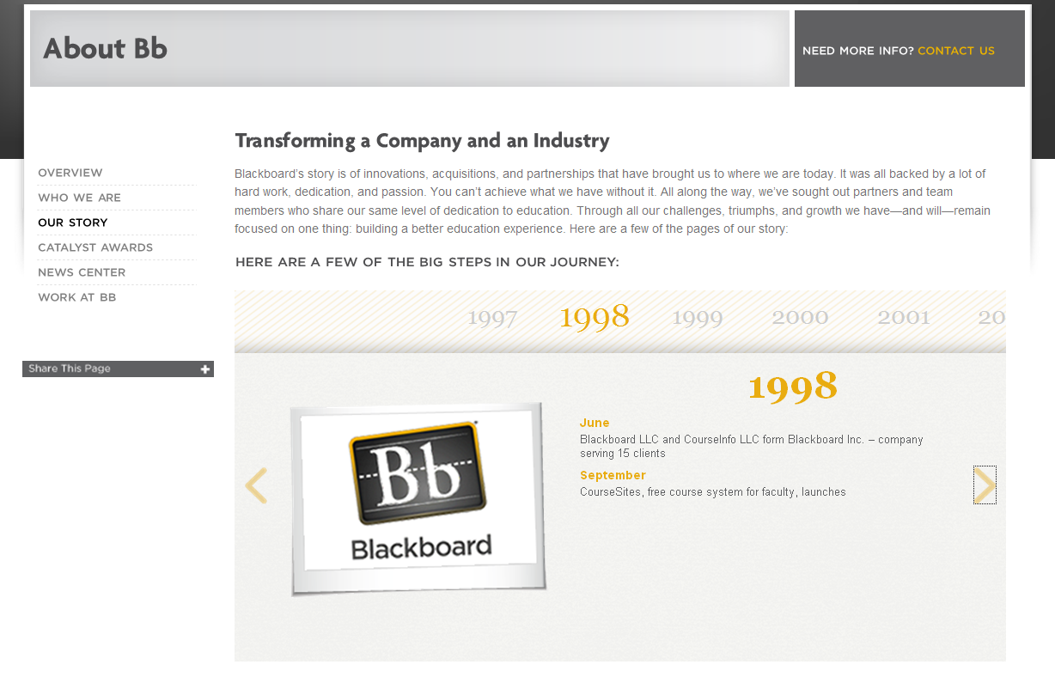
Blackboard – Our Story http://www.blackboard.com/About-Bb/Our-Story.aspx

Slide 5
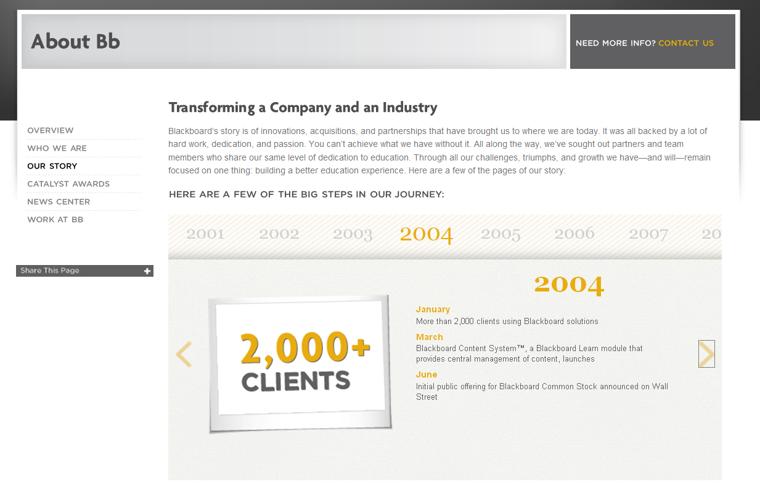
Blackboard – Our Story http://www.blackboard.com/About-Bb/Our-Story.aspx

Slide 6
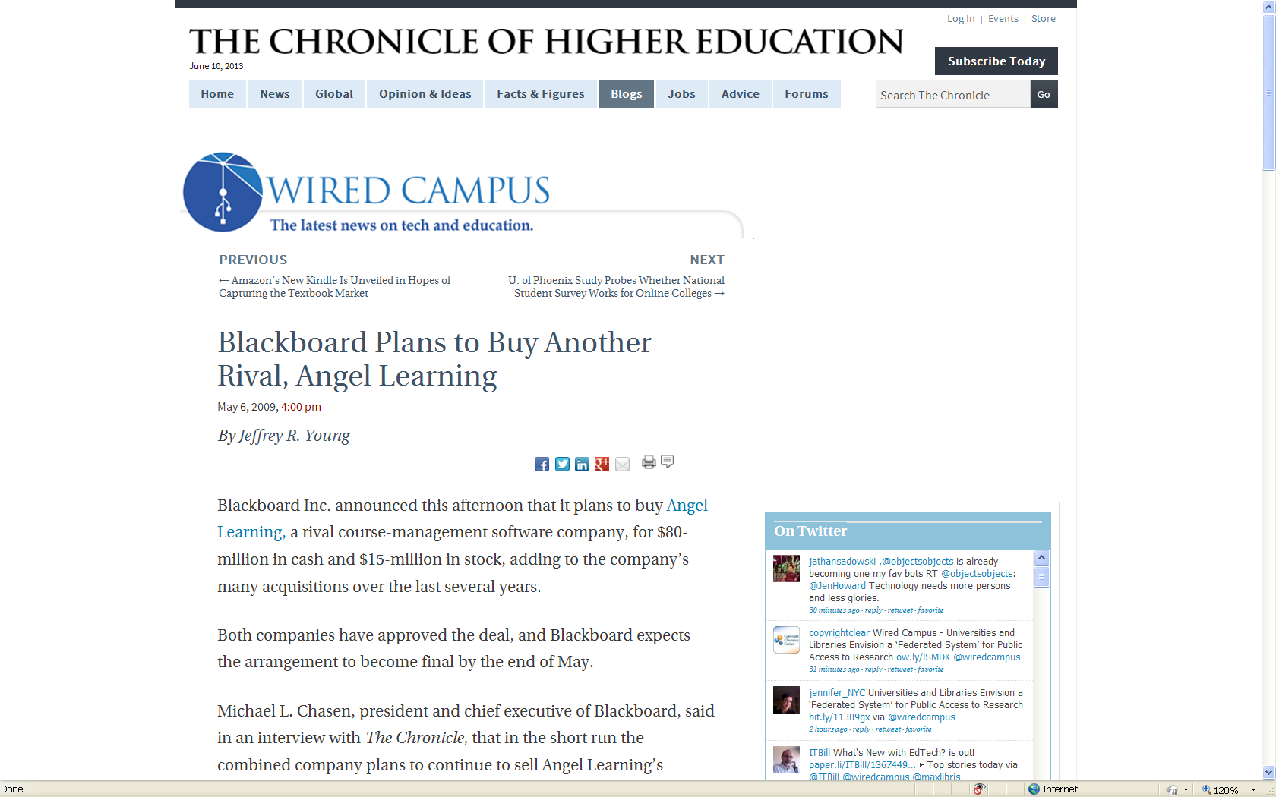
Blackboard

Slide 7
ANGEL

Slide 8
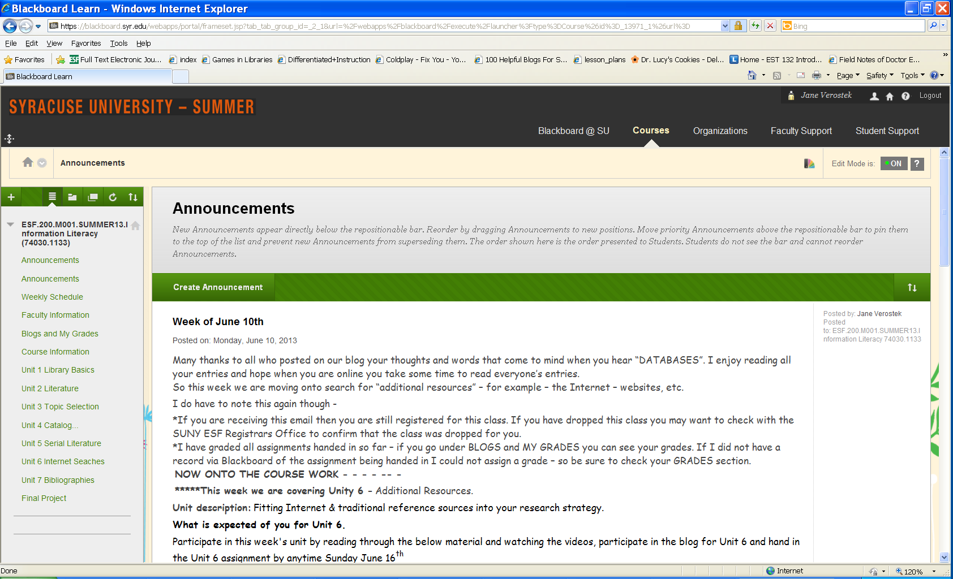
December 2010 Blackboard software and services are used by over 9,300 institutions in more than 60 countries

Slide 9
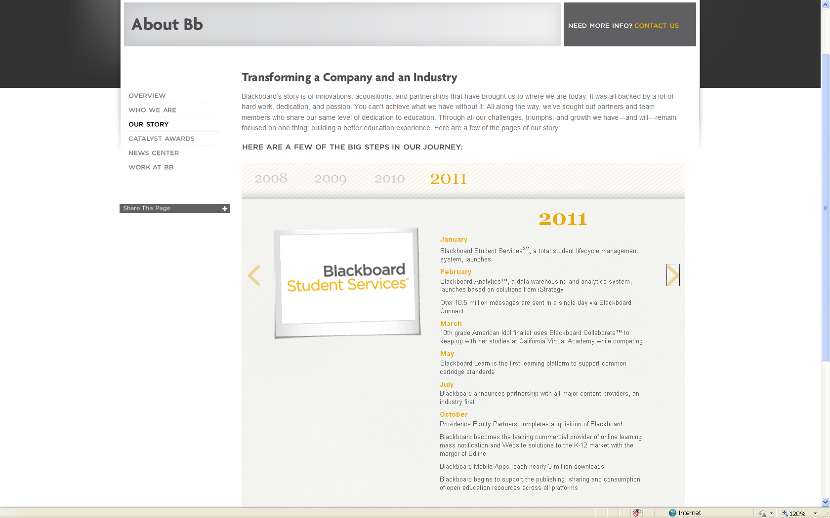
Blackboard – Our Story http://www.blackboard.com/About-Bb/Our-Story.aspx

Slide 10
SUNY ESF’s Information Literacy class and Blackboard
In the Summer of 2009 I was asked to design and teach a section of our regular in person ESF 200 Information Literacy class as a completely online course.
Our campus traditionally used Blackboard and I had used it to take courses so I was familiar with the software.
The ESF student body consists of approximately 1,650 undergraduate students. SOME of our majors on campus require this library course. We traditionally have about 5 in person sections of this class in the fall and spring with an average of 20 to 25 students in those classes.
The library class runs for the first 5 weeks of the fall and spring semesters.

Slide 11
SUNY ESF – Info Lit - The NUMBERS!
Fall 2009……….32 students
Spring 2010……44 students
Fall 2010……….56 students
Spring 2011……41 students
Summer 2011… 9 students
Fall 2011……… 23 students
Spring 2012……38 students
Summer 2012…19 students
Fall 2012……….54 students
Spring 2013……58 students
Summer 2013…15 students

Slide 12
ESF 200 Information Literacy

Slide 13
TIPS for setting up Blackboard.
*Organize coursework into clear units to keep students on track.
*Take advantage of Blackboard features such as BLOGS and
Discussion Groups.
*At the beginning of each unit have an clear outline of what is expected
for example - due dates and what the students should be reviewing in
that unit – for example PowerPoint, videos, assignments, blogs, etc.
*If you ARE NOT using some of the Blackboard features such as
JOURNAL lists or COURSE RESERVES then HIDE the links so
students don’t get confused.
*Even if you do not have the full content of a unit yet - load as much
content as you can and then HIDE the links from the student view.

Slide 14
ESF 200 Information Literacy

Slide 15
BLOGS
In Blackboard the BLOGS are organized alphabetically.
To keep them in order it is best to assign them letters
A, B, C, D, E, F, etc. so they sort in the order you want them to.

Slide 16
BLOGS
A great way to have students introduce themselves is via an Animoto video http://animoto.com
THIS IS THE TEXT I POST IN THE INTRODUCE YOURSELF BLOG
Please use this blog to introduce yourself to me and the rest of the class. Also please create an account for Animoto http://animoto.com and use that free software to create a quick video that introduces yourself to me and the rest of the class. Note Animoto lets you do free 30 second videos you don't need to purchase/pay anything to do the free 30 second videos.
My video - http://animoto.com/play/80KFhTwyr9NdCzG83HUxQQ
Some student examples
http://animoto.com/play/LLqM70Qg3xFGbZHcwKl1Bg
http://animoto.com/play/pvjbTzsBM4xIlPguDZkm4g
http://animoto.com/play/XOK8ciHPg2QaGbWvsIKWkA#
http://animoto.com/play/ZkOWitxITifyDzYVSYbFpQ

Slide 17
Beyond TEXT in BLOGS
THIS IS THE TEXT I POST IN THE LIBRARY CATALOG BLOG
As you review this week's unit - Unit 4 The Library Catalog - use this blog to share some thoughts on the class materials, our library catalog, another library catalog, one of the sites you visited from the assignment like Worldcat, LibraryThing, etc. Remember this blog is here in place of the class meeting in person.
I'd also like everyone in their blog post to include a photo or image or graphic of what a library means to you - reading? computers? technology? a place to meet friends? a place you go for a class or a program? studying? research? journals? books? imagination? a place to take a break from class to take a mental break?
You can take a photo yourself, use one you already have or find one "online" via the Internet - just make sure it is O.K. to use.
If you search Flickr.com there's an option under Advanced Search where you can limit to photos/images with Creative Commons-licensed content http://www.flickr.com/creativecommons/ Or here is another site where you can find photos http://www.pics4learning.com/ Pics4Learning is a safe, free image library for education.
After all the images are posted I'll put them all together on one screen so everyone can see what we all think libraries mean to us - visually.

Slide 18
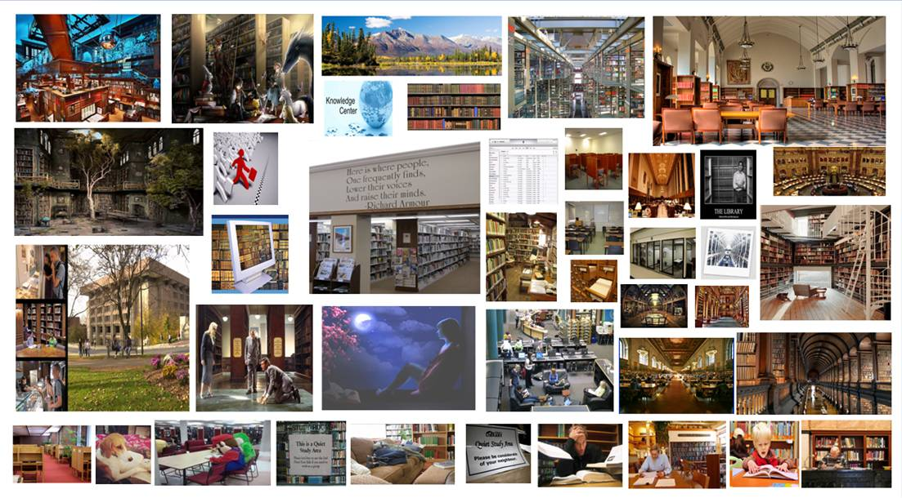
BLOG – What a library means to me

Slide 19
Beyond TEXT in BLOGS
THIS IS THE TEXT I POST IN THE SERIAL LITERATURE BLOG
Once again we will use this blog space to share comments on what you think about searching the databases for journal articles. Feel free to share your thoughts here on the SUNY ESF databases, Open access resources, etc.
ALSO - instead of having an image of what a database means to you - like we did last week for libraries I am wondering what one word comes to mind when you hear the word DATABASES?
I'll take everyone's words and put them together so we can visually see everyone's different definitions of DATABASES.

Slide 20
BLOG – What word comes to mind when you hear the word DATABASE?
http://www.wordle.net

Slide 21
Beyond TEXT in BLOGS
THIS IS THE TEXT I POST IN THE INTERNET BLOG
Again please use this blog to share your thoughts, comments, etc. on searching the internet - specifically you may want to comment on what you thought of the search tools shared with you in the internet searching assignment.
Also this week's VISUAL assignment is to draw the internet and attached your drawing to your blog entry. I'll put everyone's drawings together again into a collage.
So using whatever tool you have available on your PC, MAC, Laptop, idevice, etc. draw the internet. If you don't have software or an app available you can still draw the internet on a piece of paper then scan it in on the library's BookScan machine (or another scanner - say in Baker or in a lab you use) - save it to a thumb drive and attach it into your blog entry.
If you're looking for ideas - inspiration - visit the site -
Can you draw the internet http://www.canyoudrawtheinternet.com/

Slide 22
BLOG – Draw the Internet!

Slide 23
TIPS for setting up coursework - units
*Blackboard looks different on the administrative side so I like to ask our
helpdesk to create a fake student account for me so I can see how
blackboard really looks to the students!
*Remember students learn differently and it is even harder in an online
setting to determine learning styles. I try to present my lectures, etc. in a
WIDE variety of formats PowerPoint - Video – LibGuides.
*Try and incorporate a video of YOU or a screencast with YOUR VOICE into
the course.
*I try and state next to a video or screencast HOW LONG it will run – for
example 5 minutes or 15 minutes, etc.

Slide 24
TIPS for setting up coursework - units
I contact my students one to two weeks BEFORE class starts to make sure they know how to log into Blackboard.
I send screen captures and also an instructional video on Blackboard.
I also ask students to email me back once they have successfully logged into Blackboard and have accessed the class.

Slide 25
Library 411 Instructional Video Series
http://tinyurl.com/Library411
http://www.youtube.com/playlist?list=PL1F250FCBAF580DFE

Slide 26
Library 411 Instructional Video Series
http://tinyurl.com/Library411
http://www.youtube.com/playlist?list=PL1F250FCBAF580DFE

Slide 27
Library 411 Instructional Video Series
http://tinyurl.com/Library411
http://www.youtube.com/playlist?list=PL1F250FCBAF580DFE

Slide 28
Library 411 Instructional Video Series
http://tinyurl.com/Library411
http://www.youtube.com/playlist?list=PL1F250FCBAF580DFE

Slide 29
Example of Unit 1 – Library Basics

Slide 30
Example of Unit 2 – Resource Literature

Slide 31
Example of Unit 3 – Topic Selection

Slide 32
Example of Unit 4 – Library Catalog Searching

Slide 33
Example of Unit 5 – Serial Literature

Slide 34
Example of Unit 6 – Internet Searching

Slide 35
Example of Unit 7 – Bibliographies

Slide 36
Example of Unit 7 – Final Project

Slide 37
Links – Sites related to my Internet Searching Unit
Behind the Scenes of Google http://www.youtube.com/watch?v=TBNDYggyesc
Google Trends
http://www.google.com/trends
Ted Talks http://www.ted.com/talks
From the TedTalks website – “TED is a nonprofit devoted to Ideas Worth Spreading. It started out (in 1984) as a conference bringing together people from three worlds: Technology, Entertainment, Design. Since then its scope has become ever broader.”

Slide 38
Links – Sites related to my Internet Searching Unit
The Computer History Museum
http://www.computerhistory.org
Wikipedia 10 year anniversary
http://www.youtube.com/watch?v=HMBbGvG8lpU
I also post news articles as I see them during the semester –
for example here was one I linked students to:
Domain Names: The End Of The Dot-Com Era? http://www.huffingtonpost.com/2012/01/11/new-domain-names_n_1195042.html
And another
Internet Running Out of IP Addresses
http://www.aolnews.com/2011/02/02/internet-running-out-of-ip-addresses/

Slide 39
Things to remember
Be sure to contact students one to two weeks ahead of time to ensure they can log onto Blackboard and access your class.
Load as much as you can into your course – remember you can HIDE tabs as you work on then and then SHOW THE TAB when you are ready.
Get a FAKE student account for your course so you can see what your course looks like to the students.
Have students introduce themselves not just in a text blog but in a video blog using a free software such as Animoto http://animoto.com

Slide 40
Things to remember
Be sure to have a firm outline and schedule to stay on track.
Be clear on what you expect of the students each week and use the Blackboard ANNOUNCEMENTS sections and send regular emails.
Remember that it is difficult to know student learning styles when you are in an online environment so have a variety of ways you present your information – PowerPoint – Videos, etc.
Have a current picture and or video of yourself within the course.
Be sure to have contact information. Even though the class is online – some students may want some one on one instruction.

Slide 41
Information Literacy + Blackboard = a great way to reach on and off campus students. Jane Verostek Associate Librarian SUNY College of Environmental Science and Forestry Moon Library jmveros@esf.edu online @ SUNY ESF’s TV Channel http://tinyurl.com/Library411
THANK YOU & QUESTIONS?

