Slide 1
Ready – Set – ACTION! Jumpstart your information literacy classes with visual blogs using videos, photos and more! Jane Verostek Associate Librarian SUNY College of Environmental Science and Forestry Moon Library jmveros@esf.edu online @ SUNY ESF’s TV Channel http://tinyurl.com/Library411

Slide 2
Background: SUNY ESF’s Information Literacy class and Blackboard
In the Summer of 2009 I was asked to design and teach a section of our regular in person ESF 200 Information Literacy class as a completely online course using Blackboard.
The ESF student body consists of approximately 1,650 undergraduate students. SOME of our majors on campus require this library course. To note our majors are traditionally science based. We traditionally have about 5 in person sections of this class in the fall and spring with an average of 20 to 25 students in those classes.
The library class runs for the first 5 weeks of the fall and spring semesters.

Slide 3
SUNY ESF – Information Literacy Online sections - The NUMBERS!
Fall 2009……….32 students
Spring 2010……44 students
Fall 2010……….56 students
Spring 2011……41 students
Summer 2011… 9 students
Fall 2011……… 23 students
Spring 2012……38 students
Summer 2012…19 students
Fall 2012……….54 students
Spring 2013……58 students
Summer 2013…15 students

Slide 4
What does ESF 200 Information Literacy look like in Blackboard?

Slide 5
Use BLOGS to engage the students!
Each week my online class runs I have students have to participate in a BLOG. Along with the BLOG they are doing a handed in assignment on the same topic. In Blackboard the BLOGS are organized alphabetically. To keep them in order it is best to assign them letters A, B, C, D, E, F, etc. so they sort in the order you want them to.

Slide 6
Think beyond traditional BLOGS.
Go beyond having students enter in text.
Ask students to create videos with free software and have them post their videos.
Ask students to take photos and post them.
Ask students to use APPS they have already to draw and create and think out of the box and post their creations.
Remember to provide links to free tools, apps. etc. that students can use on a computer, laptop, mobile device.
The following slides show real world examples of these kinds of BLOGS.

Slide 7
VIDEO BLOGS
A great way to have students introduce themselves is via an Animoto video http://animoto.com
THIS IS THE TEXT I POST IN THE INTRODUCE YOURSELF BLOG
Please use this blog to introduce yourself to me and the rest of the class. Also please create an account for Animoto http://animoto.com and use that free software to create a quick video that introduces yourself to me and the rest of the class. Note Animoto lets you do free 30 second videos you don't need to purchase/pay anything to do the free 30 second videos.

Slide 8
VIDEO BLOGS
My video http://animoto.com/play/80KFhTwyr9NdCzG83HUxQQ
Some student examples
http://animoto.com/play/XOK8ciHPg2QaGbWvsIKWkA#
http://animoto.com/play/bW4C1hQ0pIVLijBJDi9Zsw
http://animoto.com/play/PVXO6I3ypry8LNGaFcVOlQ#
http://animoto.com/play/LLqM70Qg3xFGbZHcwKl1Bg
http://animoto.com/play/bW4C1hQ0pIVLijBJDi9Zsw
http://animoto.com/play/pvjbTzsBM4xIlPguDZkm4g
http://animoto.com/play/XOK8ciHPg2QaGbWvsIKWkA#
http://animoto.com/play/ZkOWitxITifyDzYVSYbFpQ

Slide 9
PHOTO BLOGS
THIS IS THE TEXT I POST IN THE LIBRARY CATALOG BLOG
As you review this week's unit - Unit 4 The Library Catalog - use this blog to share some thoughts on the class materials, our library catalog, another library catalog, one of the sites you visited from the assignment like Worldcat, LibraryThing, etc. Remember this blog is here in place of the class meeting in person.
I'd also like everyone in their blog post to include a photo or image or graphic of what a library means to you - reading? computers? technology? a place to meet friends? a place you go for a class or a program? studying? research? journals? books? imagination? a place to take a break from class to take a mental break?
You can take a photo yourself, use one you already have or find one "online" via the Internet - just make sure it is O.K. to use.
If you search Flickr.com there's an option under Advanced Search where you can limit to photos/images with Creative Commons-licensed content http://www.flickr.com/creativecommons/ Or here is another site where you can find photos http://www.pics4learning.com/ Pics4Learning is a safe, free image library for education.
After all the images are posted I'll put them all together on one screen so everyone can see what we all think libraries mean to us - visually.

Slide 10
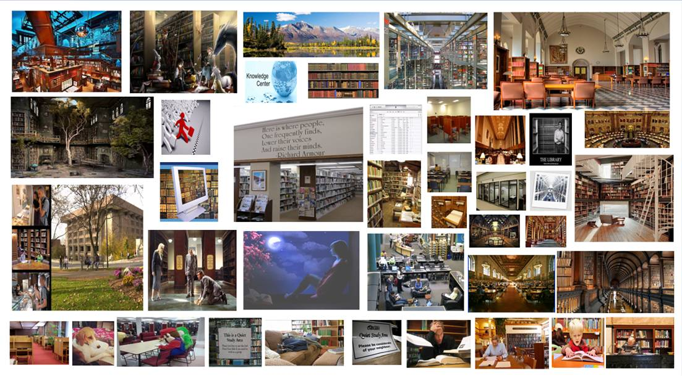
BLOG – What a library means to me

Slide 11
BLOG – What a library means to me

Slide 12
BLOG – What a library means to me

Slide 13
WORLDE CLOUD BLOGS
THIS IS THE TEXT I POST IN THE SERIAL LITERATURE BLOG
Once again we will use this blog space to share comments on what you think about searching the databases for journal articles. Feel free to share your thoughts here on the SUNY ESF databases, Open access resources, etc.
ALSO - instead of having an image of what a database means to you - like we did last week for libraries I am wondering what one word comes to mind when you hear the word DATABASES?
I'll take everyone's words and put them together so we can visually see everyone's different definitions of DATABASES.

Slide 14
BLOG – What word comes to mind when you hear the word DATABASE?
Created with
http://www.wordle.net

Slide 15
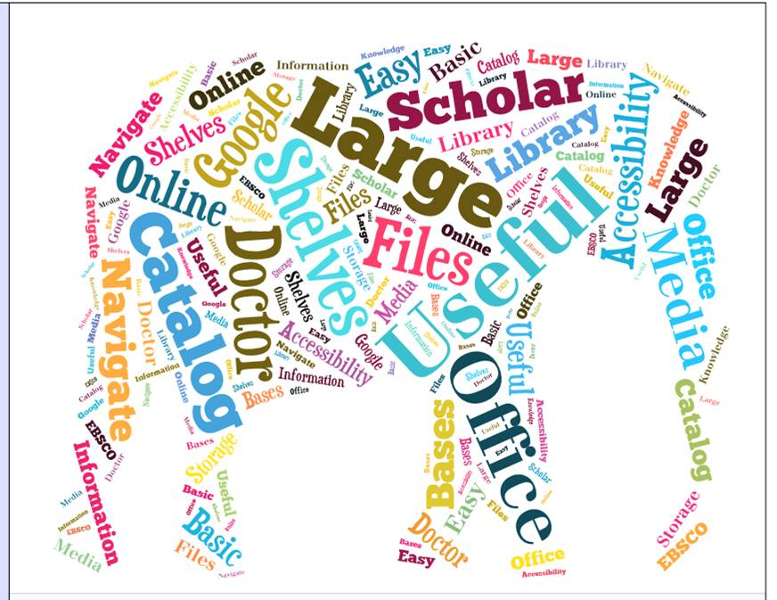
BLOG – What word comes to mind when you hear the word DATABASE?
Created with http://www.tagxedo.com

Slide 16
BLOG – What word comes to mind when you hear the word DATABASE?
Created with http://www.tagxedo.com

Slide 17
DRAWING BLOGS
THIS IS THE TEXT I POST IN THE INTERNET BLOG
Again please use this blog to share your thoughts, comments, etc. on searching the internet - specifically you may want to comment on what you thought of the search tools shared with you in the internet searching assignment.
Also this week's VISUAL assignment is to draw the internet and attached your drawing to your blog entry. I'll put everyone's drawings together again into a collage.
So using whatever tool you have available on your PC, MAC, Laptop, idevice, etc. draw the internet. If you don't have software or an app available you can still draw the internet on a piece of paper then scan it in on the library's BookScan machine (or another scanner - say in Baker or in a lab you use) - save it to a thumb drive and attach it into your blog entry.
If you're looking for ideas - inspiration - visit the site -
Can you draw the internet http://www.canyoudrawtheinternet.com/

Slide 18
BLOG – Draw the Internet!

Slide 19
BLOG – Draw the Internet!

Slide 20
BLOG – Draw the Internet!

Slide 21
Along with asking your students to post visual items such as photos and videos and drawings - you to can promote visual literacy – spend some time creating videos of you teaching. These can be used in online teaching, added to LibGuides, etc. Also take time to ask students for ideas and feedback!
Library 411 Instructional Video Series
http://tinyurl.com/Library411

Slide 22
Visual BLOGS – Visual Literacy
Introduction
The importance of images and visual media in contemporary culture is changing what it means to be literate in the 21st century. Today's society is highly visual, and visual imagery is no longer supplemental to other forms of information. New digital technologies have made it possible for almost anyone to create and share visual media. Yet the pervasiveness of images and visual media does not necessarily mean that individuals are able to critically view, use, and produce visual content. Individuals must develop these essential skills in order to engage capably in a visually-oriented society. Visual literacy empowers individuals to participate fully in a visual culture.
Visual Literacy Defined
Visual literacy is a set of abilities that enables an individual to effectively find, interpret, evaluate, use, and create images and visual media. Visual literacy skills equip a learner to understand and analyze the contextual, cultural, ethical, aesthetic, intellectual, and technical components involved in the production and use of visual materials.
Association of College and Research Libraries (ACRL), Visual Literacy Competency Standards for Higher Education

Slide 23
Ready – Set – ACTION! Jumpstart your information literacy classes with visual blogs using videos, photos and more! Jane Verostek Associate Librarian SUNY College of Environmental Science and Forestry Moon Library jmveros@esf.edu online @ SUNY ESF’s TV Channel http://tinyurl.com/Library411
THANK YOU & QUESTIONS?

