Slide 1
QUANTIFYING UNCERTAINTY IN
ECOSYSTEM STUDIES
Carrie Rose Levine, Ruth Yanai, John Campbell,
Mark Green, Don Buso, Gene Likens
Hubbard Brook Cooperators Meeting
6 July 2011
www.quantifyinguncertainty.org / quantifyinguncertainty@gmail.com

Slide 2
Outline
What is QUEST?
Uncertainty in Hydrologic Budgets
Precipitation
Streamflow
Using uncertainty to address questions about monitoring efficiency
The future of QUEST
Get involved!

Slide 3
Outline
What is QUEST?
Uncertainty in Hydrologic Budgets
Precipitation
Streamflow
Using uncertainty to address questions about monitoring efficiency
The future of QUEST
Get involved!

Slide 4
Outline
What is QUEST?
Uncertainty in Hydrologic Budgets
Precipitation
Streamflow
Using uncertainty to address questions about monitoring efficiency
The future of QUEST
Get involved!

Slide 5
Outline
What is QUEST?
Uncertainty in Hydrologic Budgets
Precipitation
Streamflow
Using uncertainty to address questions about monitoring efficiency
The future of QUEST
Get involved!

Slide 6
Outline
What is QUEST?
Uncertainty in Hydrologic Budgets
Precipitation
Streamflow
Using uncertainty to address questions about monitoring efficiency
The future of QUEST
Get involved!

Slide 7
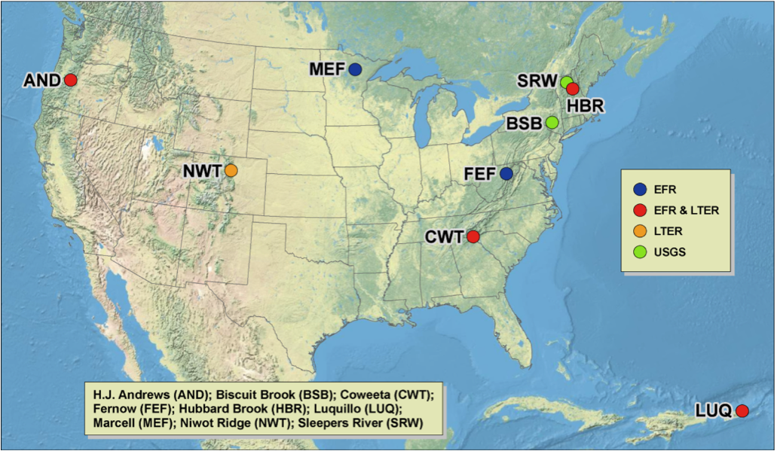
QUEST is a research network interested in improving understanding and facilitating use of uncertainty analyses in ecosystem research.
Currently funded project is an analysis of hydrologic input-output budgets in small headwater catchments throughout the US
Includes researchers and students throughout the US, and in Canada and Japan

Slide 8
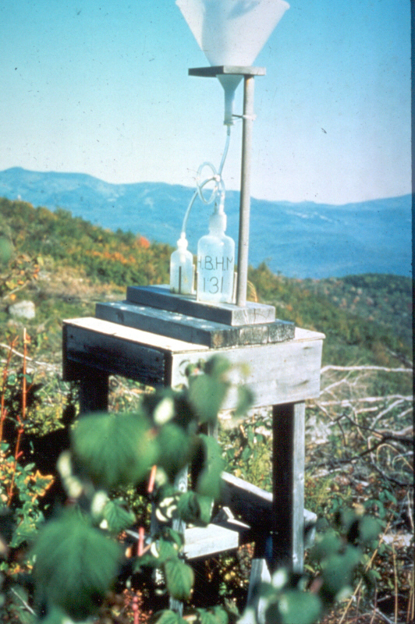
Uncertainty in Hydrologic Input-Output Budgets
Precipitation:
Most uncertainty is in spatial variability.
Varies with landscape factors; often shows orographic effects
Many spatial models can be used to predict precipitation amount in watersheds
Low temporal uncertainty: generally measured cumulatively, most uncertainty in this area arises from analytical error
http://www.hubbardbrook.org/image_library/images/Precip_Sampler.jpg
Notes:
The uncertainty in a point estimate of elemental deposition may thus be quite low, reflecting instrumental and analytical uncertainty rather than sampling uncertainty.
As a result, most of the uncertainty is in spatial variability: varies with landscape factors
Have many models for interpolating precip. in the area between gauges. . Various methods of interpolation are used in precipitation and atmospheric deposition studies, but the uncertainty in the interpolation is rarely reported.

Slide 9
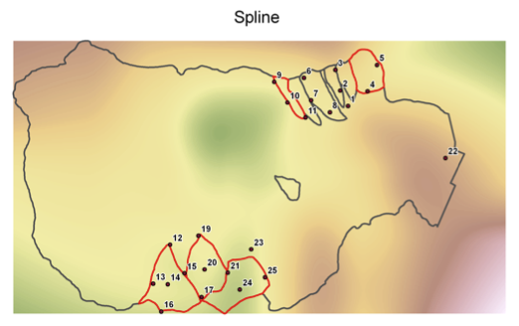
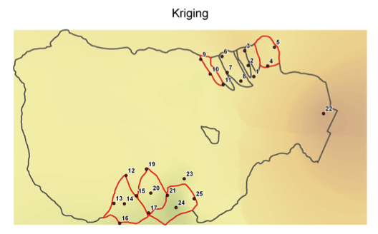
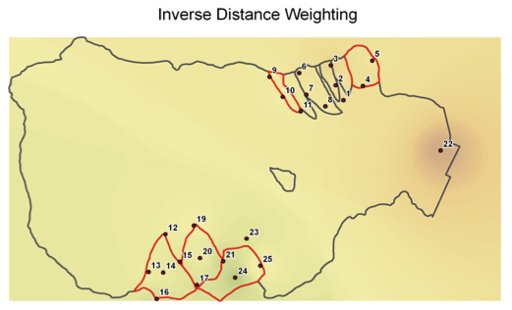
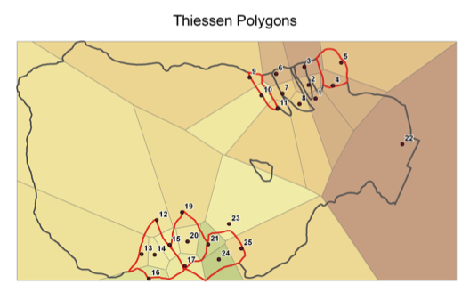
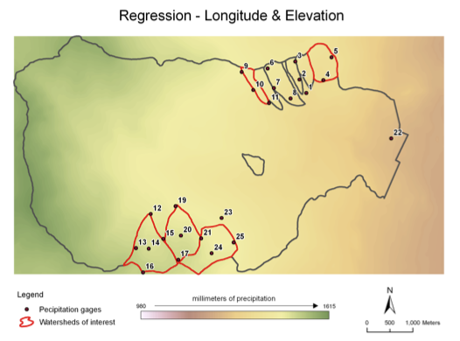
Alternative spatial models for precipitation in the Hubbard Brook Valley
Notes:
These are 5 models of precipitation in the HB valley, using built-in models in ARC GIS. We can see that each is interpolating between the rain gauges differently.

Slide 10
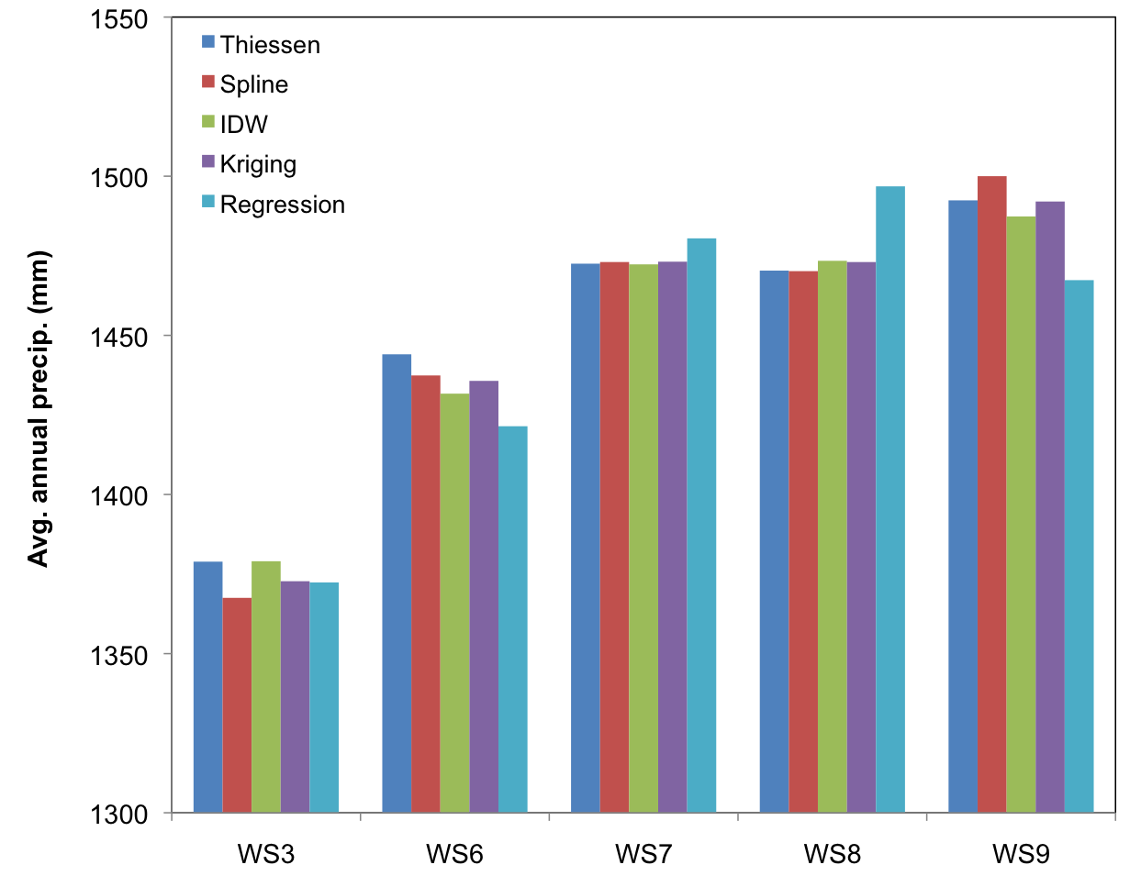
Alternative spatial models for precipitation in the Hubbard Brook Valley
Coefficient of variation between models
0.77%
0.83%
0.24%
0.58%
0.36%
Notes:
When we compare the estimates of the different models for the whole valley, we see that there is low variation between the models. Next, we will be working on how to estimate the uncertainty not just between the models, but also within each model.

Slide 11
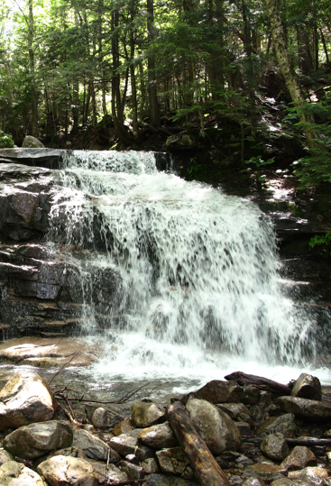
Uncertainty in Hydrologic Input-Output Budgets
Uncertainty in streamflow:
Streamflow varies temporally
Some of the major sources of uncertainty include:
Error measuring at very high flows (when flow exceeds weirs)
Many different methods exist for interpolating stream nutrient concentrations between measurements

Slide 12
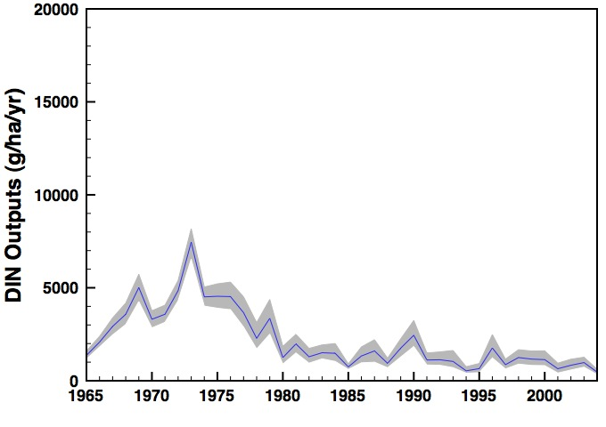
Bootstrapping approach to estimating uncertainty in streamwater flux
Estimated fluxes of dissolved inorganic nitrogen (DIN) via a bootstrapping methodology:
Produces a daily series of DIN concentrations using daily flow values and resampling existing DIN samples from similar flow rates, and is repeated 1000 times to determine the uncertainty in the DIN fluxes.
Notes:
In this bootstrapping method, we use information on discharge at similar flows to calculate the error around single measurements. When we do this 1000 times, we get a confidence interval around the measured point. It’s exciting that we can use the long-term records at HB to examine long-term trends like DIN outputs in new ways.

Slide 13
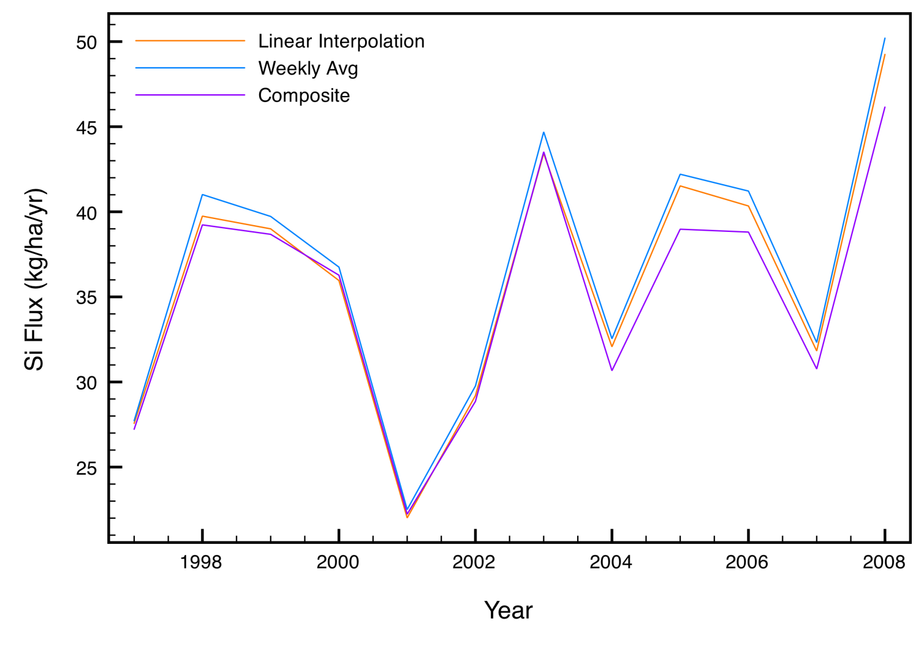
Uncertainty in streamwater chemistry estimates: Methods comparison
Comparing methods for estimating flux of Si at Hubbard Brook:
Linear interpolation: concentrations for the week are linearly estimated between the two sampling dates
Weekly average: One value applied to the entire week (many ways to do this)
Composite method: model including a concentration-discharge relationship which is driven through the measured points
Annual Si fluxes varied by ~5%
Notes:
Unlike precipitation estimates, where water is collected continuously, streamwater concentrations are taken weekly, and we have no information about how the concentration fluctuates during the week. There are several different methods for estimating streamwater concentrations between measured points: HB uses linear interpolation, where the daily concentration is linearly estimated between the two weekly sampling points. Other sites use a weekly constant, but there are many ways even to use this method: some sites apply the concentration to the preceding week, some to the week that follows, some extend the concentration to the midpoint between the previous and following sampling times. A third option is the composite methed, which uses a regression equation driven through the measured points, and is considered to be the most robust model, but which is also the most difficult to implement.

Slide 14
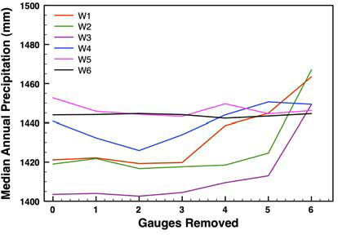
Using uncertainty to assess monitoring efficiency: Precipitation
Test how sampling intensity contributes to confidence in the annual precipitation estimates by sequentially omitting individual precipitation gauges.
Median annual precipitation estimates varied little until five or more of the eleven precipitation gauges were ignored.
Notes:
Now we will switch gears and look at how these types of uncertainty analyses can be used to make decisions about monitoring efforts. To test the degree to which sampling intensity contributed to our confidence in the annual precipitation estimates, we sequentially omitted individual precipitation gauges in the analysis of Hubbard Brook data. We found that the median annual precipitation estimates varied little until five or more of the eleven precipitation gauges were ignored. This information could be very useful at a site where decisions needed to be made about redistributing sampling efforts to best capture the uncertainty in a system.

Slide 15
Using uncertainty to assess monitoring efficiency: Streamflow
Annual Streamwater N export, W6 (kg ha⁻¹ yr⁻¹)
Year
Notes:
Like the precipitation example, we can look at sampling intensity of streamwater to make decision about cost and monitoring effort. In this case, we have annual streamwater N export from W6 at HB, from 1978-2005. You can see the regression line on the graph for that 27-year period.

Slide 16
Using uncertainty to assess monitoring efficiency: Streamflow
Annual Streamwater N export, W6 (kg ha⁻¹ yr⁻¹)
Year
Notes:
When we remove sampling years from the data set, we can see how the regression changes. Measuring every other year seems to give regressions that are very similar to measuring every year, but measuring less frequently results in regressions that are quite different from the original. We could also remove sampling intervals within the annual estimates, but we anticipate that that would be less desirable, because seasonal trends might be missed.

Slide 17
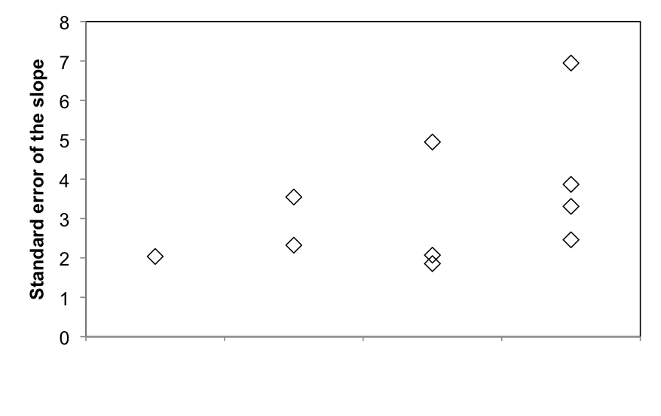
Using uncertainty to assess monitoring efficiency: Streamflow
Streamwater N export (kg ha⁻¹ yr⁻¹)
Every year Every other Every third Every fourth
year year year
Year
Standard error of the slope increases as the number of sampled years decreases
Trade off between less sampling (lower cost) and higher error around regression
Notes:
Here we can see the trade-off that comes with sampling less frequently. As sampling dates are removed, the uncertainty in the regression grows. This is the kind of trade-off that must be made when deciding between on an optimized sampling plan for a site.

Slide 18
Future QUEST projects:
Hydrologic budget of QUEST sites including uncertainty in inputs and outputs
QUEST workshops on soils, vegetation, and ecosystem budgets
Ecosystem nutrient budgets including uncertainty in all pools and fluxes
Be a part of QUEST!
Find more information at: www.quantifyinguncertainty.org
Read papers, get sample code, stay updated with QUEST News
Email us at quantifyinguncertainty@gmail.com

Slide 19
QUEST would like to thank:
NSF Long-Term Ecological Research Network
NSF Division of Environmental Biology
All QUEST sites for contributing data
QUEST Steering committee: Doug Burns (USGS) and Shannon LaDeau (Cary Institute)
All participants of the QUEST working group who contributed to the QUEST workshop in March 2011:
Mary Beth Adams (USFS), Mark Harmon (Oregon State), Trevor Keenan (Harvard Univ.), William McDowell (UNH), Jordan Parman (CU-Boulder), Stephen Sebestyan (USFS), Jaime Shanley (USGS), Jim Vose (USFS)

