Slide 1
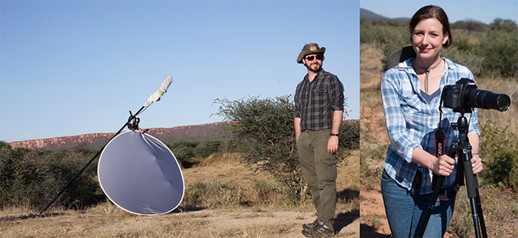
Environmental Film & Literature (CSS395) Tiffany Deater & Jarrod Hagadorn SUNY – Oswego
Explore environmental issues through philosophy, nature writing, film and video
Communications/Interpretation directed elective for EE&I and ConBio

Slide 2
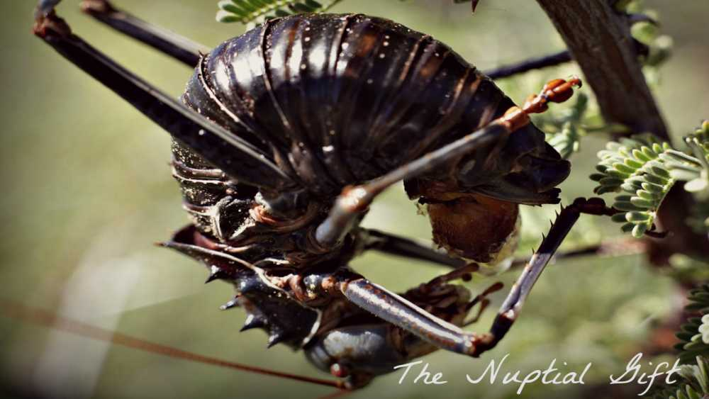
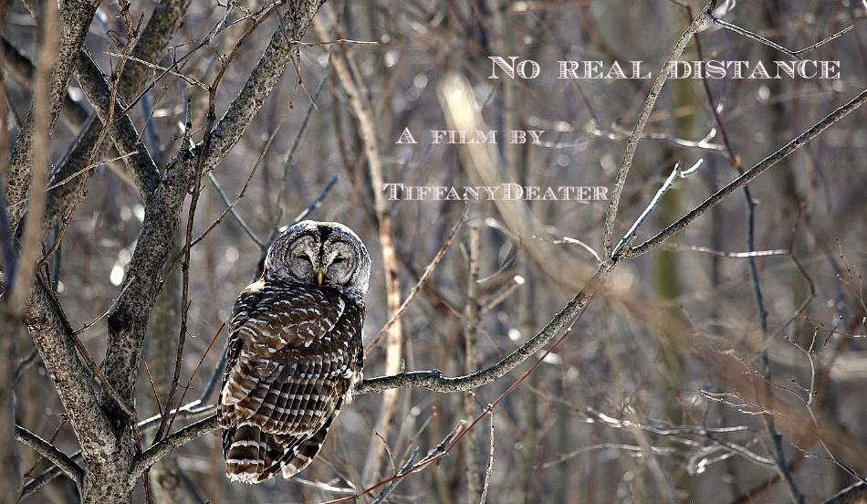
Specific Objectives/Skills:
Develop ability to understand and interpret literature and film within environmental, political, and philosophical contexts, and to understand the significance of various interpretations.
Engage in writing / filming / editing video productions about the environment.

Slide 3
Schedule
Last week of Session C to First Week of Session D
July 19 – July 31

Slide 4
Questions?
Contact Tiffany Deater
deater@oswego.edu
Notes:
Carex arctata, Carex gynandra

