Slide 1
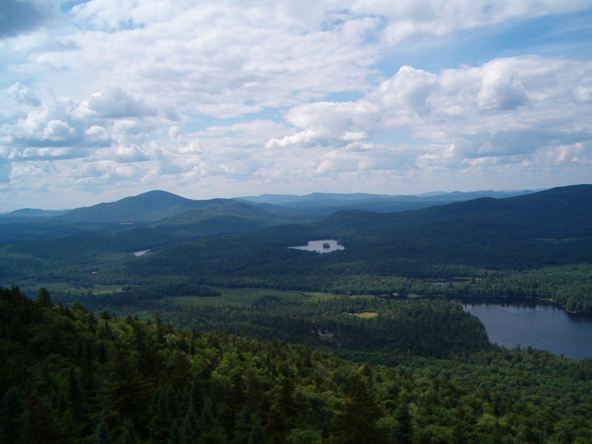
Adirondack Flora (EFB327) Dr. Niels Proctor Cornell Univ. College of Agriculture and Life Sciences School of Integrative Plant Science
Recognize and identify regional vascular plants, and know their ecological characteristics
Recognize and understand regional plant community types
Satisfies EFB Plant Diversity or Field Study Requirements.

Slide 2
Specific Objectives/Skills:
Know ~150 spp., 25 families of vascular plants
Learn to use a technical dichotomous key to identify unknowns
Understand the topo-edaphic factors influencing distributions of species and community types within the Adirondacks

Slide 3
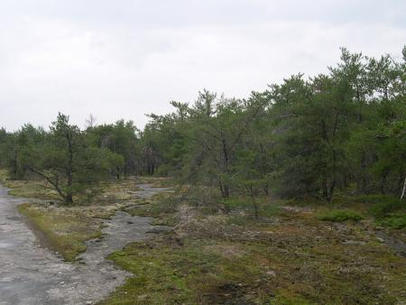
Unique systems
Altona Jack Pine Barrens

Slide 4
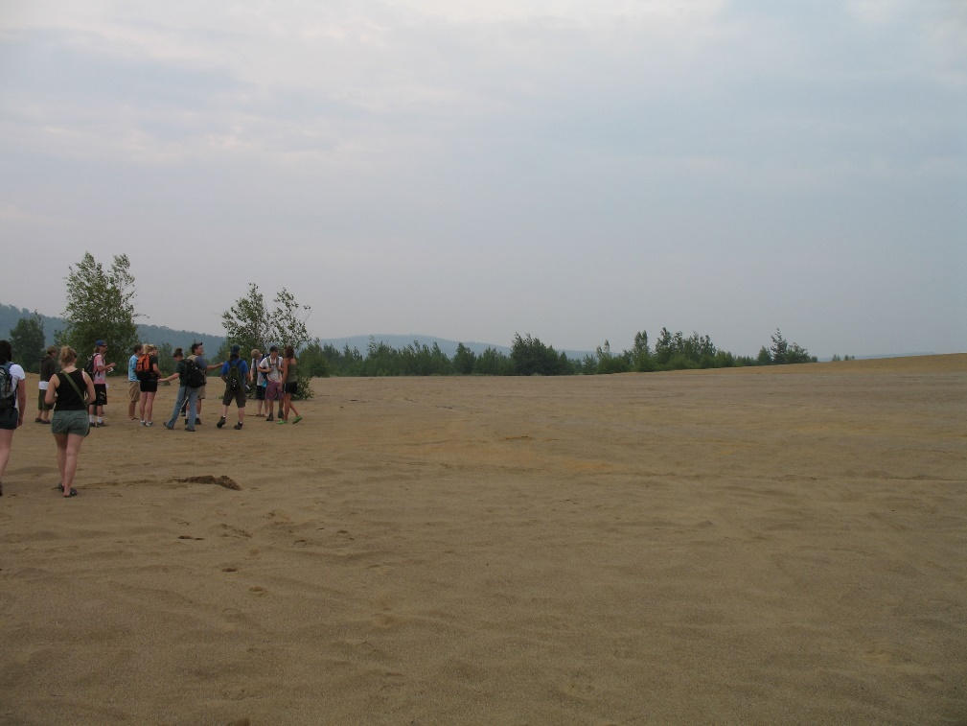
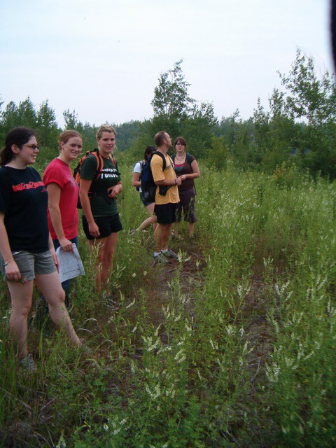
Disturbance & Succession

Slide 5
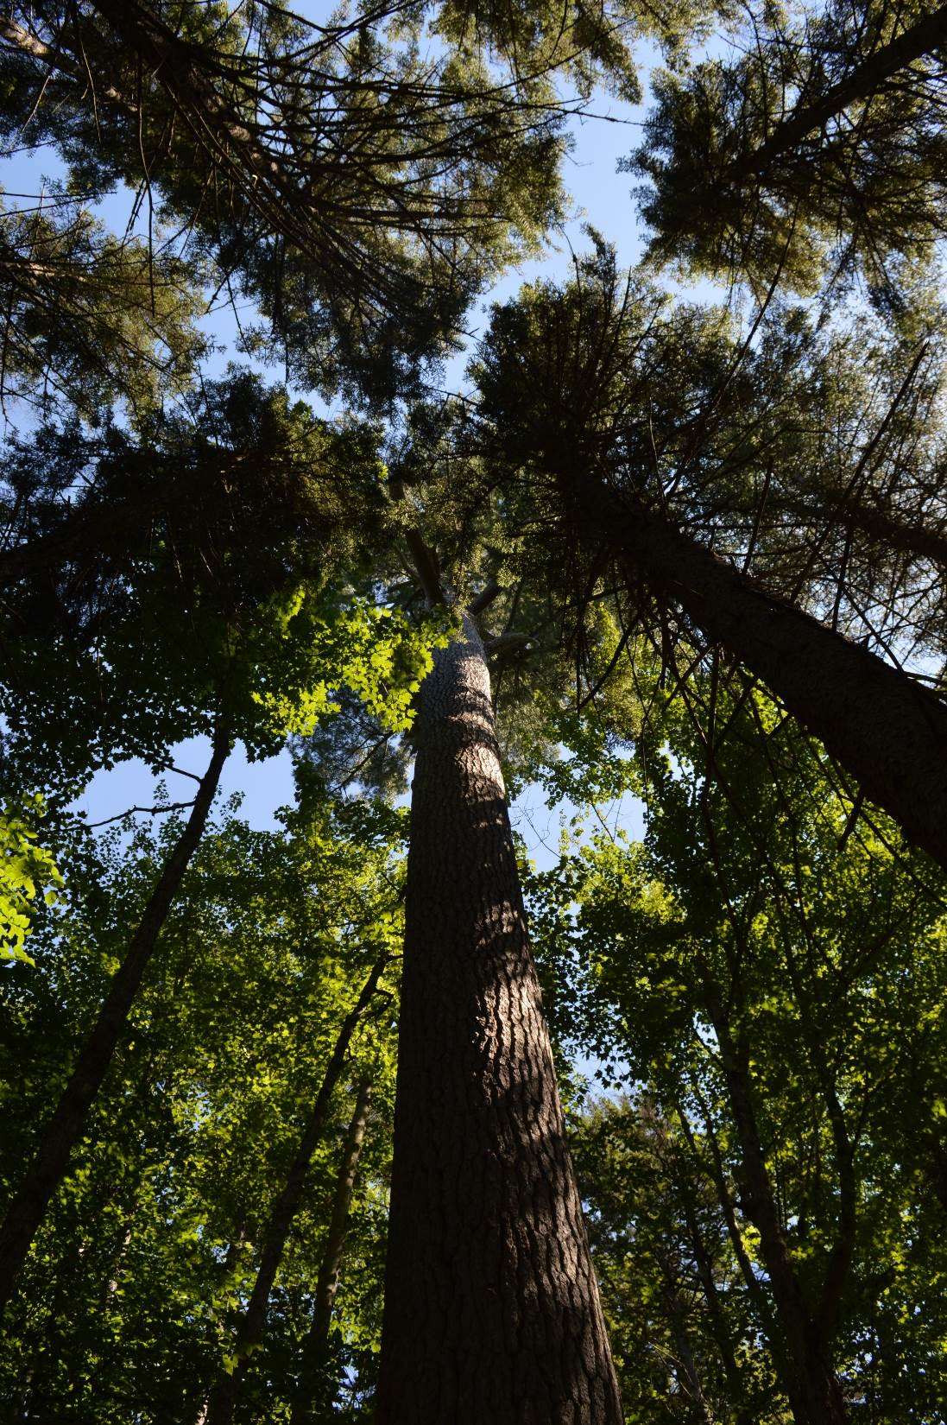
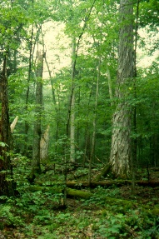
Old growth

Slide 6
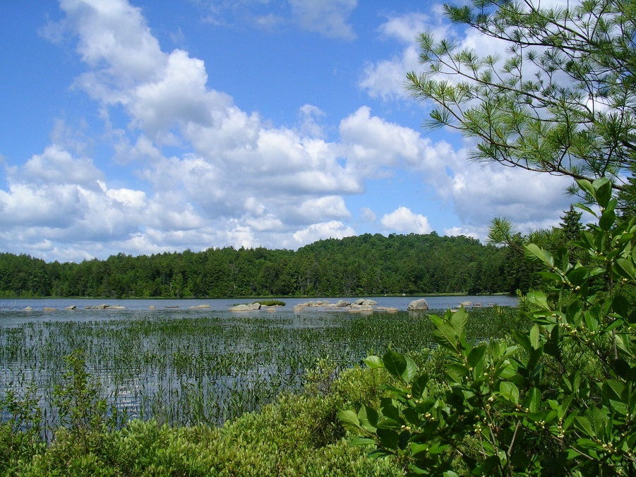
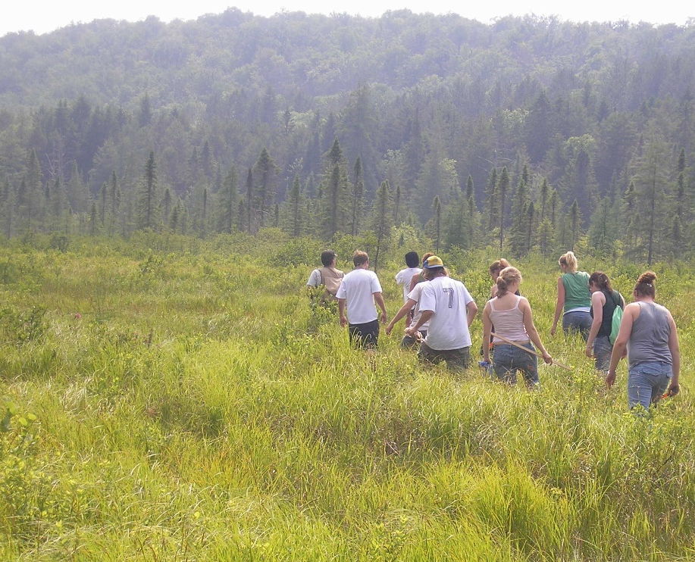
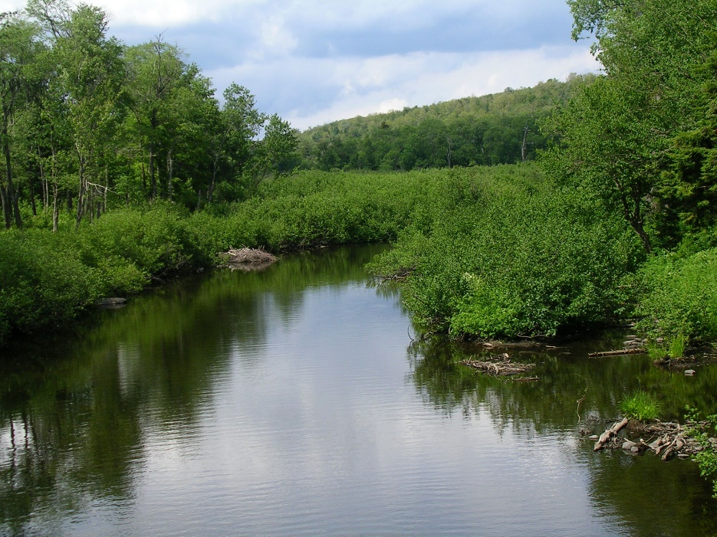
Wetlands

Slide 7
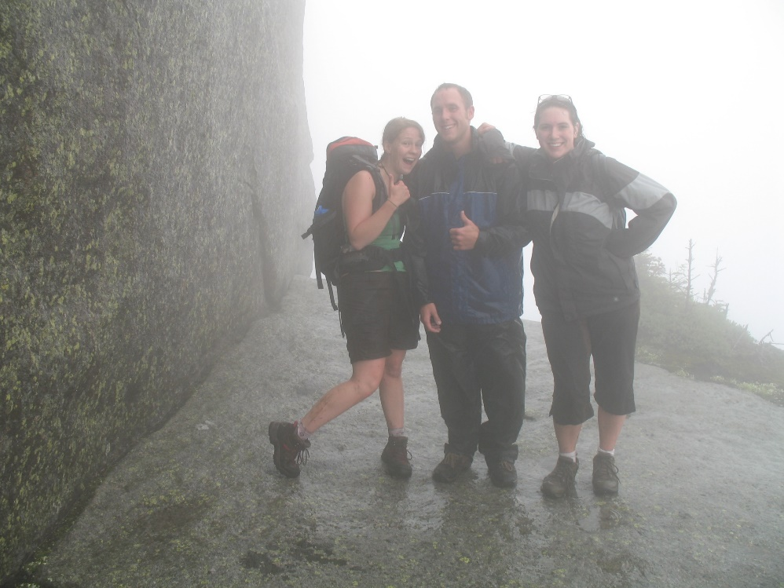
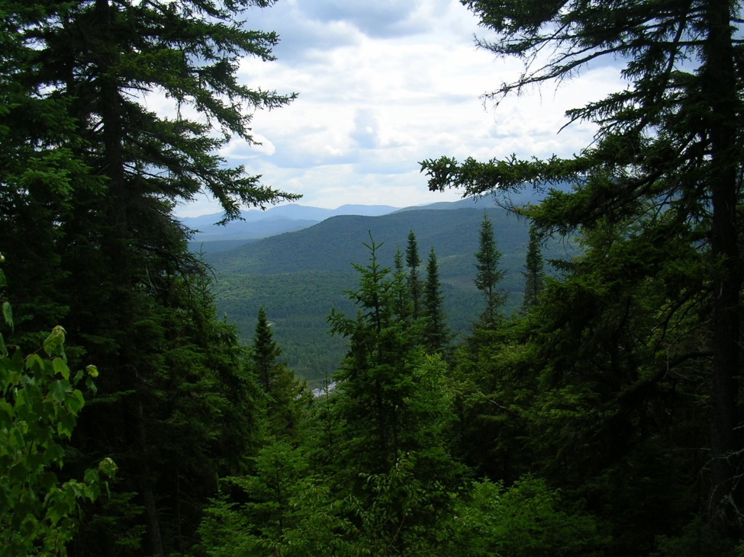
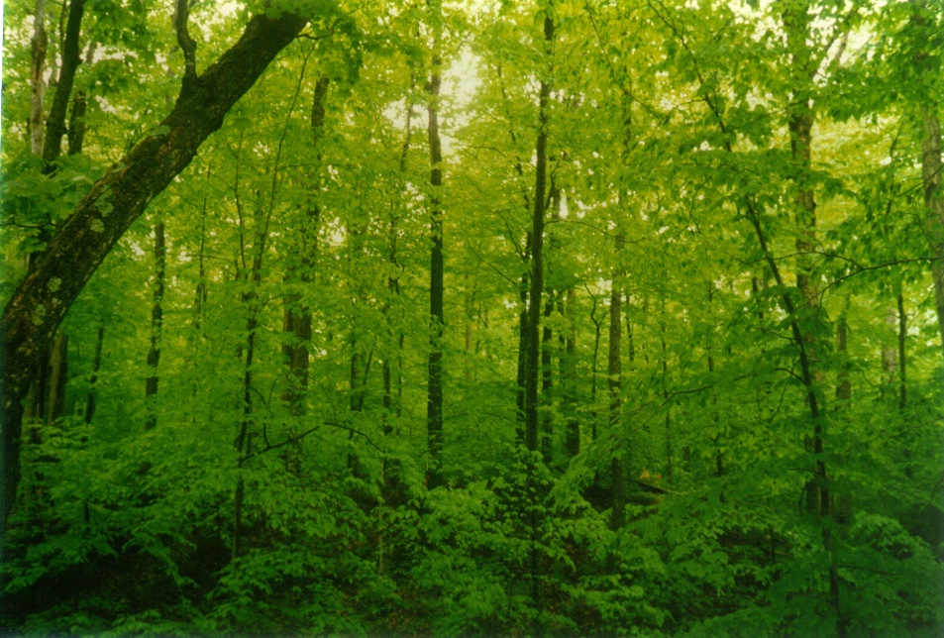
Elevation Gradients

Slide 8
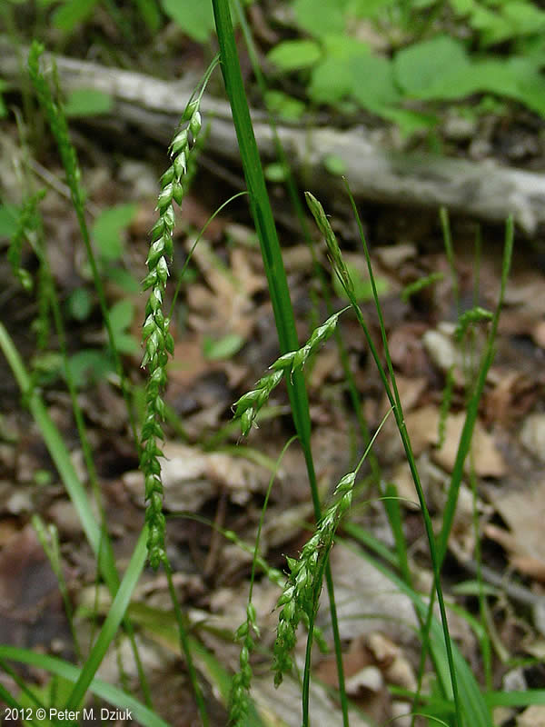
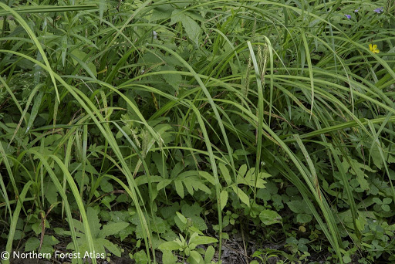
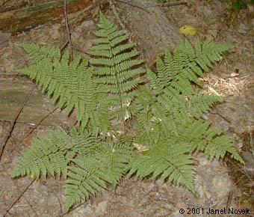
Proficiency with technical keys
Carex spp.?
or
C. arctata,
C. gynandra
Dryopteris intermedia ?
Dryopteris carthusiana ?
Dryopteris campyloptera ?
Notes:
Carex arctata, Carex gynandra

Slide 9
Questions?
Contact Dr. Niels Proctor
np397@cornell.edu
Notes:
Carex arctata, Carex gynandra

