Slide 1
Scoring Beech Bark Disease
Adam Wild- adamdwild@gmail.com (716)244-7723
Mariann Johnston- mjohnston@esf.edu
John Cale - jcale7@gmail.com
Photos taken by Adam Wild

Slide 2
Rating System: Houston’s Beech Bark Disease Indices with amendments (personal communication via John Cale, ESF PhD student jcale7@gmail.com.
Definitions are based on a 2m tall band around the bole
* Excluding category 1, all descriptions refer to at least half the zone being as severe as
the relevant score class is defined. For areas up to half the zone, ascribe to the next
lower category
Wax cover: Cryptococcus fagisuga infestation as evidenced by amount of wax secreted.
0 – No colonies visible
1 – Trace, from one colony to very light scattered individual colonies. One or two larger
colonies only.
2 – Light, scattered colonies. Some larger colonies may be present.
3 – Moderate infestation, many colonies visible. Substantial number of larger colonies
may be present.
4 – Heavy infestation. Many large colonies present. Some colonies coalescing.
5 – Very Heavy infestation. Much of bark conspicuously white.
Neonectria Fungus: Evidenced by clearly visible red or brownish perithecia or sunken legions.
0 – Absent.
1 – Sparse, localized perithecia or few widely scattered circular infections. Sparse sunken legions.
2 – Moderate, scattered fruiting on isolated circular infections. Few sunken legions covering part of the tree.
3 – Heavy, A heavy covering of isolated circular infections with heavy fruiting; some
coalescing into larger patches. Sunken legions covering most of the tree.
4 – Very Heavy, Large areas with heavy fruiting, such that part of the diseased or dead tree is conspicuously red or brownish. Sunken legions covering the entire trunk.
Tree condition:
1 – Good: foliage green, <10% dead crown branches
2 – Fair: foliage green to yellow green, 10-50% dead crown branches
3 – Poor: foliage green to yellow green, >50% dead crown branches
4 – Dead: no foliage alive

Slide 3
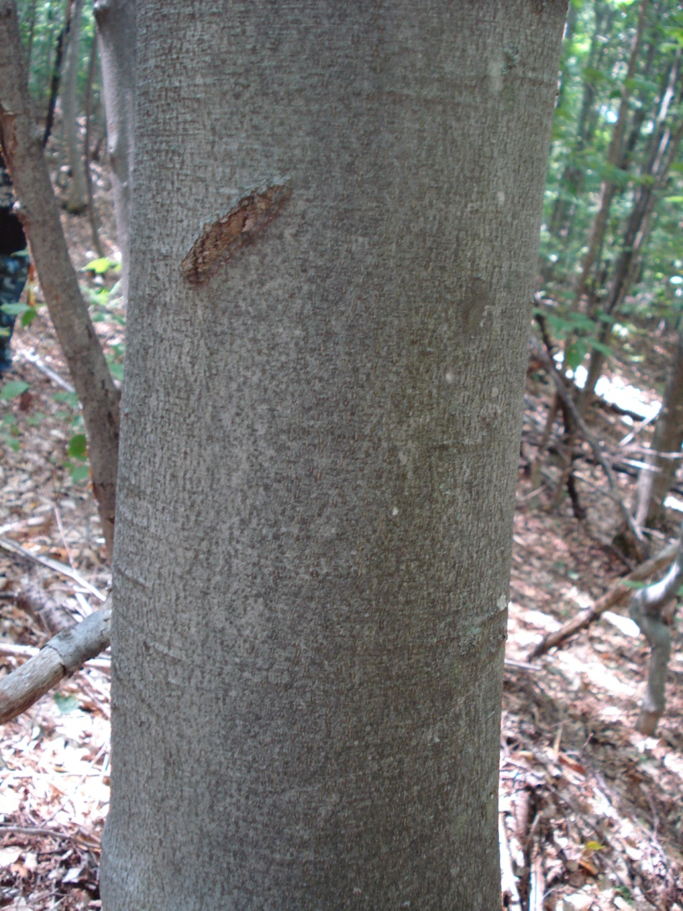
Scale Insect Score: 0
No colonies present.

Slide 4
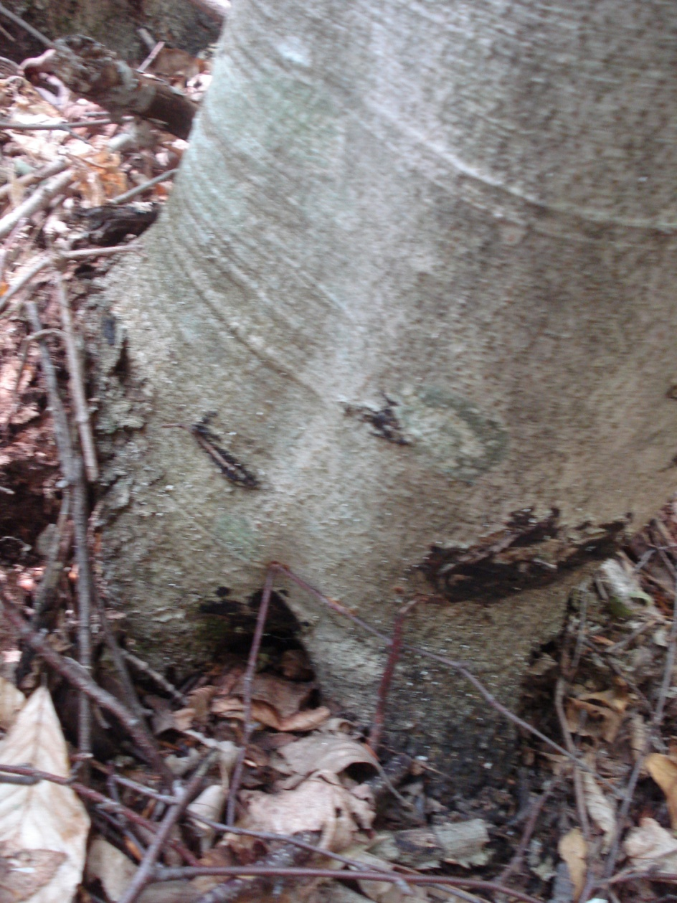
Scale Insect Score: 1
Trace, from one colony to very light scattered individual colonies.
One or two larger
colonies only.

Slide 5
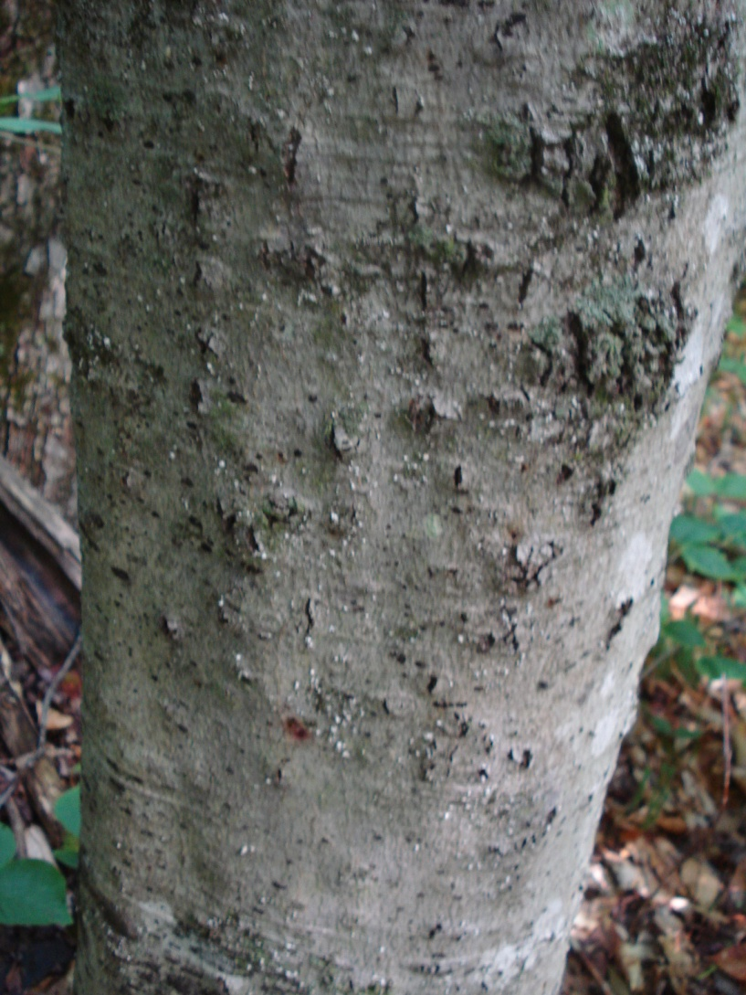
Scale Insect Score: 2
Light, scattered colonies. Some larger colonies may be present.

Slide 6
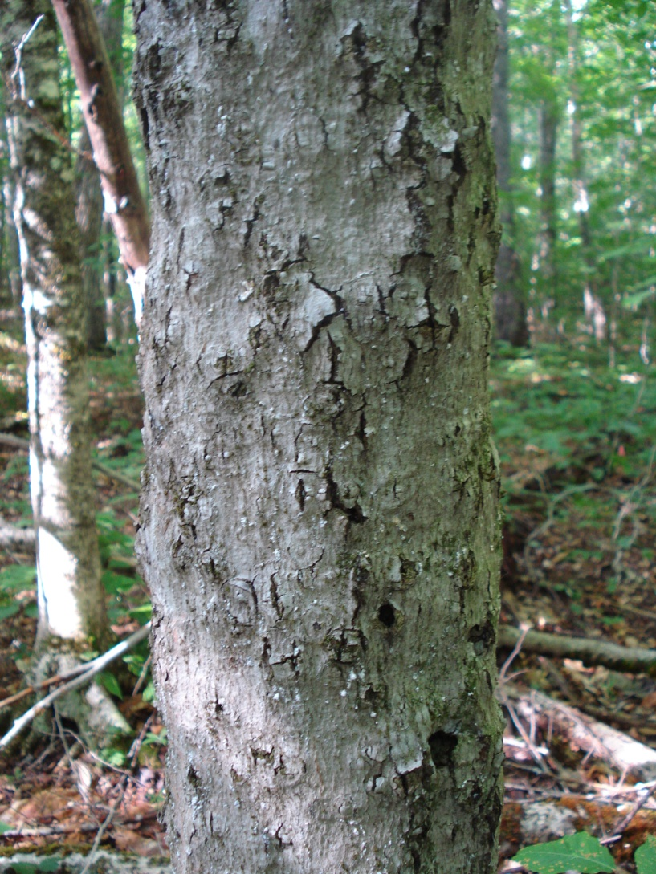
Scale Insect Score: 3
Moderate infestation, many colonies visible. Substantial number of larger colonies may be present

Slide 7
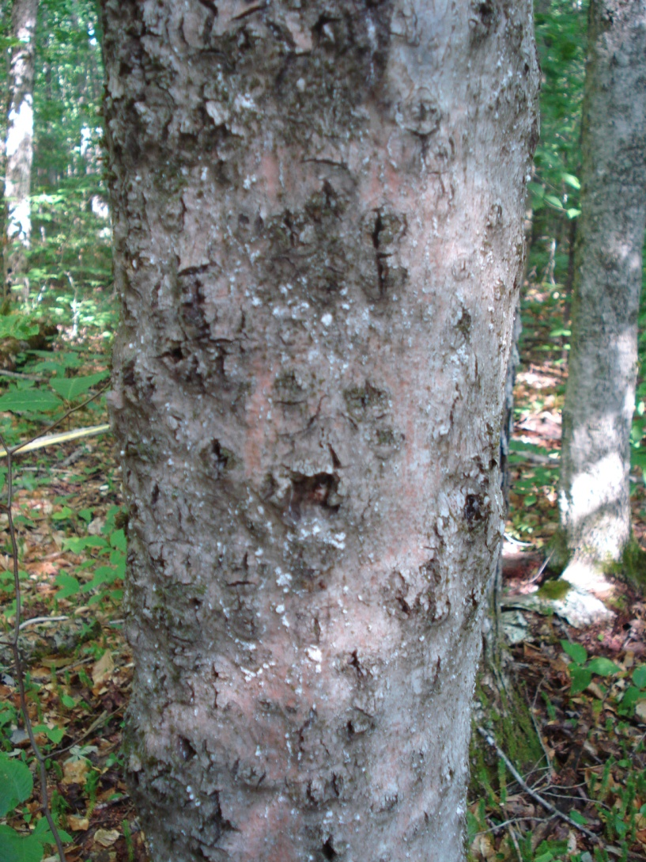
Scale Insect Score: 4
Heavy infestation. Many large colonies present. Some colonies coalescing.

Slide 8
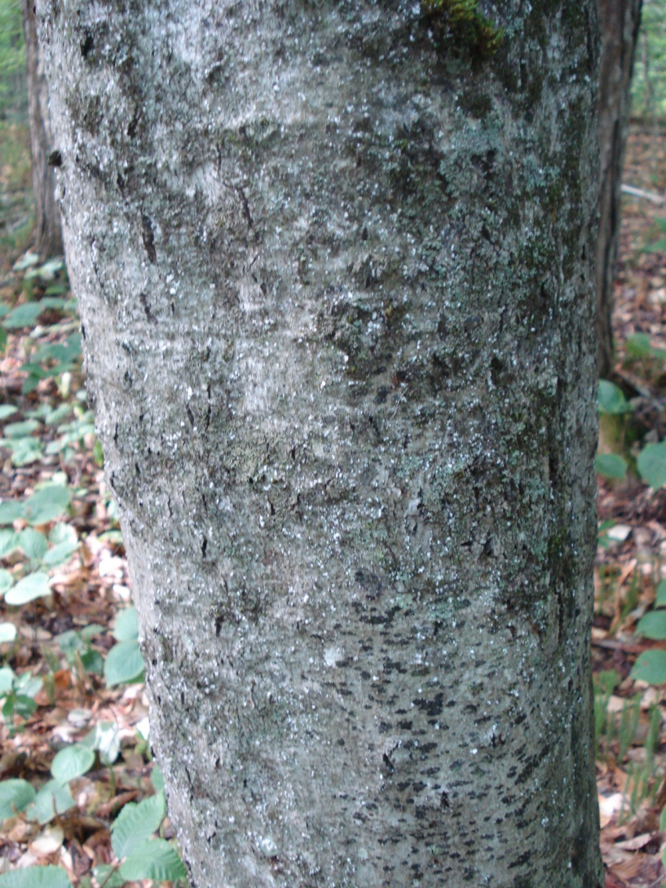
Scale Insect Score: 5
Very Heavy infestation. Much of bark conspicuously white.

Slide 9
Fungal Score: 0
Absent.

Slide 10
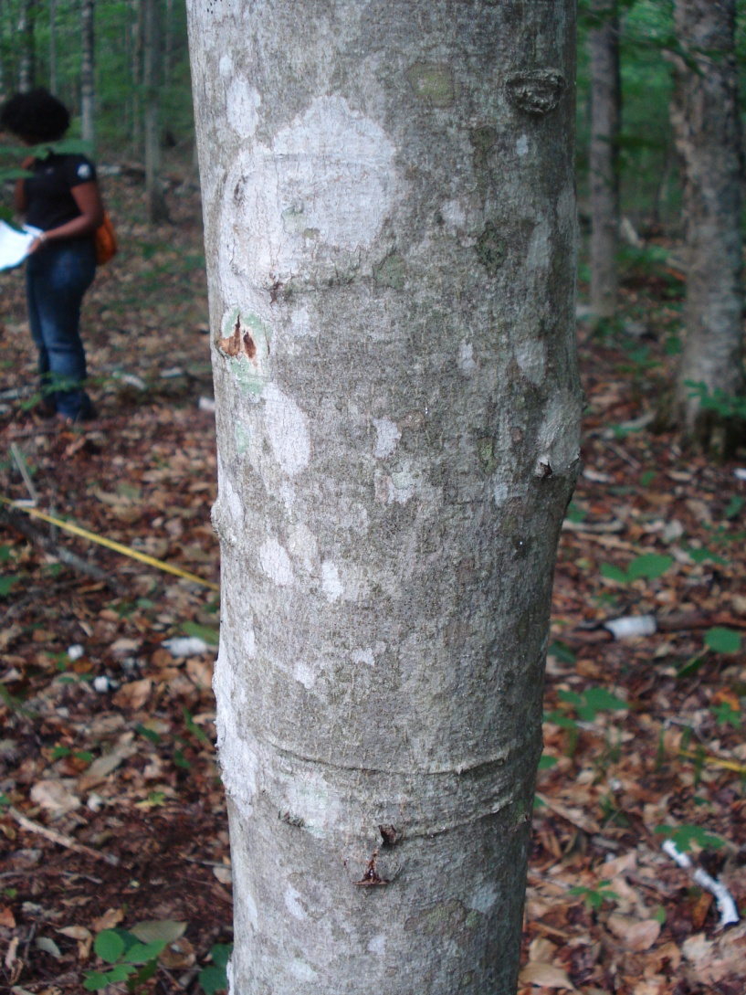
Fungal Score: 1
Sparse, localized perithecia or few widely scattered circular infections. Sparse sunken legions.

Slide 11
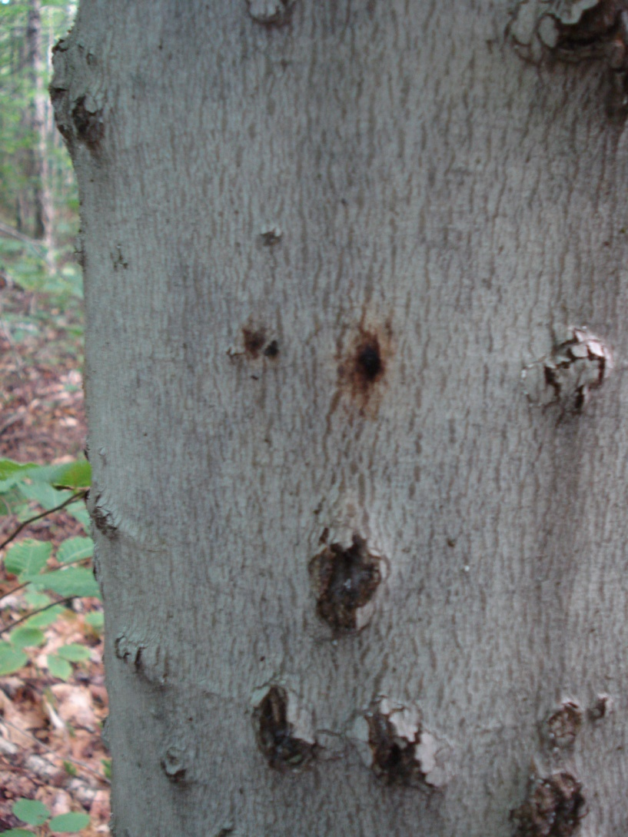
Fungal Score: 2
Moderate, scattered fruiting on isolated circular infections. Few sunken legions covering part of the tree.

Slide 12
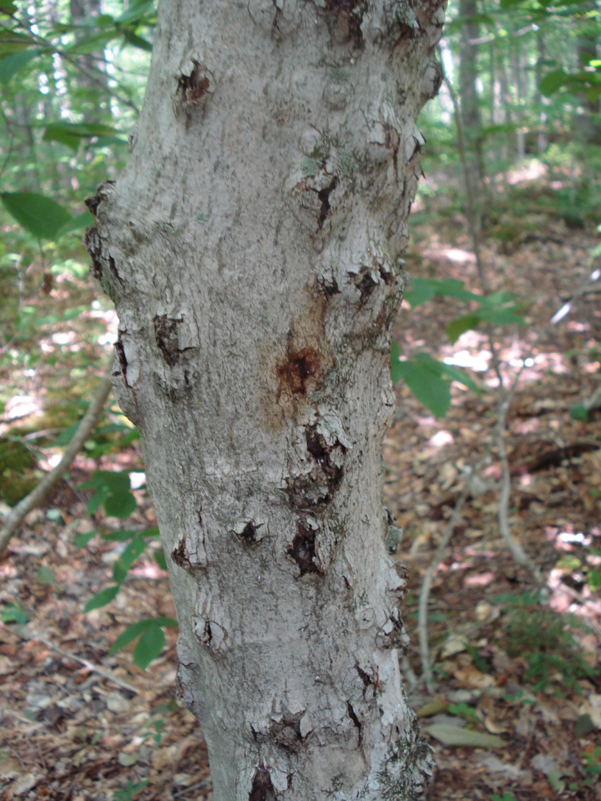
Fungal Score: 3
Heavy, A heavy covering of isolated circular infections with heavy fruiting; some coalescing into larger patches. Sunken legions covering most of the tree.

Slide 13
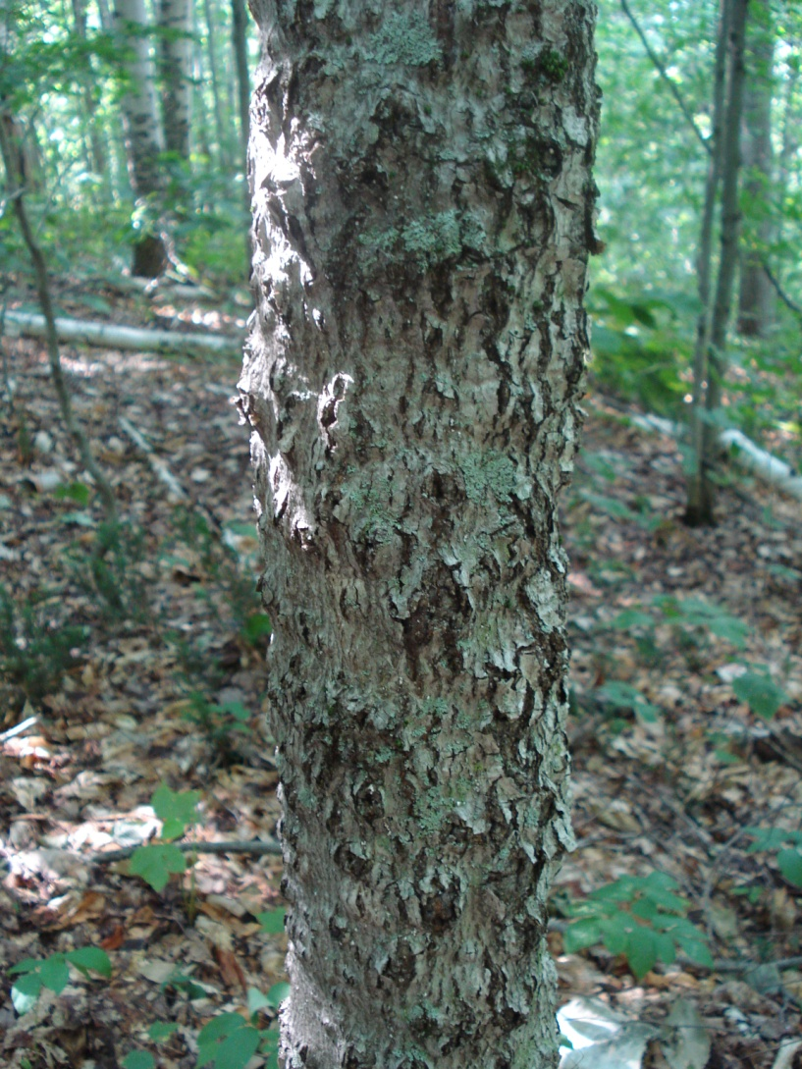
Fungal Score: 4
Very Heavy, Large areas with heavy fruiting, such that part of the diseased or dead tree is conspicuously red or brownish. Sunken legions covering the entire trunk.

Slide 14
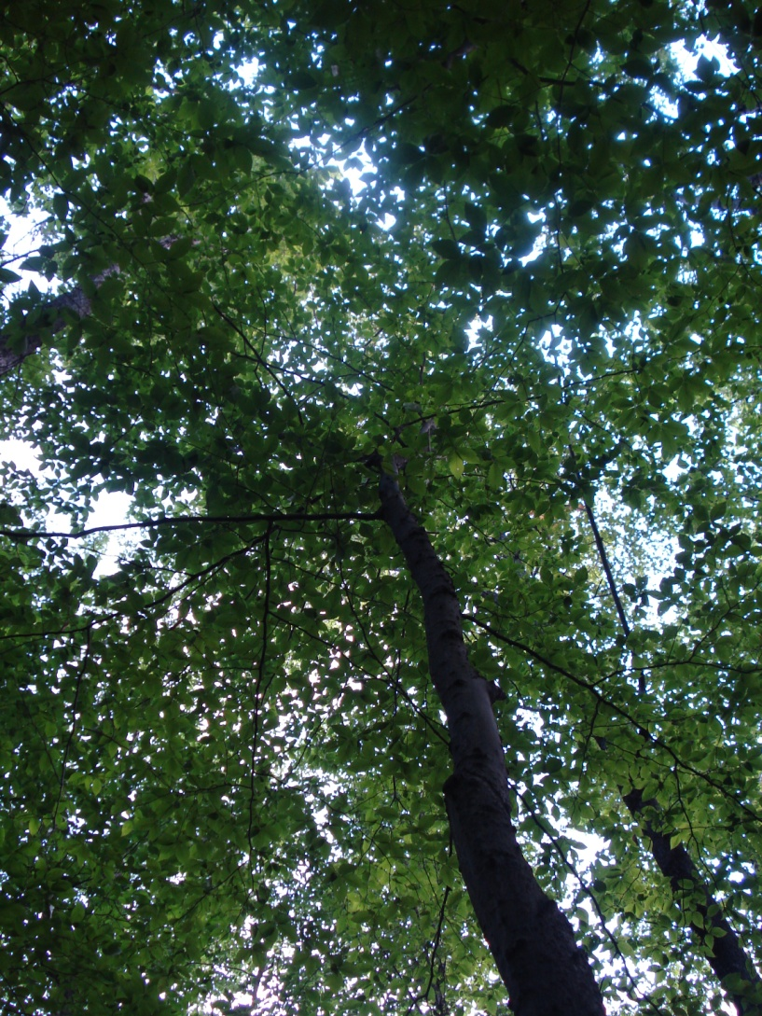
Tree Condition: 1
Good: foliage green, <10% dead crown branches

Slide 15
Tree Condition: 2
(No picture available)
Fair: foliage green to yellow green, 10-50% dead crown branches

Slide 16
Tree Condition: 3
(No picture available)
Poor: foliage green to yellow green, >50% dead crown branches

Slide 17
Tree Condition: 4
(No picture available)
Dead: no foliage alive

