Slide 1
ESF Board of Trustees Meeting
February 11, 2011

Slide 2
SUNY Strategic Plan
Relationship of ESF Vision 2020 and The Power of SUNY
Goal #1 Enrich Academic Excellence in Both Undergraduate and Graduate Education | SUNY and the Seamless Education Pipeline
Goal #2 Provide an outstanding Student Experience | SUNY and the World
Goal #3 Be the “go-to” Institution with a Strong and Visible Reputation | SUNY and the World SUNY and a Healthier New York
Goal #4 Become Financially Secure and Independent | SUNY and the Entrepreneurial Century

Slide 3
SUNY Strategic Plan
Relationship of ESF Vision 2020 and The Power of SUNY (cont’d)
Goal #5 Strategically Build and Enhance Partnerships and Collaborative Relationships | SUNY and the Vibrant Community SUNY and the Entrepreneurial Century SUNY and the Seamless Education Pipeline
Goal #6 Respond to the Needs of Society | SUNY and the Entrepreneurial Century SUNY and the Seamless Education Pipeline
Goal #7 Invest in ESF’s Human Resources and Physical Infrastructure | SUNY and an Energy-Smart New York

Slide 4
ESF Advances Relative to SUNY Strategic Plan – Six Big Ideas
SUNY and the Entrepreneurial Century
Green Entrepreneurship courses (business plan competition)
Potential affiliation agreement with Upstate Freshwater Institute
SKD Environmental Systems, LLC (Sustainable Koncepts & Design for Environmental Systems)
Development of “Water Center” in conjunction with Clarkson University, Cornell, Syracuse COE, and RIT
Impact Technologies – evaluation of 4 KW vertical axis wind turbine

Slide 5
ESF Advances Relative to SUNY Strategic Plan – Six Big Ideas
SUNY and the Seamless Education Pipeline
ESF in the High School (~500 students)
ESF Science Corps
Sponsored Science Fairs
Distance Learning Global Environment
1 and 3 credit courses on climate change and renewable energy
Northeast Adirondack Natural Science Initiative
Non-traditional Student Programming to be offered through the New York Academy of Sciences
Partnership for Better Education/Say Yes/SCSD

Slide 6
ESF Advances Relative to SUNY Strategic Plan – Six Big Ideas
SUNY and a Healthier New York
Development of a program of study in partnerships with Upstate Medical University in Environmental Health
Source Sentinel LLC
Chronic Wasting Disease Studies for NYS DEC

Slide 7
ESF Advances Relative to SUNY Strategic Plan – Six Big Ideas
SUNY and an Energy-Smart New York
Biomass Boiler at Ranger School
Three 25 KW PV installations at AEC, Tully Experiment Station, Moon Library
Cellulosic based Biofuels (Ethanol/Butanol/Biodiesel)
Gateway Building Innovative CHP System
SUNY SPARE and SURE extended education programs
NYPA Campus Energy Efficiency Study

Slide 8
ESF Advances Relative to SUNY Strategic Plan – Six Big Ideas
SUNY and the Vibrant Community
Habitat for Humanity Chapter (with SU)
Your Town initiative
Council for Community Design Research
Coastal Zone Management Support to Communities through NYS DOS
74,000 hours of Community Service in AY 2009-2010
Carnegie Foundation Community Service Recognition (1of 10 institutions in NYS)

Slide 9
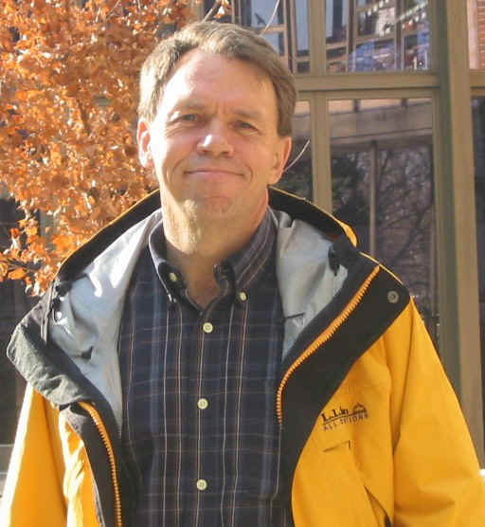
ESF Advances Relative to SUNY Strategic Plan – Six Big Ideas
SUNY and the World
Engineers without Borders (joint chapter w/SU)
Recent international cooperative agreements
India Forest Research Institute (jointly with SU’s Maxwell School)
University of Chile
University of Jinan (China)
Moscow State University
Costa Rica Monteverde Institute
19% of students have an international experience
International Peace Corps Masters
48 research projects with a research project on every continent
NSF sponsored Climate Change & Anthropogenic Influences in Mongolia by Dr. Myron Mitchell
LA semester abroad
ESF short-term international courses
Dr. Myron Mitchell

