Slide 1
Board of Trustees Meeting
February 5, 2010

Slide 2
Report of the President – Neil Murphy
ESF Capital Plan

Slide 3
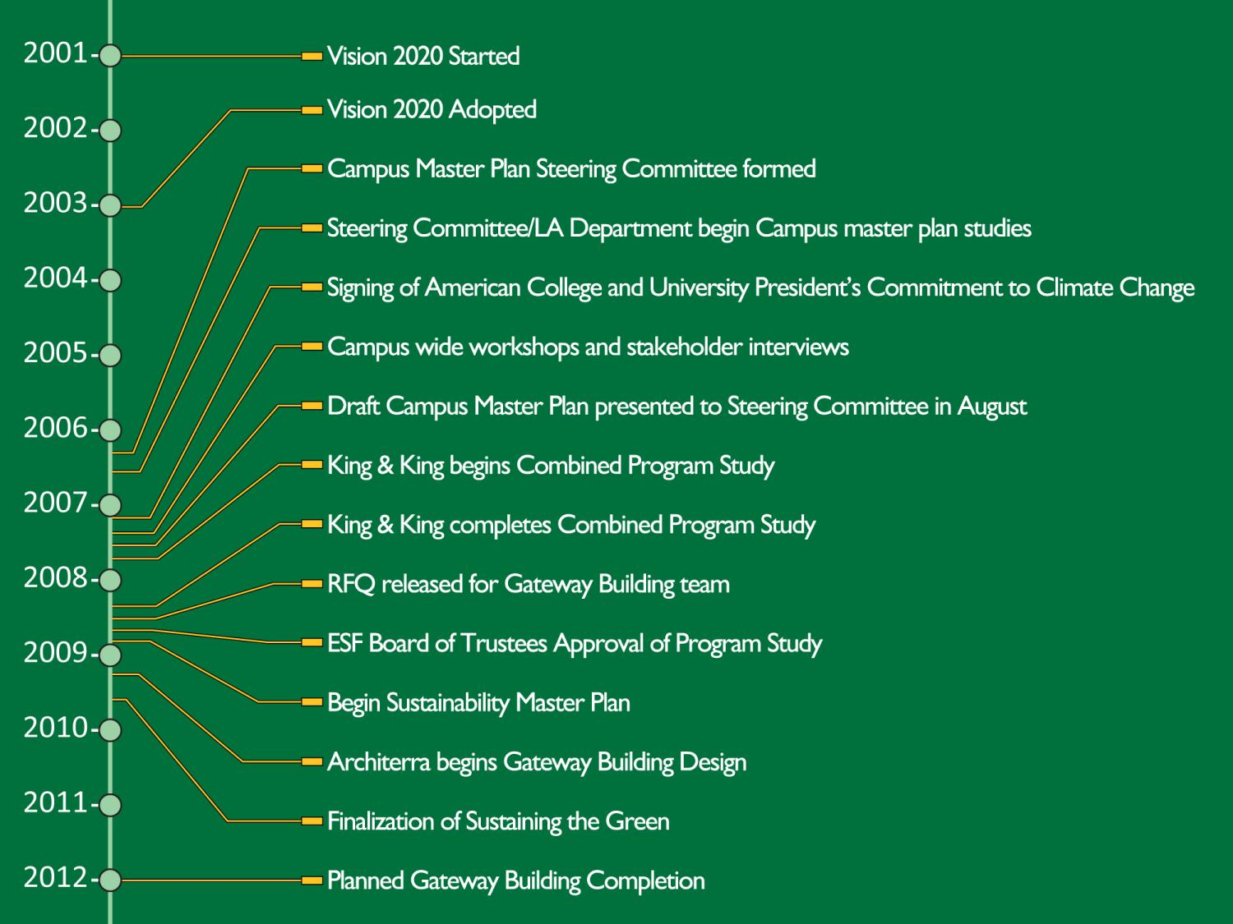
and approved by ESF Board of Trustees
and approved by ESF Board of Trustees

Slide 4
Strategic Plan
ESF Capital Plan

Slide 5
Strategic Plan
ESF Capital Plan
ESF Strategic Planning (completed 2003)
ESF BOT/Admin/Faculty/Staff/Students/SU
Physical facilities identified
Targets to achieve by 2020
Additions to several campus buildings
Surge space to facilitate the renovation of older campus facilities
A student center
A residential building exclusively for ESF students
A biotechnology research center to be operated in cooperation with Upstate Medical University

Slide 6
Strategic Plan
ESF Capital Plan
Physical facilities identified (cont’d)
Targets to achieve by 2020
At least one new academic building
Additional parking space and facilities
Expanded campus dining facilities
Larger meeting and conference facilities
Improved campus roads and walkways, designed for both safety and ease of maintenance
Endorsement by ESF Board of Trustees in 2003

