Slide 1
Faculty Meeting
February 3, 2010

Slide 2
Report of the President – Neil Murphy
ESF Capital Plan

Slide 3
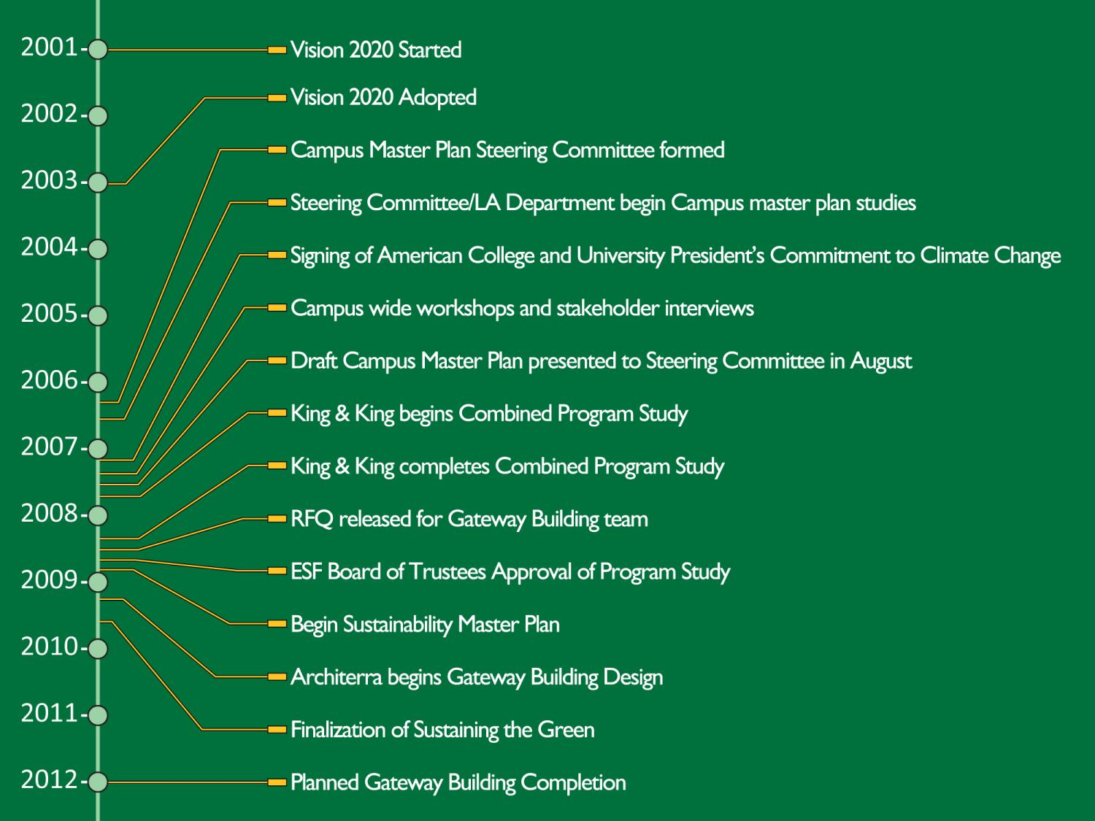
and approved by ESF Board of Trustees
and approved by ESF Board of Trustees

Slide 4
Strategic Plan
ESF Capital Plan

Slide 5
Strategic Plan
ESF Capital Plan
ESF Strategic Planning (completed 2003)
ESF BOT/Admin/Faculty/Staff/Students/SU
Physical facilities identified
Targets to achieve by 2020
Additions to several campus buildings
Surge space to facilitate the renovation of older campus facilities
A student center
A residential building exclusively for ESF students
A biotechnology research center to be operated in cooperation with Upstate Medical University

Slide 6
Strategic Plan
ESF Capital Plan
Physical facilities identified (cont’d)
Targets to achieve by 2020
At least one new academic building
Additional parking space and facilities
Expanded campus dining facilities
Larger meeting and conference facilities
Improved campus roads and walkways, designed for both safety and ease of maintenance
Endorsement by ESF Board of Trustees in 2003

Slide 7
2008 Combined Site and Program Study
ESF Capital Plan

Slide 8
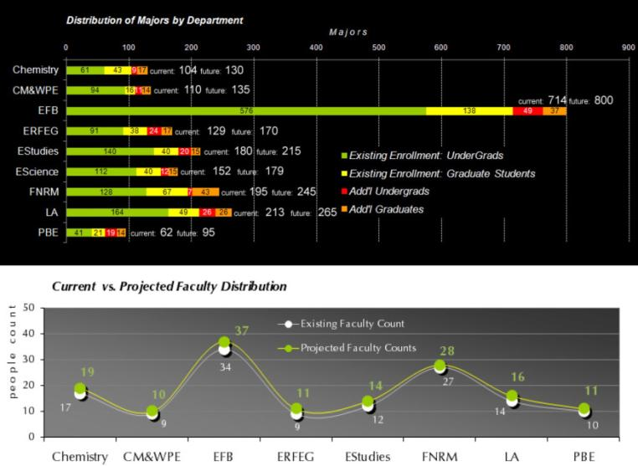
How much is ESF projected to grow by 2020?
2,241 Students (+375)
146 Faculty (+14)
Information provided by King & King Assoc.
Notes:
Note student number reflects traditional students only
Estimate an additional 1000+ non-traditional students

Slide 9
How much space do we need?
Information provided by
King & King Assoc.
‘Right-Size’ and Update Classroom Space
(+3,000 NSF)
Teaching Lab Expansion
(+13,600 NSF)
Research Lab Expansion
(+21,000 NSF)
Expand Office Space
(+10,000 NSF)
Add Study/Collaborative Space
(+6,700 NSF)
Add Lounge/Dining Space
(+15,000 NSF)
vacated space
offices
building support
research labs
general use
teaching labs
special use
classrooms
study space
Current Space Distribution vs. Preliminary Proposed Distribution
500,000
65,600 NSF
Total Program
Growth
39,029
26,072
9,247
26,851
400,000
32,389
35,065
11,053
26,851
28,314
300,000
127,571
n e t s q u a r e f e e t
110,497
200,000
145,004
420,124 NSF
495,000 NSF
122,209
100,000
46,174
59,729
33,353
35,624
0
Current Distribution
Proposed Distribution
Notes:
65,600 NSF of growth

Slide 10
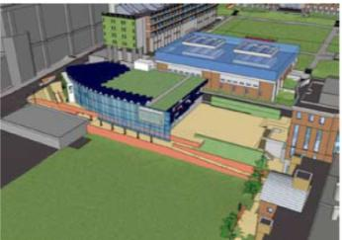
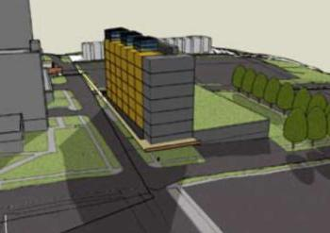
Combined Program Study
Where is this space?
Concept graphics provided by King & King Assoc.
Proposed Buildings
Gateway Building and Moon Student Center
Academic Research Building
Existing Buildings
Rehab and Update Existing Buildings
Increase space utilization to 65% (Currently ~50%)
Increase seat utilization to 75% (Currently ~48%)
Building Expansions
Notes:
Space/seat utilization = right sized classrooms

Slide 11
2008 Combined Site and Program Study
ESF Capital Plan
Gateway Building
Defined requirements of Gateway Building (Community Outreach and Technology Transfer Center)
33,659 GSF
Meeting and conference facilities
LEED Platinum certification
Flexible space for multiple functions
Display and dedicated museum space
Include parking facility
Outreach and Instructional Quality

Slide 12
ESF Capital Plan

Slide 13
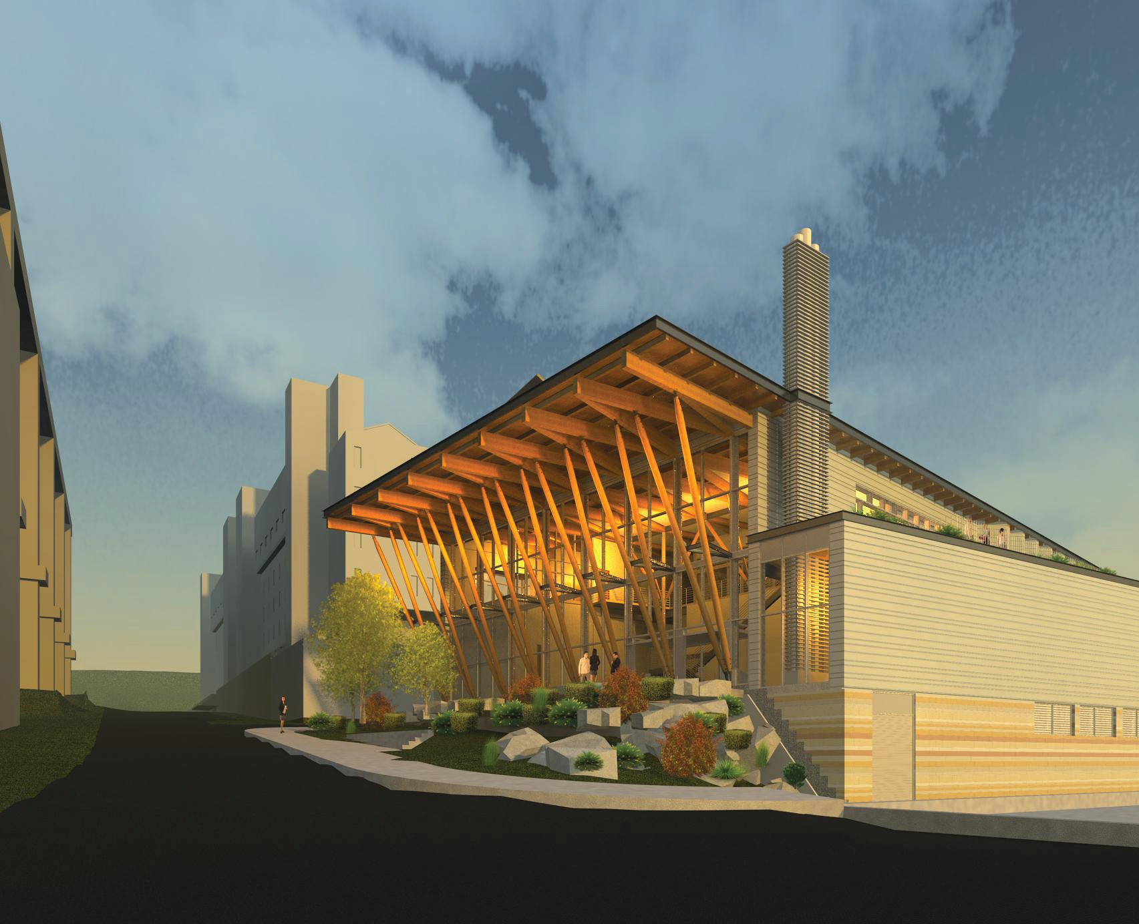
Gateway Building

Slide 14
Status of Gateway Building
ESF Capital Plan
New Gateway Building $28.3M
ESF secured $6.3M from NYS Senate
$22M of supplemental financing provided by joint support of NYS Senate and Assembly Central New York delegation
Parking and Site Modifications $1.8M
Part of the $28.3M Gateway Building project

Slide 15
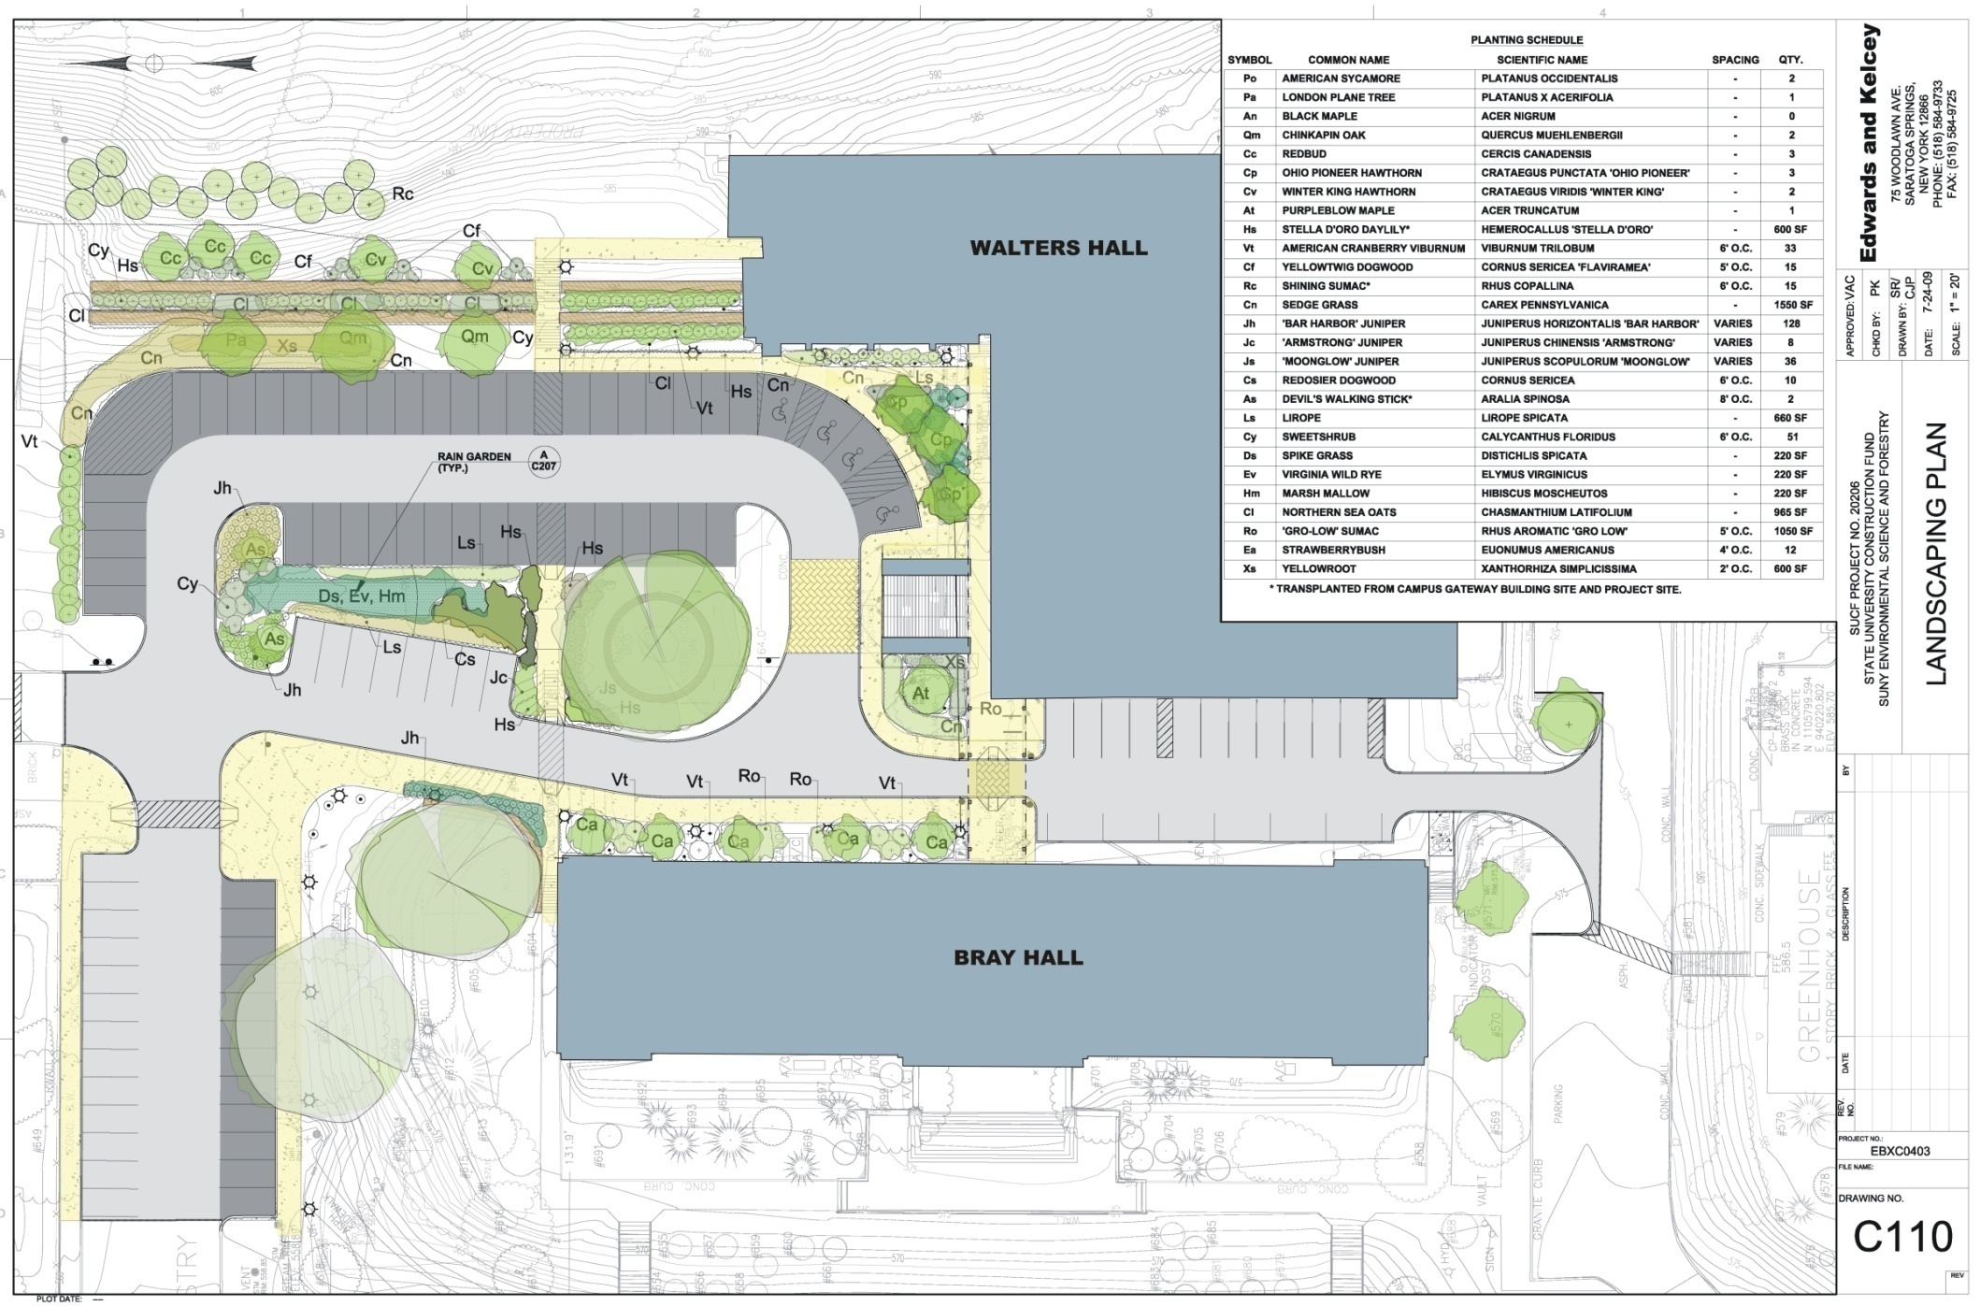
Parking and Site Modifications

Slide 16
2008 Combined Site and Program Study
ESF Capital Plan
New Academic/Research Building

Slide 17
Academic Research Building
ESF Capital Plan

Slide 18
Academic Research Building
ESF Capital Plan

Slide 19
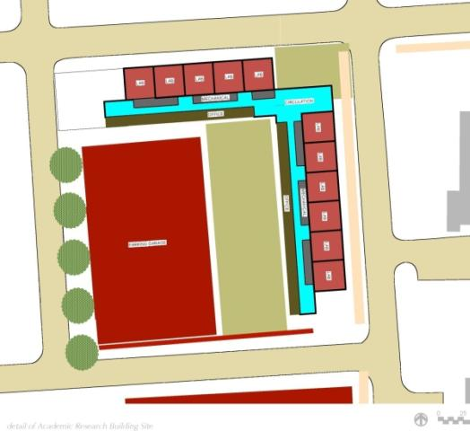
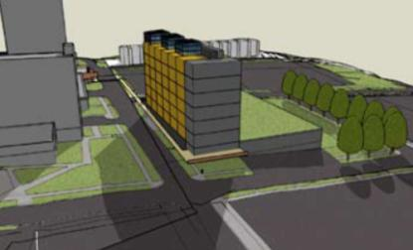
Academic Research Building (ARB)
E. Raynor Ave.
Stadium Pl.
Henry St.
Building Program
EFB Administrative/Faculty Offices
Graduate student offices
Dry/Wet Research Labs
(180+/- NSF per researcher)
Greenhouses
Study/Collaborative Space
Insect Museum, Mycological Collection and Vascular Plant Herbarium Display
Parking Facility
(240+/- spaces)
Standart St.
Concept graphics provided by King & King Assoc.
Anticipated Completion: 2014
Notes:
Several options studied
55,732 NSF
101,331 GSF
The ARB will be 55,732 NSF of program space that will ultimately promote award winning research, funding for future research programs, while expanding for student enrollment and faculty growth.

Slide 20
Status of New Academic Research Building
ESF Capital Plan
New Academic/Research Building $86M
ESF secured $44m from NYS Senate and Assembly
Current request for $42M advanced to 6 members of CNY legislative delegation

Slide 21
ESF Advocacy for Funding
ESF Capital Plan
Student Residence - $30M
ESF College Foundation Board
Approved moving ahead
Retained development team
Financing provided by tax exempt bonds
Biotechnology Research Center - $22M
Dr. Greg Eastwood former president of UMU and ESF secured $5M of GENYSIS funding through DASNY help from NYS Senate and $15M of funding from Executive Branch
$2M provided by UMU from SUCF fund balance
$0.5M of support provided by BMS

Slide 22
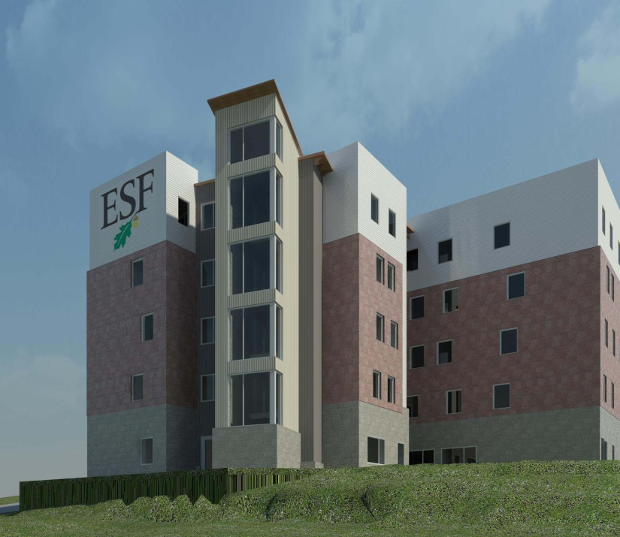
Student Residence

Slide 23
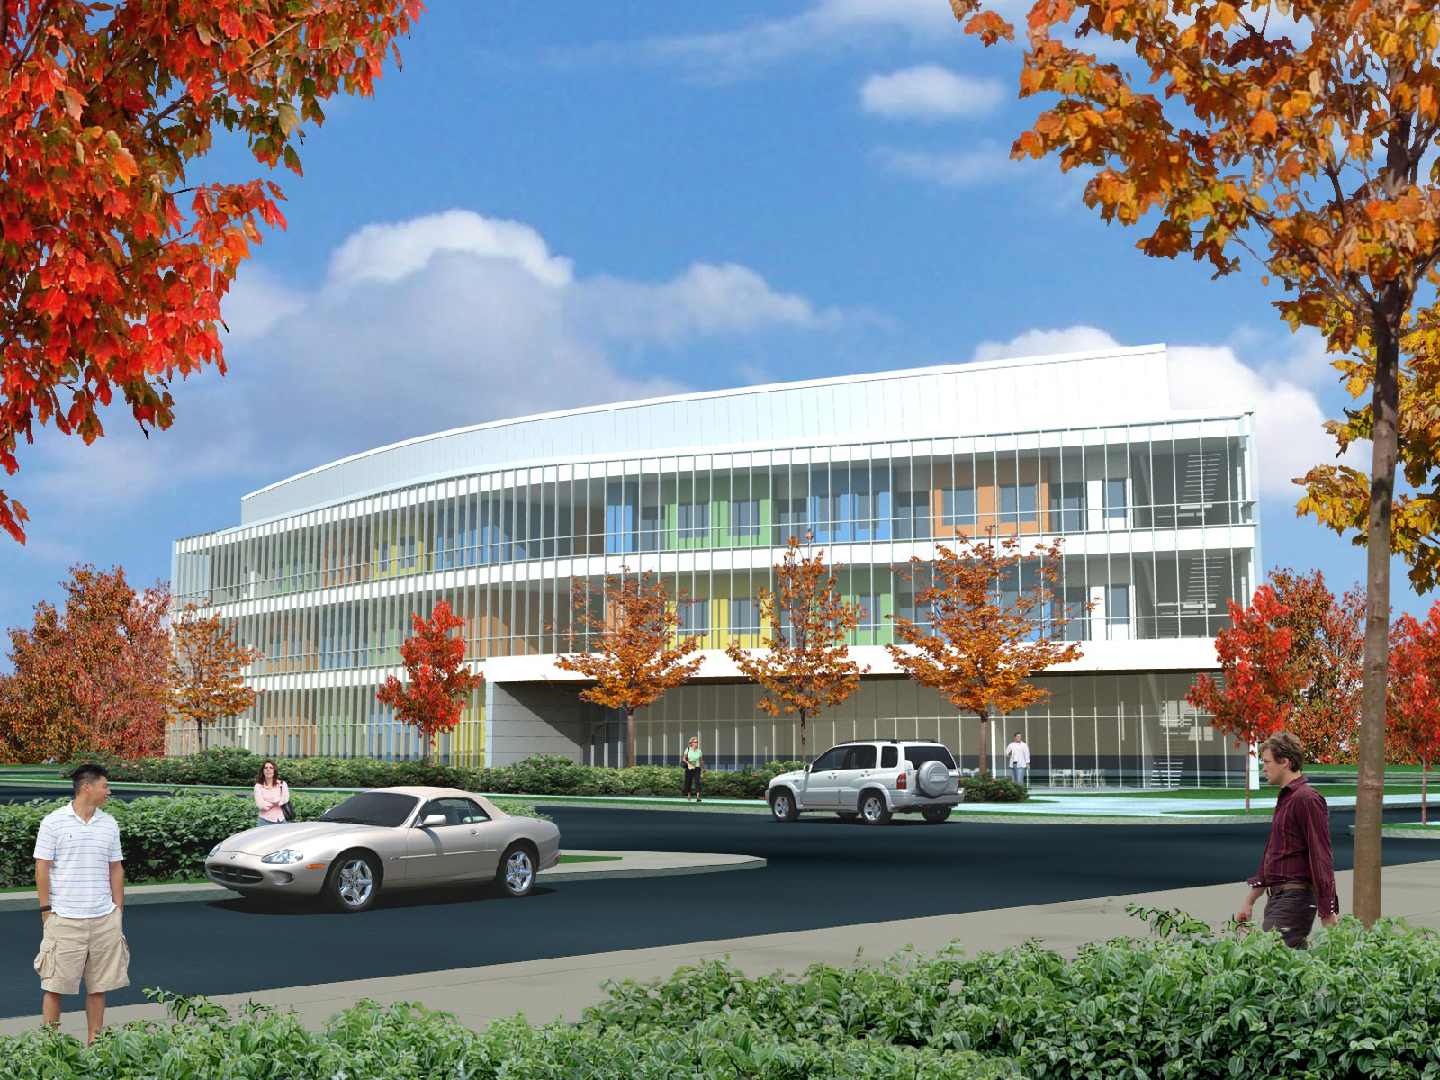
CNY BRC

Slide 24
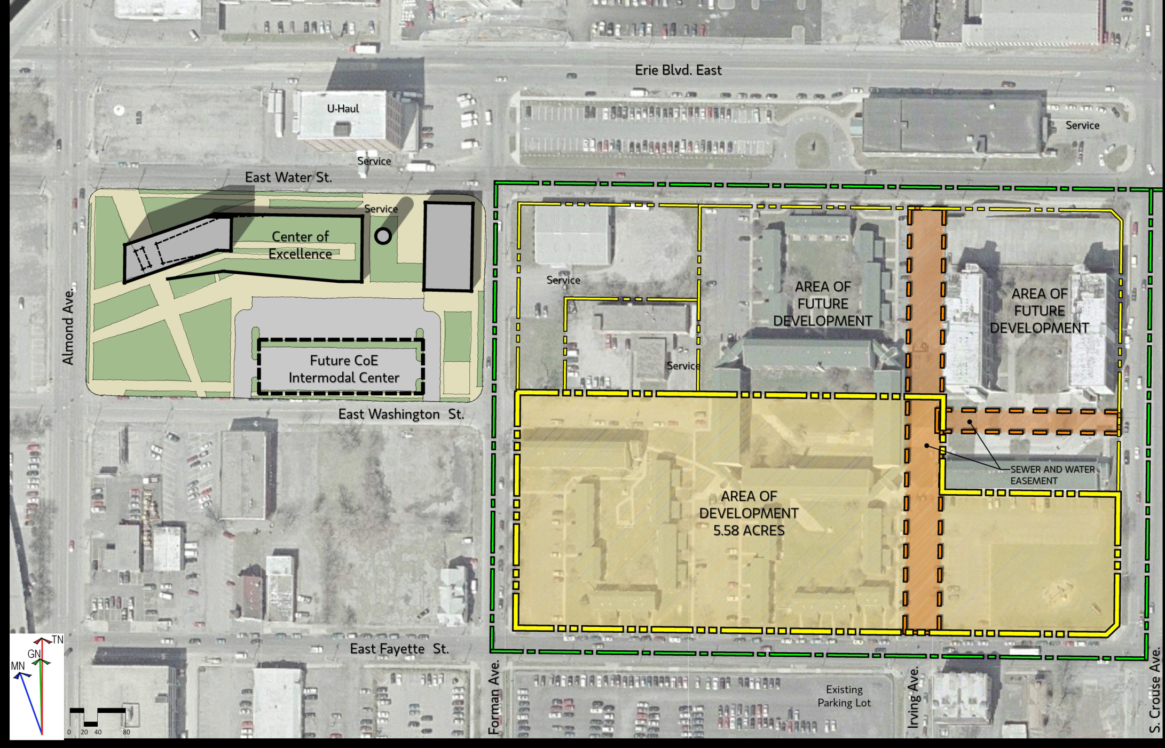
CNY BRC

Slide 25
2008 Combined Site and Program Study Student Center
Preliminary Building Program
45,000
Building Support
Student Services Offices and Support
General Building
40,000
Student Mailboxes/Lockers
35,000
Student Center Lounges
Café/Dining Service
Student Organizations
30,000
Café
Student Organizations (Clubs, Yearbook, Newspaper, etc.)
Student Services Offices & Support
25,000
20,000
Lounges
22,000 NSF (36,300 GSF)
15,000
Mailboxes/Lockers
10,000
5,000
0
Student Union
Space
Distribution
Information provided by King & King Assoc.
Notes:
Anticipated completion 2020 (with Moon library rehab)
The New Student Center will provide approximately 22,000 NSF of program space and will ultimately generate collaborative space for students, faculty and staff to gather, study and socialize.

Slide 26
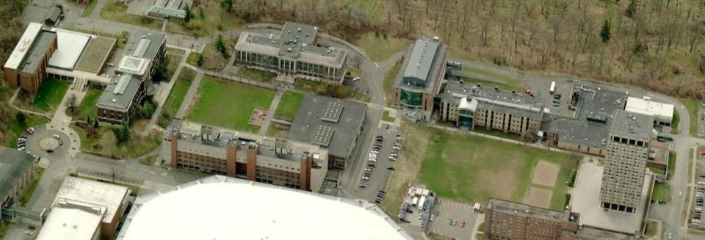
Existing Campus Buildings
Update and Modernize
Preliminary Rehab Schedule
Illick, Phase 1: 2014-2016
Illick, Phase 2: 2016-2018
Moon: 2018-2020
Old Greenhouses: 2019
Marshall: 2020-2021
Bray: 2021-2022
Walters, major: 2022-2024
Potential Strategies
Improved energy systems
Increased space utilization

Slide 27
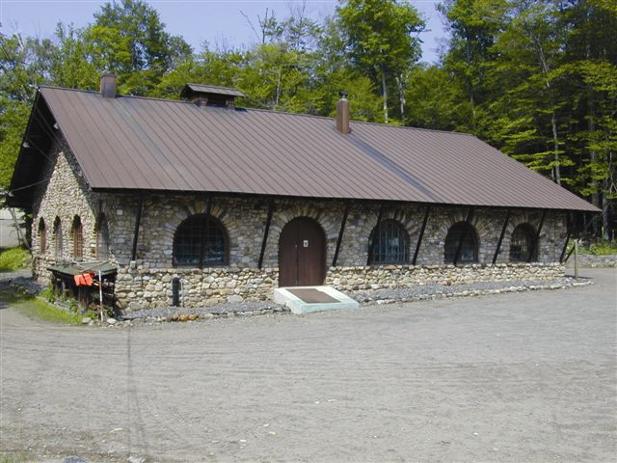
Adirondack Ecological Center
ESF Capital Plan
AEC Stone Garage $2.5M
ESF secured $2.5M from NYS Senate and Assembly

Slide 28
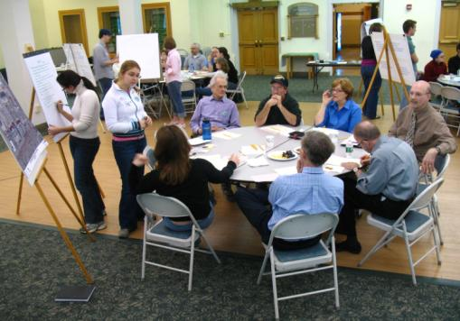
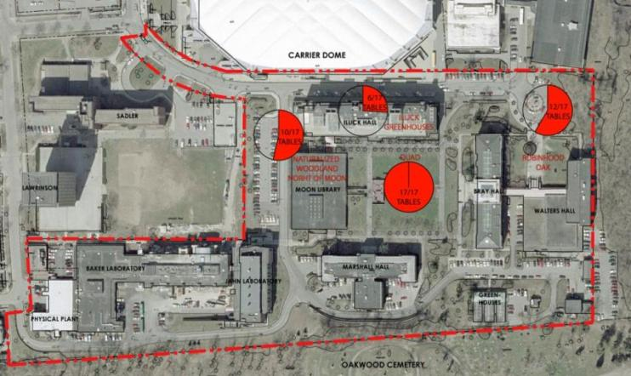
Campus Workshops Sustainability Master Plan
Sacred Spaces
Notes:
Lots of constituents and stakeholders involved (faculty, students, staff, visitors, moms and dads)
~120 attendees
Each program, department and several offices on campus represented

Slide 29
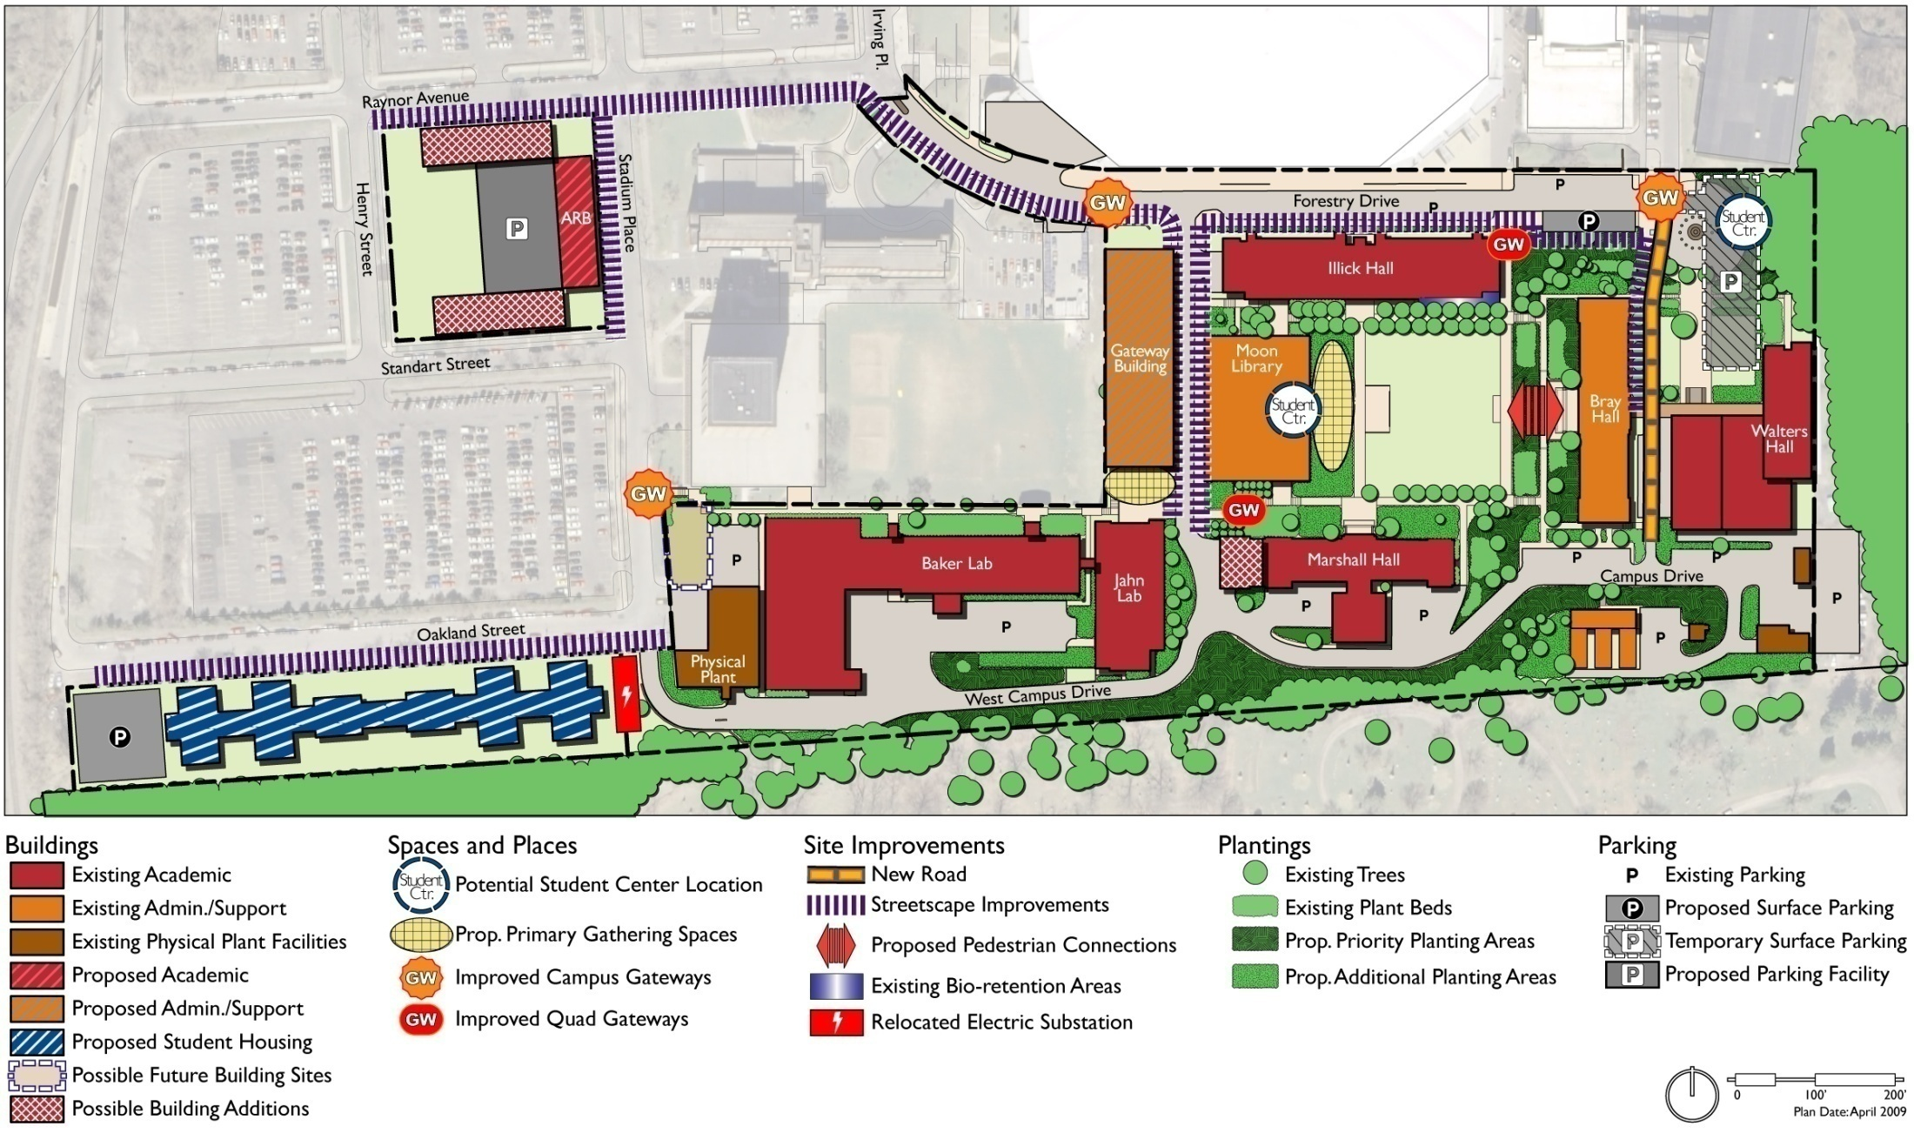
The Future Framework

