Slide 1
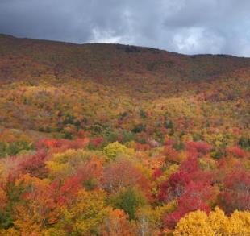
Uncertainty in Measurements of Trees in the US Forest Service Forest Inventory and Analysis (FIA) Program
Ruth Yanai¹, John Campbell², Gretchen Dillon¹, Alexander Young¹, Mark Green³, Charles Barnett⁴, Grant Domke⁵, and Christopher Woodall⁴
(1)SUNY College of Environmental Science and Forestry, Syracuse, NY, United States, (2)USDA Forest Service, Northern Research Station, Vallejo, CA, United States, (3)Case Western Reserve University, Department of Earth, Environmental, and Planetary Sciences, Cleveland, OH, United States, (4)USDA Forest Service, Northern Research Station, Durham, NH, United States, (5)USDA Forest Service, Northern Research Station, St. Paul, MN, United States
Notes:
I will take one moment to say that he next four talks will focus on uncertainty. We’ll have three talks on forest carbon, and one on forest soils.

Slide 2
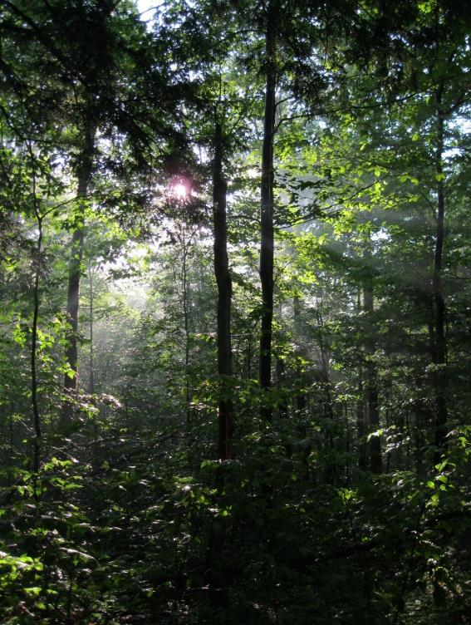
Why Quantify Uncertainty
in Forest Inventory Measurements?
Helps us interpret forest inventory data used in applications (carbon accounting, biodiversity)
Can be used to improve monitoring programs
Adds scientific rigor to analyses
Notes:
We need

Slide 3
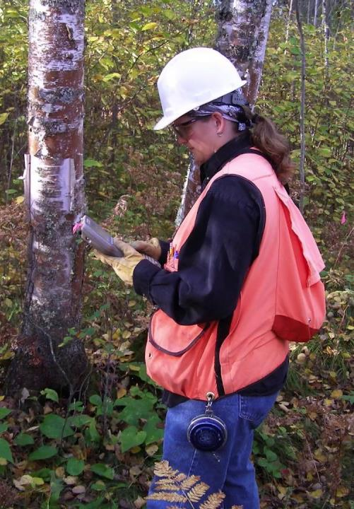
Forest Inventory and Analysis
Conducts a comprehensive inventory of US forests
Northern Research Station FIA unit is responsible for inventorying forests in 24 states (Forests cover 30% of land)
Implements QA procedures – Blind remeasurement
Notes:
The USDA FS FIA program is amazing; I appreciate it more now that I’m learning what countries are going through to try to
A QC crew follows them

Slide 4
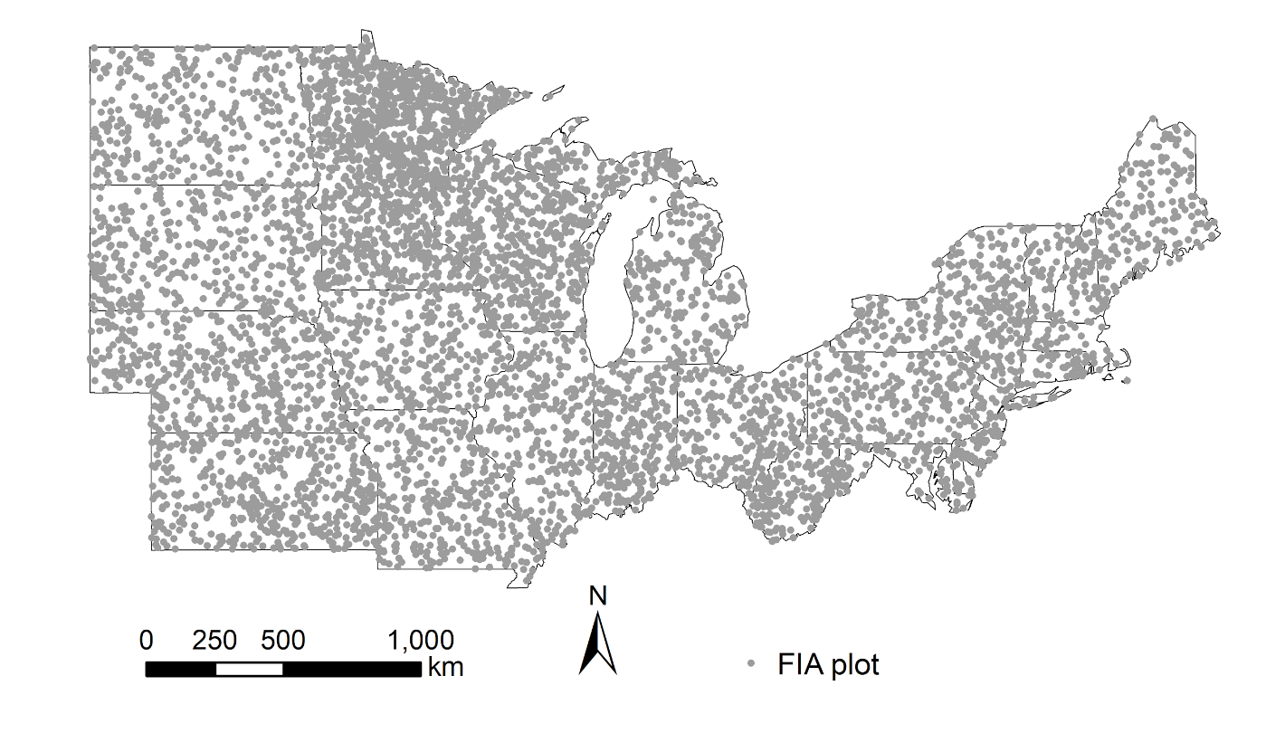
FIA plots
6095 permanent FIA plots
One plot/2428 ha (6,000 acres)
Visit 20% of plots/state/year

Slide 5
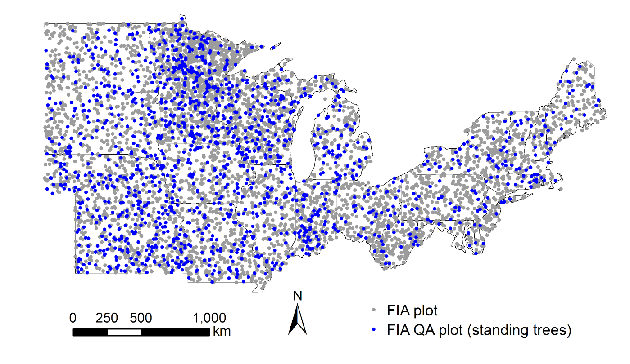
FIA plots (QA)
      Core variables - tree diameter, height, species, timber quality, etc.
      1440 QA plots (24% of FIA plots)
Notes:
1440 plots (24% of plots)
The primary purpose of these checks is quality control, not the quantification of measurement uncertainty.

Slide 6
FIA Remeasurement Error: Continuous Variables
Notes:
Just so that you can see the magnitude of this gold mine of information

Slide 7
FIA Remeasurement Error: Continuous Variables
Notes:
John Battles said these diameter errors are too small--

Slide 8
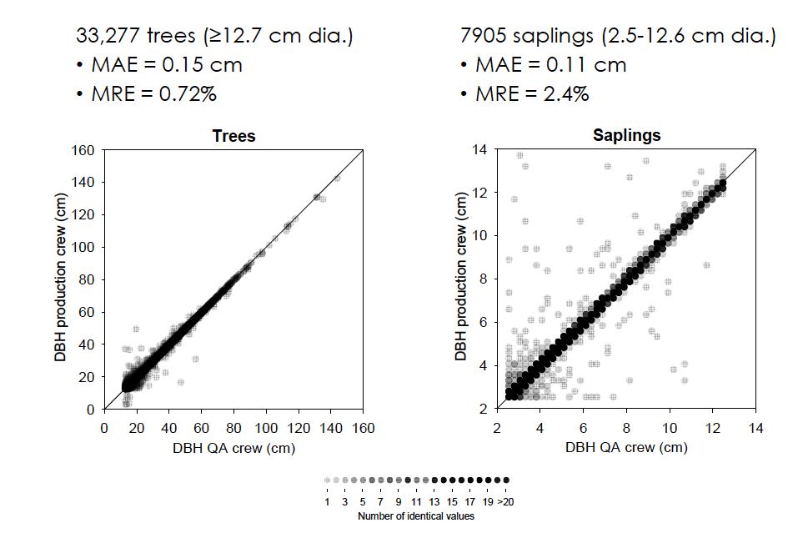
Tree diameter measurement
Notes:
Trees are > 5” DBH. Saplings are 1-5”

Slide 9
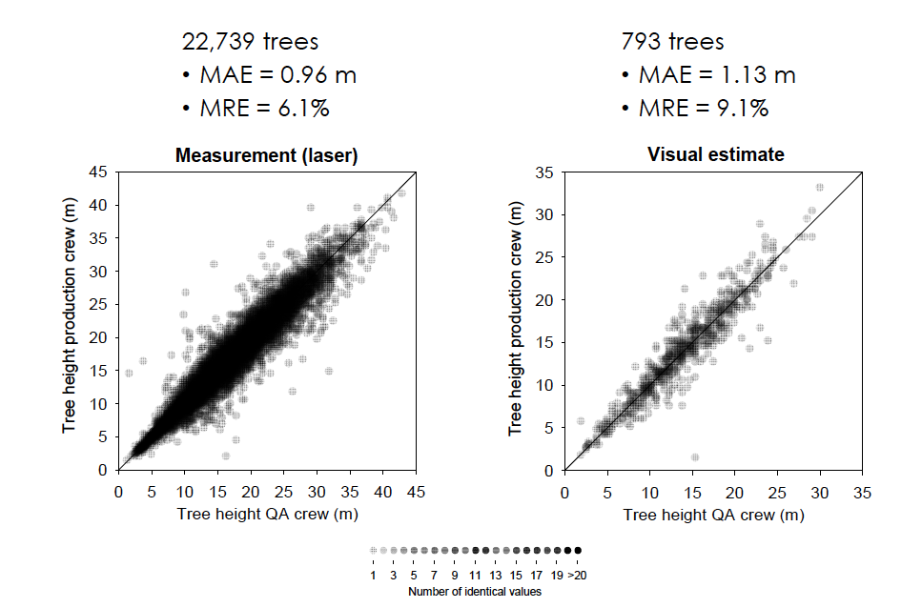
Tree height measurement

Slide 10
FIA Remeasurement Error: Ordinal Variables
For ordinal variables, the error is described by the number of classes by which the field crew and the QC crew disagreed.

Slide 11
FIA Remeasurement Error: Categorical Variables

Slide 12
FIA Remeasurement Error: Categorical Variables

Slide 13
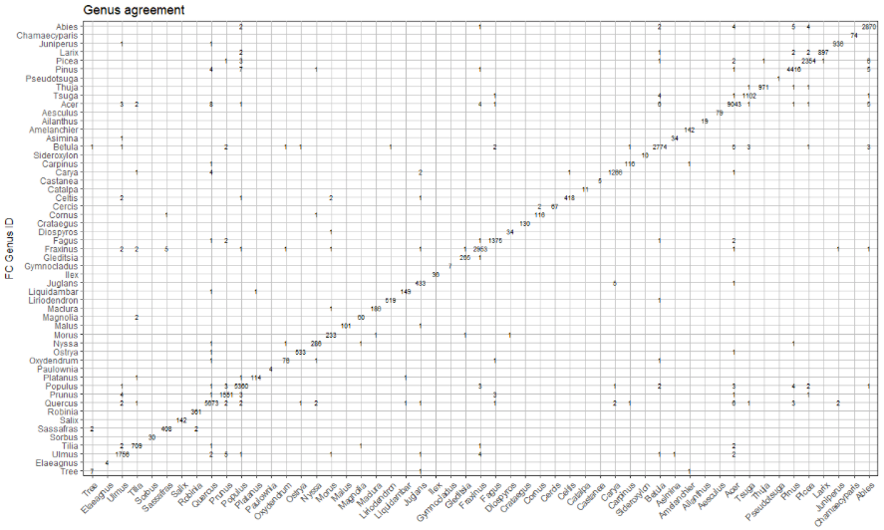
Tree species identification

Slide 14
Tree species identification
Acer rubrum (red maple; 4736 trees)
Quercus shumardii (Shumard oak; 28 trees)
Quercus pagoda (cherrybark oak; 3 trees)
Celtis laevigata (sugarberry; 17 trees) vs.
Celtis occidentalis (hackberry; 400 trees)

Slide 15
FIA Remeasurement Error: Continuous Variables
Notes:
The mean absolute error is less than 1/10 of an inch

Slide 16
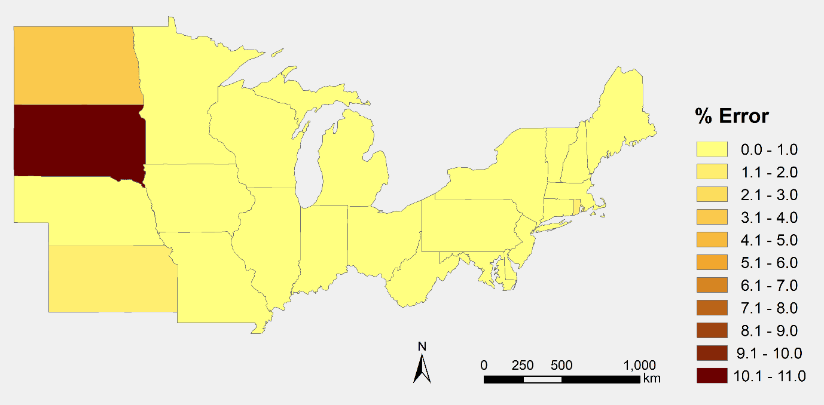
Uncertainty in Aboveground Carbon
Live trees > 2.5 cm
Dead trees ≥ 12.7 cm
All tops/limbs (no foliage/bark)

Slide 17

Conclusions
Uncertainty in tree diameter is small
Uncertainty in visual estimates of tree height were nearly as good as measured values
FIA QC remeasurement is a rich source of information on uncertainty
Uncertainty can guide investments in improving monitoring schemes

Slide 18
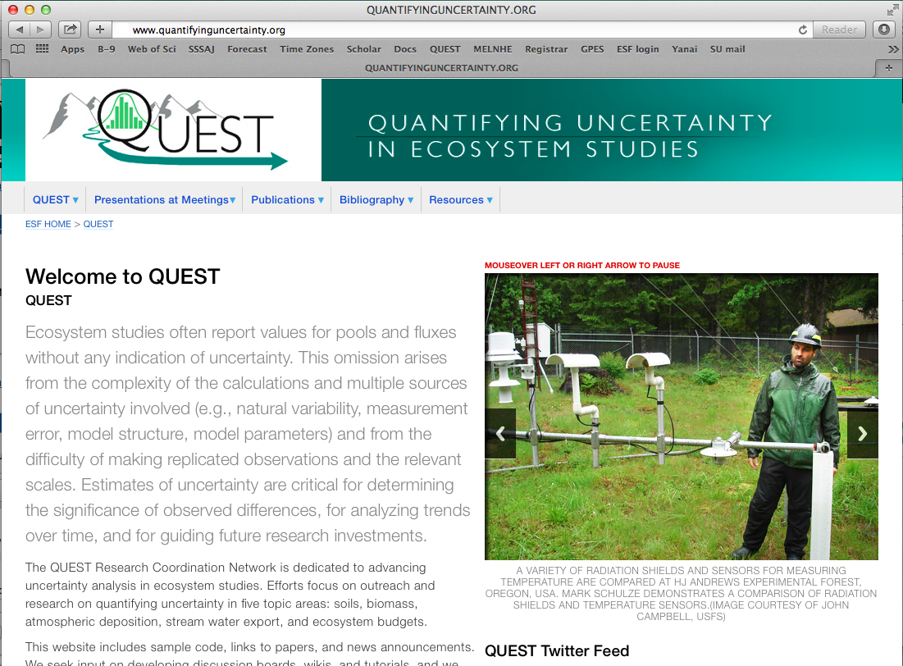
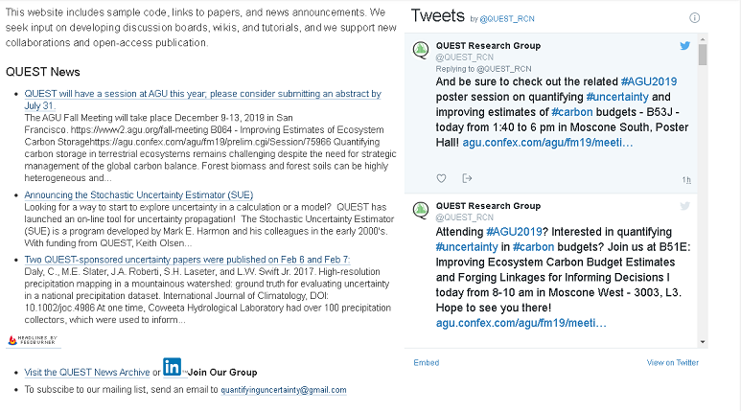
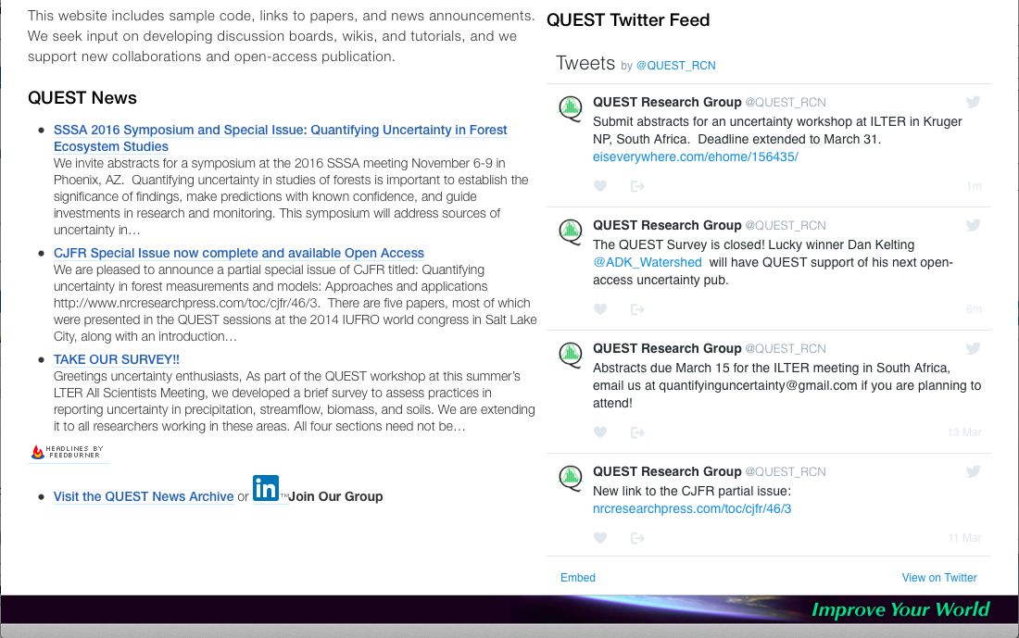

Join QUEST!
Visit our website: www.quantifyinguncertainty.org
  Download papers and presentations
  Share sample code
  Stay updated with QUEST News
Join our mailing list (quantifyinguncertainty@gmail.com)
Suggest papers for bibliographies, write papers for our Special Feature in Ecosphere
Follow us on Twitter @QUEST_RCN
Notes:
A shameless plug for the QUEST ResearchCoordination Network.

Slide 19
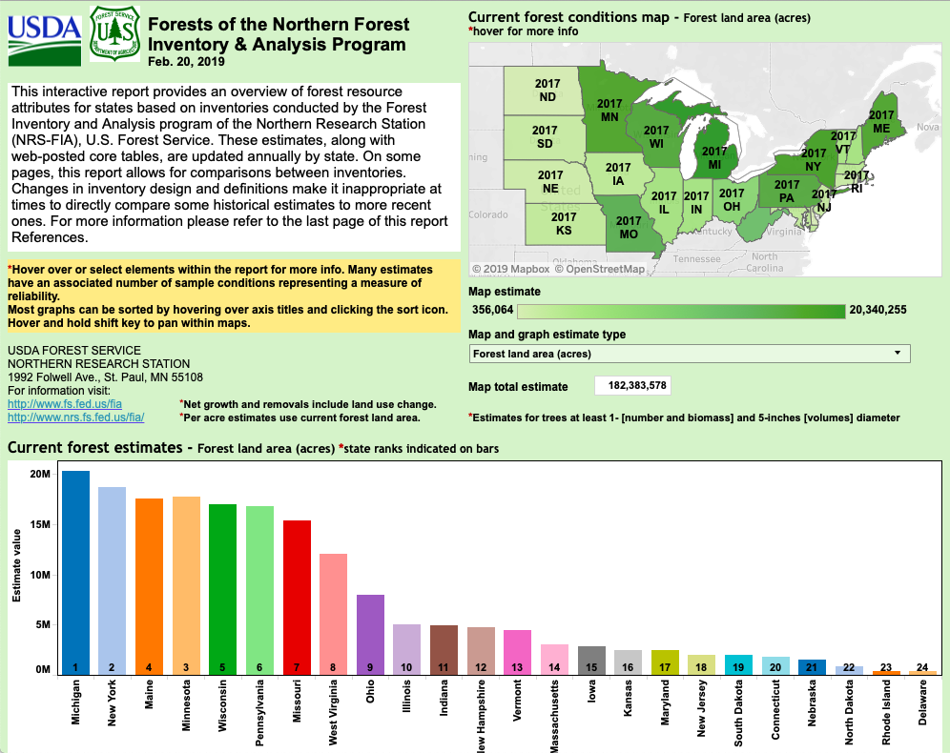
Do Measurement Errors Matter?

Slide 20
Notes:
The next four talks will focus on uncertainty. Following NASA’s carbon cycle, we’re moving to the USDA Forest Service Inventory and Analysis program, We’ll have three talks on forest carbon, and a fourth one on soils.

