Slide 1
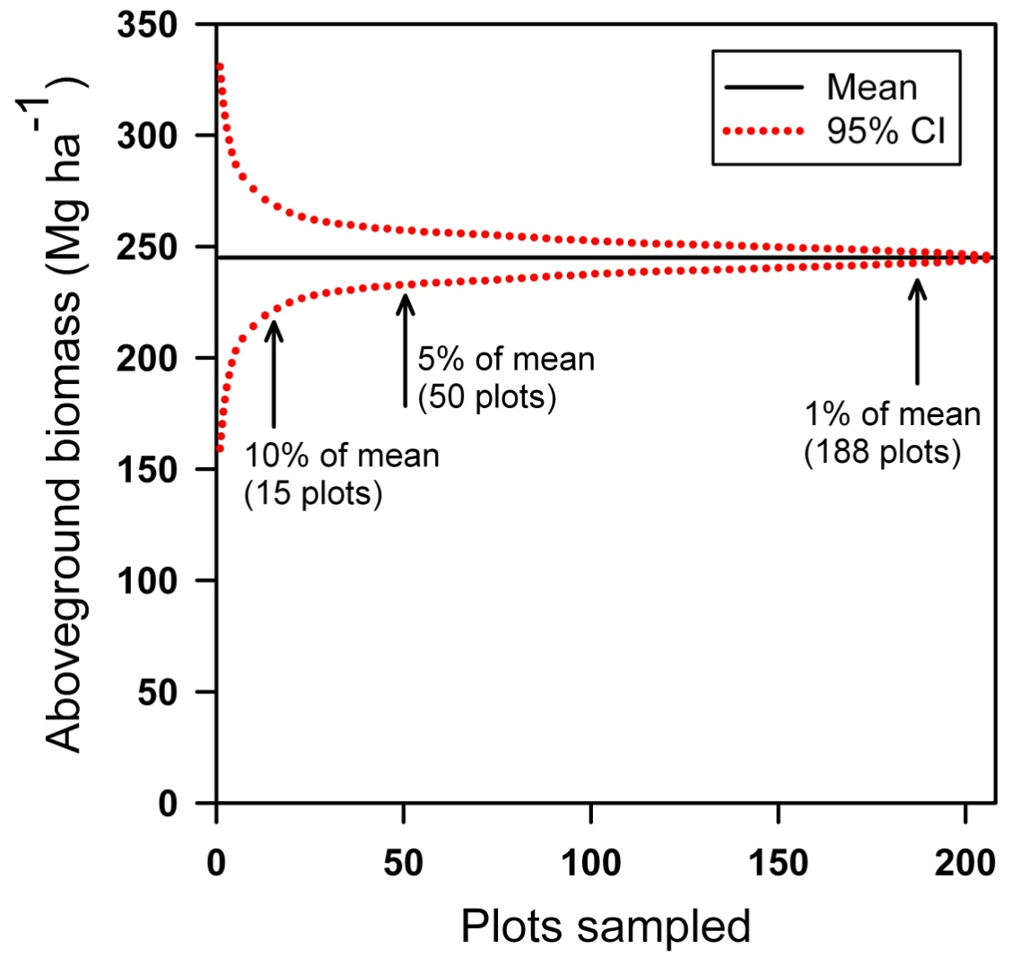
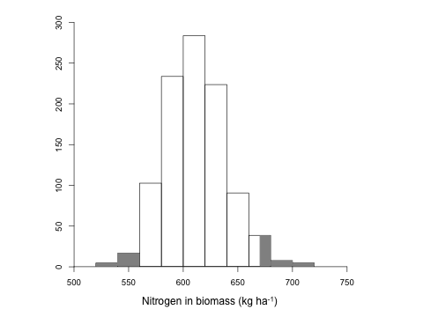
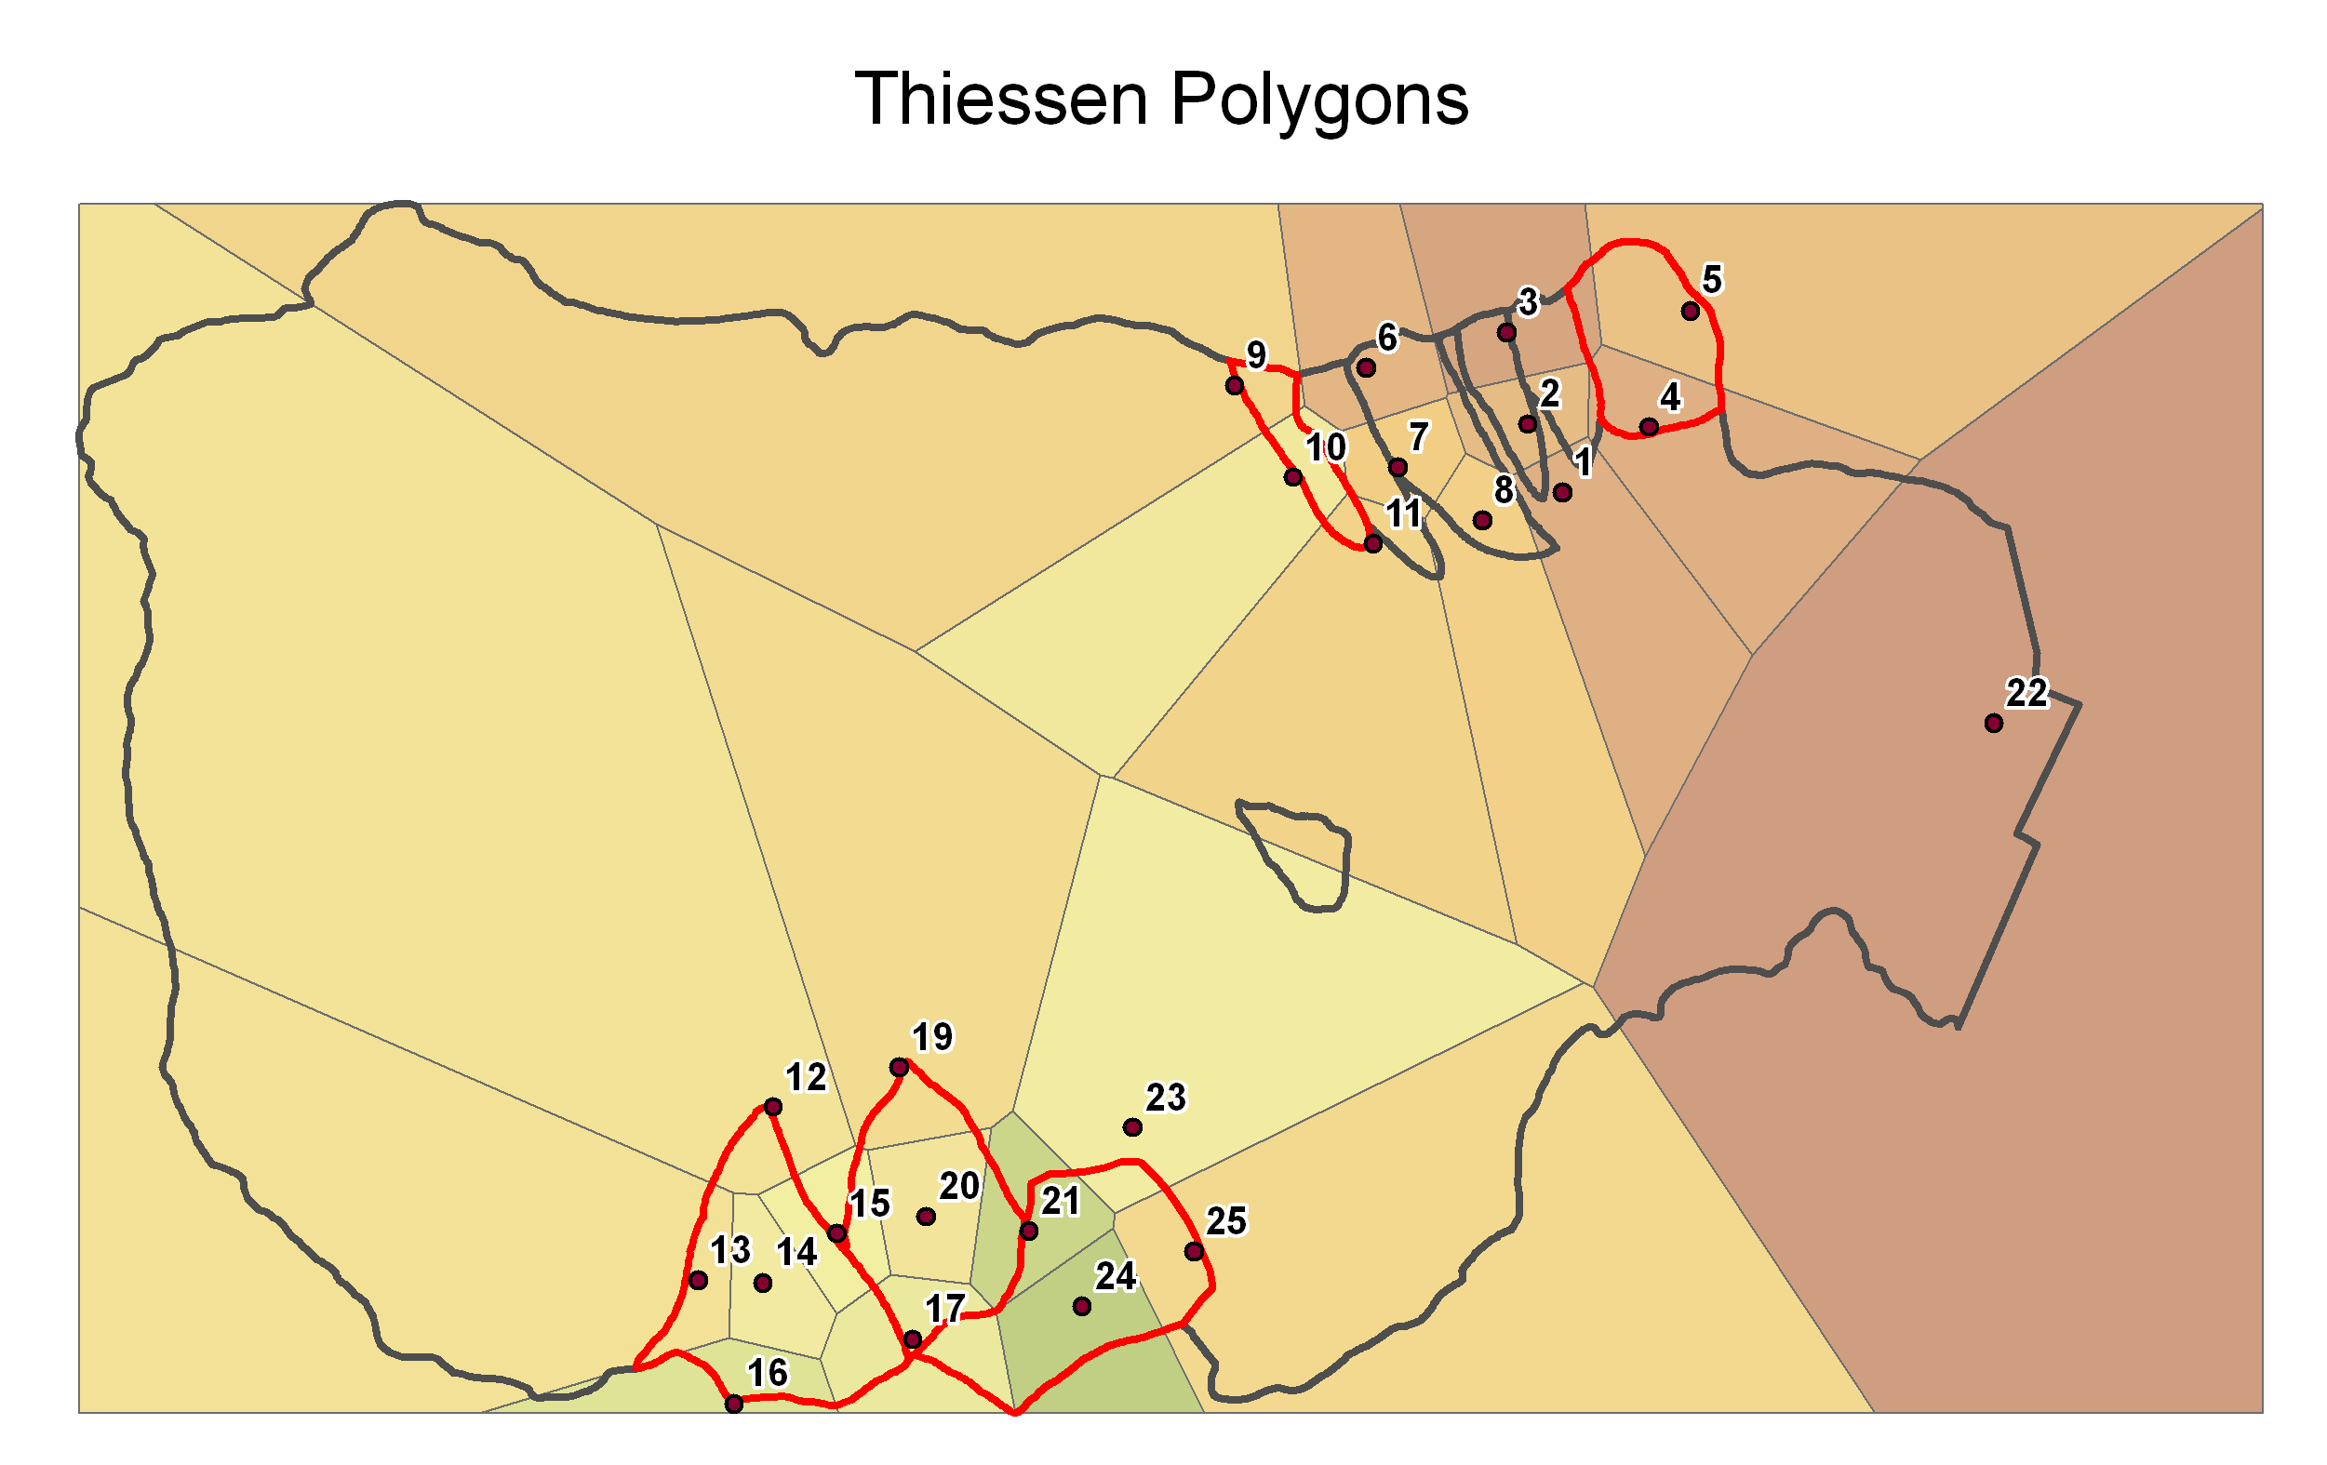
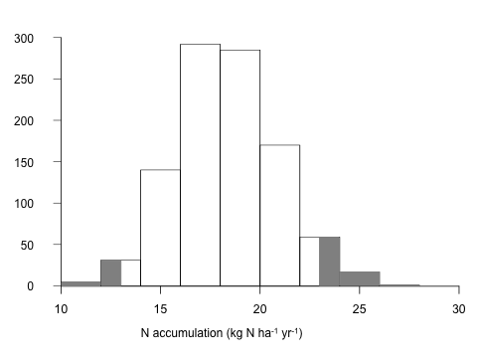
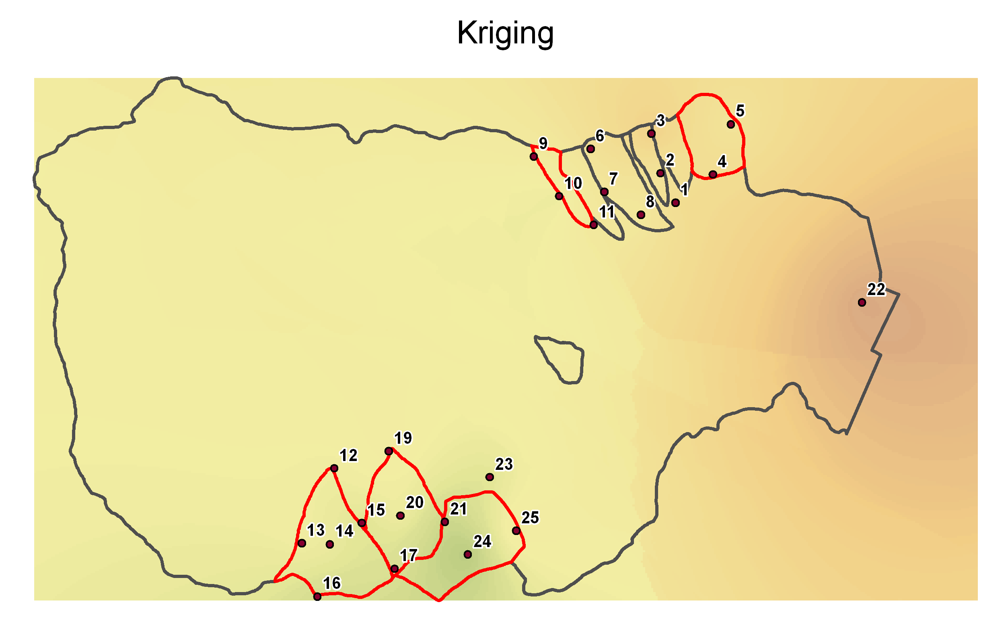
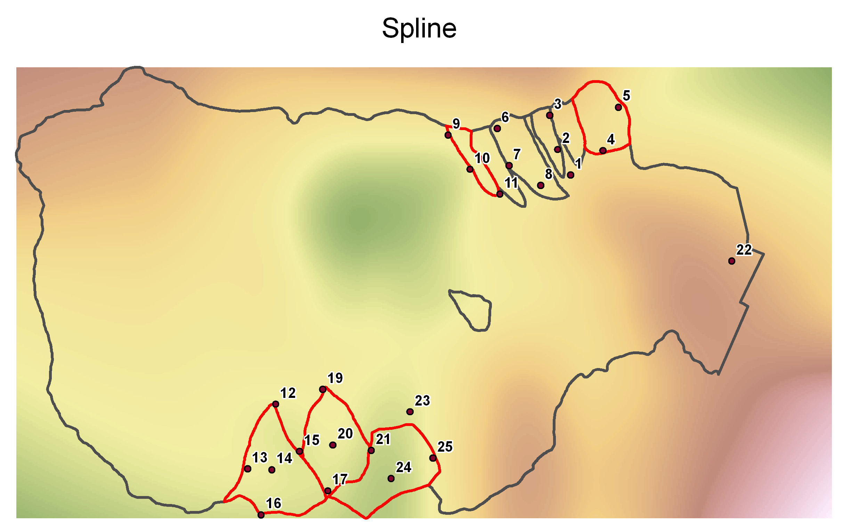
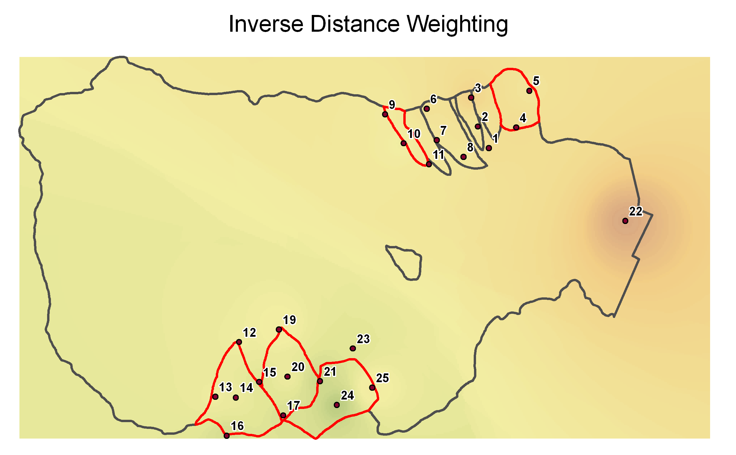
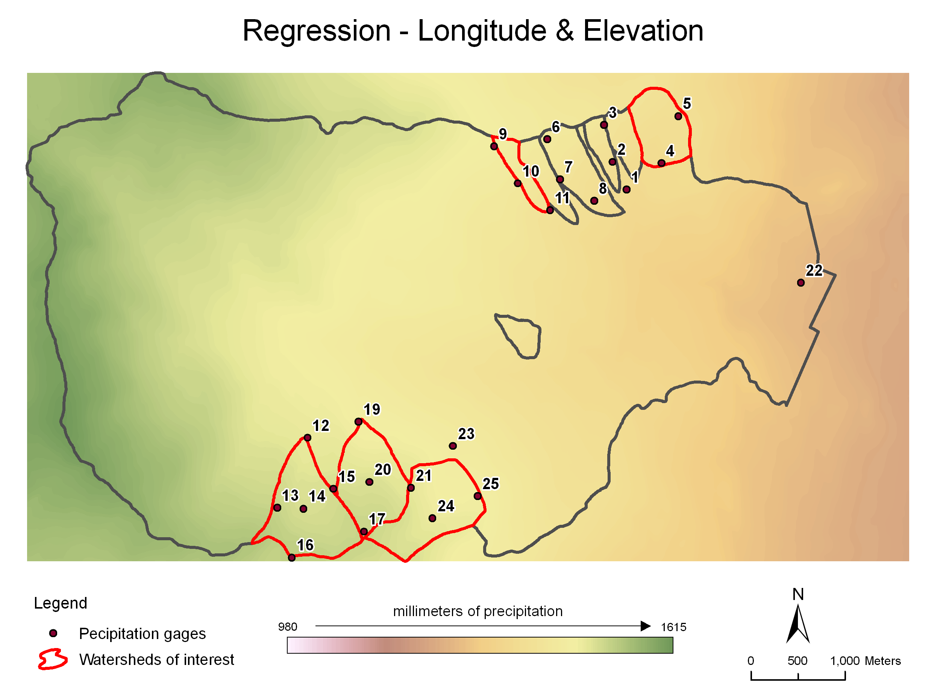
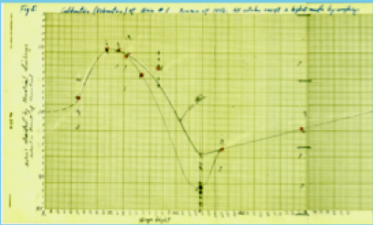
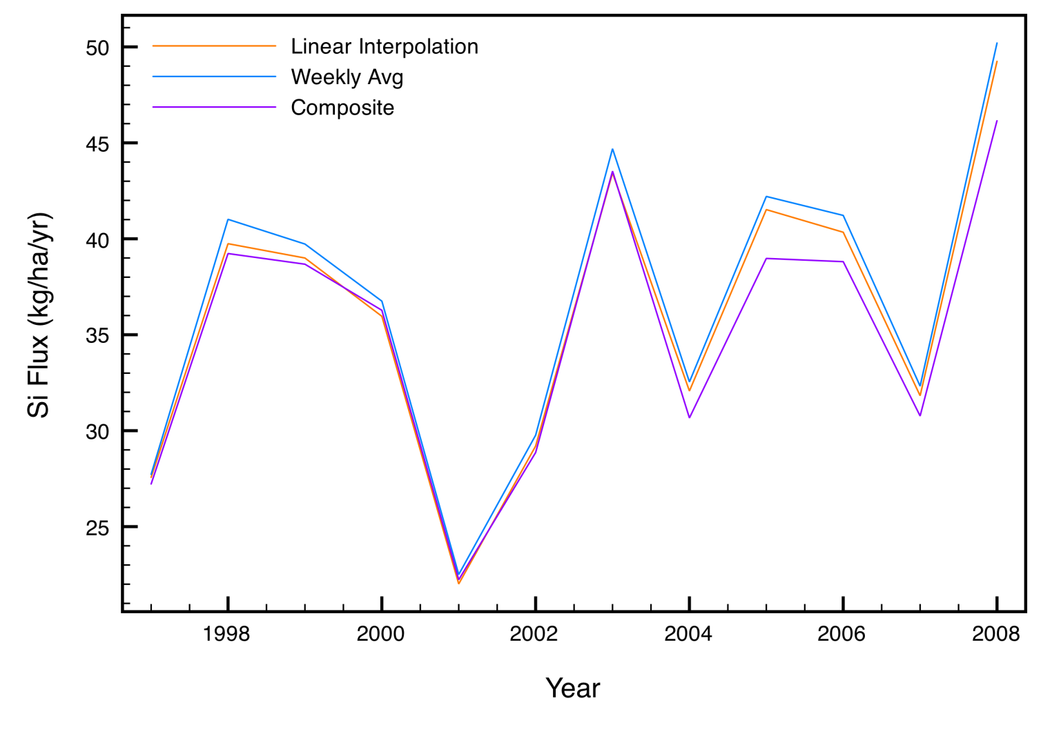
Is the Missing Nitrogen Source (or Sink)
at Hubbard Brook Statistically Significant?
Ruth D. Yanai¹, Carrie Rose Levine¹, Mark B. Green^{2, 3}, John L. Campbell³ rdyanai@syr.edu
¹SUNY College of Environmental Science and Forestry, Syracuse, NY; ²Plymouth State University, Plymouth, NH; ³US Forest Service, Durham, NH.
Ecosystem Budgets
Have no Error
Nutrient budgets for forested ecosystems have rarely included error analysis, making it difficult to establish the statistical significance of the results. The pursuit of closure in nutrient budgets can provide insight about ecosystem processes and also suggest where more research is needed.
At the Hubbard Brook Experimental Forest, the N budget for the period 1965 – 1977 showed more N accumulating in living biomass than was deposited from the atmosphere, and the "missing source” of 14.2 kg N ha⁻¹ y⁻¹ was attributed to N fixation. More recently (1992–2007), biomass accumulation has been negligible, and streamwater export of N has fallen to ~1 kg-N ha⁻¹ y⁻¹ despite chronically elevated atmospheric N deposition, resulting in a “missing sink” of ~6 kg N ha⁻¹ y⁻¹.
The imbalance in the 1965 N budget sparked interest in quantifying N fixation (Roskowski 1980); currently, the N budget closure suggests a missing sink, not a missing source, and researchers are measuring denitrification (Groffman et al. 2009). However, there are large uncertainties in the N budget, some of which have never been quantified.
When estimating forest biomass, researchers commonly report sampling uncertainty but rarely propagate the uncertainty in the allometric equations used to estimate tree biomass. The uncertainty in change over time in biomass N at Hubbard Brook is ± 0.6 – 4.7 kg N ha⁻¹ yr⁻¹, depending on the time interval (Figure 3).
The uncertainty in change in the forest floor is -21 to +24 kg N ha⁻¹ y⁻¹ and in the mineral soil ± 53 kg N ha⁻¹ y⁻¹. Clearly, to attribute missing sources or sinks to N fixation or denitrification would require more precise estimates of change in soil stores.
Changes in the net hydrologic flux of N (streamflow – precip) have less uncertainty than the ecosystem fluxes involving biomasss and soils.
Gradually, researchers are developing approaches to quantifying uncertainty in ecosystem studies. In this poster, we illustrate current approaches to uncertainty analysis, using the example of the N budget for the Hubbard Brook Experimental Forest in New Hampshire, USA .
Sources of Uncertainty
Sources of uncertainty can be classified into those arising from imperfect knowledge (such as measurement error and model selection error) and those arising from the inherent variability in the system studied (such as spatial and temporal sampling error) (Harmon et al. 2007).
… in biomass estimates and accumulation
.
…in soils
Forest soils are notoriously heterogeneous, with both horizontal and vertical spatial variation contributing uncertainty to most sampling approaches. Quantitative soil pits are accurate but not very precise if the number of pits is small, each pit being time-consuming to excavate. More precise estimates can be made by taking a greater number of soil cores, but coring is inaccurate in rocky soils (Levine et al. 2012).
Using 60 quantitative soil pits each 0.5 m² in area, uncertainty in soil N storage is 730 kg N ha⁻¹ at Hubbard Brook (Huntington et al. 1988). Thus it would require 50 years of observation for a budget error of 14.2 kg ha⁻¹ yr⁻¹ to be distinguishable as a change in the mineral soil. From 1983 to 1998, 15 years post-harvest, there was a non-significant decline of 54 ± 53 kg N ha⁻¹ y⁻¹ in W5. Change in the forest floor, based on repeated sampling from 1977 to 2002, was 2 ± ~23 kg N ha⁻¹ ha⁻¹ y⁻¹ (Hamburg et al., in preparation). The total change in soil N storage is thus not significantly different from zero, as assumed in the N budget for Hubbard Brook, but it has an uncertainty of about 70 kg N ha⁻¹ y⁻¹.
Estimating the nutrient contents of forest biomass at Hubbard Brook involves biomass equations and tissue chemistry for 5-6 tree species and 5-7 tissue types applied to thousands of trees. We used a Monte Carlo approach, in which the entire calculation was repeated using random sampling of values for nutrient concentrations and biomass equations defined by the statistical distribution of the sampled trees Figure 1). The mean for biomass N content in 1965 is 611 kg N ha⁻¹, and the uncertainty, which has never before been estimated, shows a 95% confidence interval ranging from 562 to 670 kg N ha⁻¹.
A
C
A
B
B
Figure 2. Uncertainty in biomass estimates: A. in allometric regression,
B. between models, C. due to sampling uncertainty (natural spatial variation).
Figure 1. Uncertainty in the N contents of biomass, reflecting uncertainty in allometric equations and in tissue N concentrations. a. Monte Carlo results of N in biomass in 1965 for 100 iterations. b. Frequency distribution of 1000 iterations, showing the 95% confidence interval in white.
For many purposes, the change in a nutrient pool is more important than its size. Figure 3 shows the results of 100 Monte Carlo estimates for the 1997 and 2002 inventory of W6, with the uncertainty in allometry and N concentrations sampled simultaneously for the two sampling dates at each iteration. Because of the consistency of a bias in the calculation, the uncertainty in the change over time (10 kg N ha⁻¹ yr⁻¹, Figure 3) is much less than the uncertainty in the mean at one point in time (108 kg N ha⁻¹ yr⁻¹, Figure 1).
…in atmospheric deposition
Temporal variation generally contributes little uncertainty to estimates of deposition, because precipitation amounts are measured at short intervals or are cumulative. The chemistry of precipitation is also commonly measured on the accumulated samples, and is thus representative of the time interval sampled .
The greatest source of uncertainty in precipitation inputs is associated with the spatial interpolation of precipitation amounts between precipitation stations and collectors. Different methods of interpolation (Figure 6) give different estimates, especially far from the measured points, but the differences in estimates for the monitored watersheds at Hubbard Brook was less than 1%. This uncertainty in model selection has often been overlooked.
Additional challenges to be addressed are associated with the difficulty of monitoring dry deposition and cloud deposition and their interaction with vegetation structure.
There are other sources of uncertainty not captured by propagating the errors in the biomass equations (Figure 2A) and nutrient concentrations. In the Hubbard Brook case, there are species not described by Whittaker, which are estimated using equations for other species or from other sites. This is an example of model selection error, which can be very large (Figure 2B). For five tree species in northwestern Oregon, models differed by 20-40% in estimates of forest biomass (Melson et al. 2011).
Sampling error is important in most estimates of uncertainty in forest inventory. We simulated sampling uncertainty by selecting plots (25 m x 25 m) at random (stratified by elevation) from the 208 plots in W6, without including uncertainty in the allometric equations (Figure 2C). Clearly, measuring all 208 plots every 5 years is excessive. Increasing the number of plots cannot make the estimate more accurate than the uncertainty in the allometric estimates of N content, which was 18% of the mean (Figure 1).
A
B
Why Use Uncertainty Analysis?
Analyzing the relative contributions of various sources of uncertainty can help identify opportunities to improve allocation of sampling resources. In the case of the N content of forest biomass, individual equations, such as that for bark biomass, may be highly uncertain but not contribute as much to overall uncertainty as an equation with lower uncertainty that describes a more massive ecosystem component, such as wood biomass (Yanai et al. 2010). An optimized sampling design for describing tree allometry might therefore involve greater numbers of trees to describe wood biomass and fewer to describe bark biomass.
Simulating sampling designs of varying sampling intensity (e.g. Figure 2) is another approach to evaluating the efficiency of forest measurements. There are many sampling designs in place that do not optimally allocate resources, and the framework of uncertainty analysis can provide a basis for rational discussion of alternative designs.
Figure 3. Uncertainty in the change over time of N contents of biomass at the Hubbard Brook Experimental Forest over a 5-year period. a. Monte Carlo results of N in biomass in 1992 and 1997, 100 iterations. b. Frequency distribution of 1000 iterations of the difference between 1992 and 1997, showing the 95% confidence interval.
…in streamflow and export.
Uncertainty in stream water export is due to high variability over time in discharge and concentration. Although stream discharge has been measured continuously, ever since the advent of chart recorders, stream concentrations have traditionally been sampled at frequencies of weekly or less. Now, higher-frequency measurements of concentration data can be used to identify the relationship of uncertainty to sampling effort.
At low flows, the height-discharge relationship can be validated by measuring discharge volumes (Figure 4). Corrections to this relationship amount to < 1% of annual water flux. The greatest source of uncertainty in stream export of nutrients is the discharge rate at very high flow, when volumes cannot be measured accurately.
We are also quantifying analytical uncertainty in solute concentration, uncertainty due to gaps in the discharge record, the measurement of watershed area, and the selection of models to interpolate concentration between measurements, using data from HBR and CWT.
Figure 6. Alternative models for interpolating precipitation volume.
Figure 4. Calibration of the rating curve for W1 in 1956.
Figure 5. Model comparison for stream Si flux.
QUEST network and website
We have initiated a research network called QUEST (Quantifying Uncertainty in Ecosystem Studies) to raise consciousness about the value of uncertainty analysis, provide guidance to researchers interested in uncertainty analysis, and support both developers and users of uncertainty analyses. QUEST has a website (http://www.quantifyinguncertainty.org) with news feed, relevant papers, and examples of code in SAS, R, STATA, and Excel. Please join us if you are feeling at all uncertain.
Acknowledgements
QUEST has received funding from the National Science Foundation as a Working Group through the Long Term Ecological Research (LTER) Network Office, from the Japan Society for the Promotion of Science, and from the NSF Division of Environmental Biology. Heather Engelman, SUNY ESF, assembled this poster.
In a comparison of methods for estimating flux of Si at Hubbard Brook (Figure 5), we found that annual Si fluxes varied by only 5% when comparing models using weekly concentration, linearly interpolated concentration, or a composite method using regression to interpolate concentration based on discharge.

