Slide 1




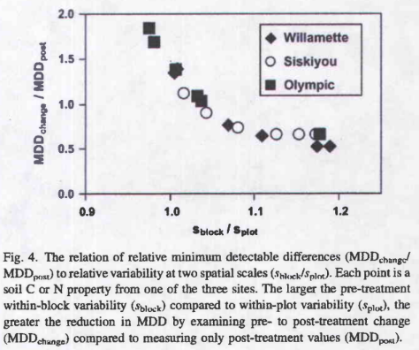
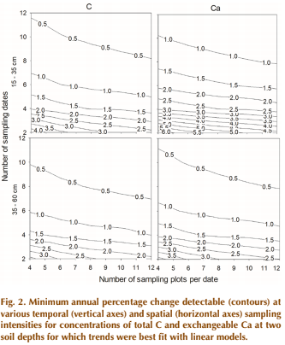
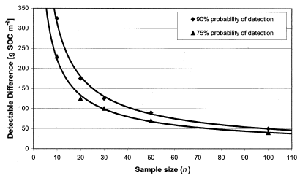
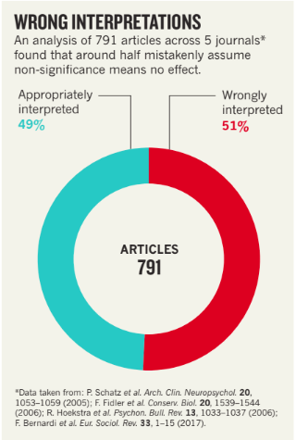
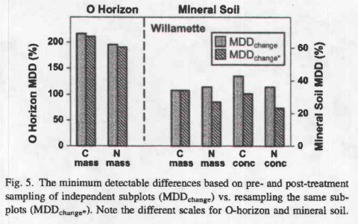
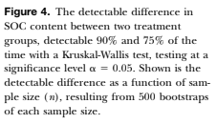



Never Say “There was no difference”-
Report the Magnitude of Change You Could Detect in Ecosystem Studies
Yang Yang¹, Alexandrea M. Rice², and Ruth D. Yanai²
¹Sierra Nevada Research Institute, 5200 Lake Rd., Merced, CA 95343
²SUNY-ESF, 1 Forestry Dr., Syracuse, NY 13210
Introduction
Limitations and concerns of relying on P values have been long recognized in the scientific community¹⁻³. However, the judgement of significant results during the peer-review process still heavily depends on the P value (threshold of 0.05), causing a small niche to publish “insignificant” studies. This is partially because authors are unaware of additional information they can report from the “non-significant” results. There is an importance in knowing whether the lack of a significant difference in a result is because the true difference is small or because variability is so high that only a very large difference would be statistically significant.
Recent review articles have explored reporting the reason for insignificant results by using other criteria such as effect size, confidence interval, Bayes factor and Akaike information criterion in biology and biomedical studies⁴⁻⁵. We are proposing that authors calculate and report the minimum detectable change (MDC), the smallest amount of change that can be detected given the current sample size and power, with their study results. A relationship of sample size and MDC can also be built based on the sample variance to inform future sampling designs. In this project, we reviewed the basic theory and current applications of calculating MDC in ecosystem studies.
Detect differences between treatments
Goal
Detect change over time
T-test
ANOVA
MDD$=N ×t_{[n\left( N−2\right)]}Sb\sqrt{\frac{1+p}{1−p}}$
MDD= $\sqrt{\frac{2s^{2}}{n}}{(t}_{α,v}+t_{β(1),v})$
MDD= $\sqrt{\frac{2ks^{2}ϕ^{2}}{n}}$
Relationships of power, MDC, sample size and cost
n= sample size; s²= variance
k= # treatments at each sampling date
ф= critical value based on α and β
n= sample size; s²= variance
N= # sample dates; n= sample size per sampling date
P= autocorrelation coefficient; S_{b}= standard deviation of slope
MDC with fixed power
Cost
Power to detect a change
“Eradicating categorization will help to halt overconfident claims, unwarranted declarations of “no difference”
And absurd statements about ‘replication failure’.”
Homann et al. 2008
Sample size
Poussart et al. 2004
Mobley et al. 2019
Lists of Ecosystem Articles Reporting MDC
Subject | Site | Data type | Study goal | Software | Reference
Soil Chemistry | Calhoun LTER | Repeated measures time series | Temporal changes | SAS (Mixed) and Mathematic equations | Mobley et al. 2019
Soil organic carbon | North-central United States; Sudan | Randomized completed block design; ANOVA | Treatment effects | SAS (Mixed) | Necpalova et al. 2014; Poussart et al. 2004
Soil carbon and nitrogen | Washington and Oregon, U.S.; Ontario, Canada and Illinois, U.S.; Hesse, Germany | Repeated Measures between two points in time | Treatment effects | Mathematic equations | Homann et al. 2008; Yang et al. 2008; Knebl et al. 2015
Tree roots | New Hampshire, U.S. | ANOVA | Method effects and spatial differences | Mathematic equations | Fahey et al. 2017
Sugarcane | South Africa | Repeated measures time series | Genotype differences | SAS (Mixed) | Zhou 2017
Fish | Michigan, U.S. | Time series |  | SAS (Mixed) | Wagner 2009
Earthworms | Germany and France | Blocked time series | MDD for Taxa and treatment effect | Mathematic equations | Andrade et al. 2017
Invertebrates | Germany | Blocked time series | Treatment effect | Mathematic equations | Wieczorek et al. 2016
Amrhei et al. 2019
Subject | Site | Data Type | Study Goal | Software | Reference | Other information?
Your Studies
(Please add)
Definitions
MDC/MDD- the smallest amount of change that can be detected given the sample size and power
Power-the ability of a test/study to detect a “true effect” that is different from the null hypothesis
References
1. Goodman SN. Toward evidence-based medical statistics, 1: the P value fallacy. Ann Intern Med. 1999;130(12):995-1004.
2. Goodman S. A dirty dozen: twelve p-value misconceptions. Semin Hematol. 2008;45(3):135-140.
3. Gelman A. P values and statistical practice. Epidemiology. 2013;24(1):69-72.
4. Chavalarias, D., Wallach, J.D., Li, A.H.T. and Ioannidis, J.P., 2016. Evolution of reporting P values in the biomedical literature, 1990-2015. Jama, 315(11), pp.1141-1148.
5. Halsey, L.G., 2019. The reign of the p-value is over: what alternative analyses could we employ to fill the power vacuum?. Biology letters, 15(5), p.20190174.
6. Amrhein, V., Greenland, S. and McShane, B., 2019. Scientists rise up against statistical significance.
7. Mobley, M.L., Yang, Y., Yanai, R.D., Nelson, K.A., Bacon, A.R., Heine, P.R., and D.D. Richter, 2019. How to Estimate Statistically Detectable Trends in a Time Series: A Study of Soil Carbon and Nutrient Concentrations at the Calhoun LTSE. Soil Science Society of America Journal, online
8. M. Necpálová, R.P. Anex, Jr., A.N. Kravchenko, L.J. Abendroth, S.J. Del Grosso, W.A. Dick, M.J. Helmers, D. Herzmann, J.G. Lauer, E.D. Nafziger, J.E. Sawyer, P.C. Scharf, J.S. Strock, and M.B. Villamil, 2014. What does it take to detect a change in soil carbon stock? A regional comparison of minimum detectable difference and experiment duration in the North-Central United States. Journal of Soil and Water Conservation, 69 (6), 517-531.
9. Poussart, J.N., Ardo, J., and L. Olsson, 2004. Verification of Soil Carbon Sequestration: Sample Requirements. Environmental Management, 33(1), 416-425
10. Homann, P.S., Bormann, B.T., Boyle, J.R., Darbyshire, R.L., and R. Bigley, 2008. C and N minimum detectable changes and treatment differences in a multi-treatment forest experiment. Forest Ecology and Management, 225, 1724- 1734.
11. Yang, X.M., Drury, C.F., Wander, M.M., and S.D. Kay, 2008. Evaluating the Effect of Tillage on Carbon Sequestration Using the Minimum Detectable Difference Concept. Pedosphere, 18(4), 421-430.
12. Knebl, L., Leithold, G., and C. Brock, 2015. Journal of Plant Nutrition and Soil Science, 178, 35-42.
13. Fahey, T.J., Yanai, R.D., Gonzales, K.E., and J.A. Lombardi, 2017. Sampling and processing roots from rocky forest soils. Ecosphere, 8(6), online.
14. M. Zhou, 2015. Minimum detectable differences for cane yield, sucrose content and sugar yield among the Midlands and Coastal Short Cycle sugarcane breeding programmes in South Africa, South Africa Journal of Plant and Soil, 322(3), 175-182.
15. T. Wagner, 2009. Evaluating the Power to Detect Temporal Trends in Fishery- Independent Surveys: A Case Study Based on Gill Nets Set in the Ohio Waters of Lake Erie for Walleyes. North American Journal of Fisheries Management, 29, 805-816.
16. Andrade, T.O., Bergtold, M., and P. Kabouw, 2017. Minimum significant differences (MSD) in earthworm field studies evaluation potential effects of plant protection products. Journal of Soils and Sediments, 17, 1706-1714.
17. Wieczorek, M.V., Bakanov, N., Stang, C., Bilancia, D., And L. Lagadic, 2016. Reference scenarios for exposure to plant protection products and invertebrate communities in stream mesocosms, 545-546, 308-319.
Notes:
Make title bigger and authors smaller

