Slide 1
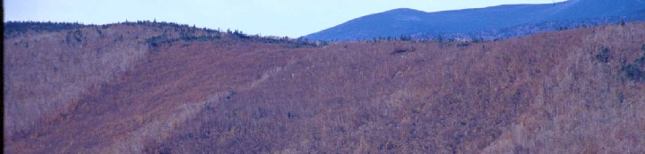




Long-term trends in uncertainty of element fluxes at the Hubbard Brook Experimental Forest
Mark Green, Donald Buso, John Campbell, Carrie Rose Levine, Gene Likens, Ruth Yanai

Slide 2
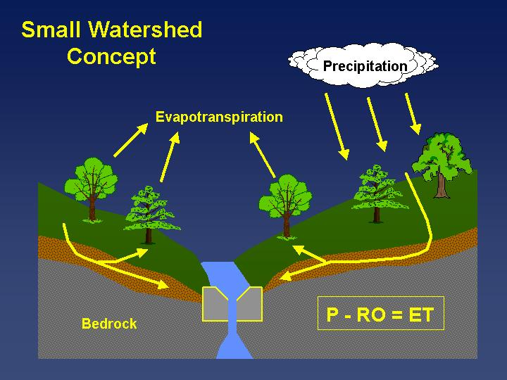

Slide 3

Element Fluxes
: Flux [mass per time]
: Concentration [mass per volume]
: Concentration [volume per time]

Slide 4
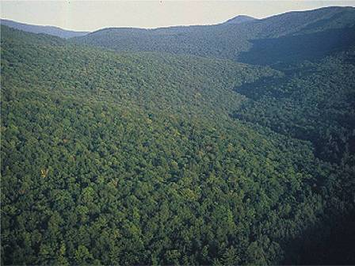
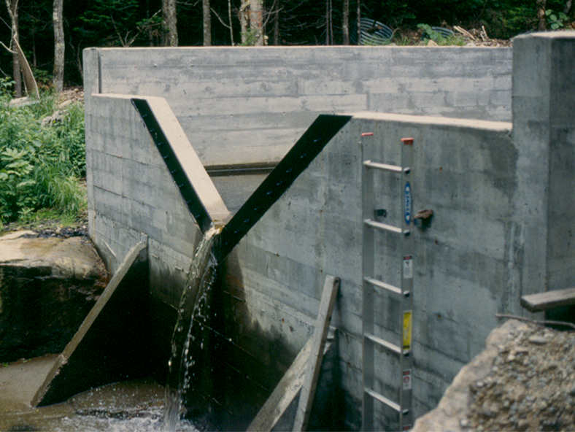
Hubbard Brook Experimental Forest
White Mountain National Forest, NH
Hubbard Brook
White Mtn. Natl. Forest
New Hampshire
Map courtesy of Dr. John Campbell, USFS

Slide 5
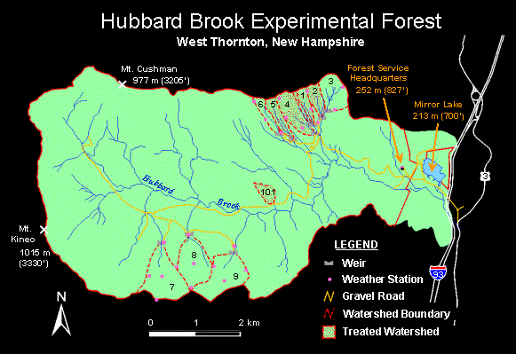

Slide 6
Our Guiding Questions
Objective
Propagate some sources of uncertainty through flux estimates.
How certain are our flux signals?
Is there new information that may arise from quantifying uncertainty?

Slide 7
Approach
Quantify uncertainty in annual fluxes into and out from Watershed 6 at HBEF
  Nitrate
  Silicon
Only a few sources of uncertainty are addressed so far

Slide 8
UNCERTAINTY
Natural Variability
Knowledge Uncertainty
Spatial Variability
Measurement Error
Temporal Variability
Model Error
Modified from Harmon et al. (2007)

Slide 9
Model Selection Uncertainty

Slide 10
Weekly Average
Streamwater
Concentration
Time

Slide 11
Linear Interpolation
Streamwater
Concentration
Time

Slide 12
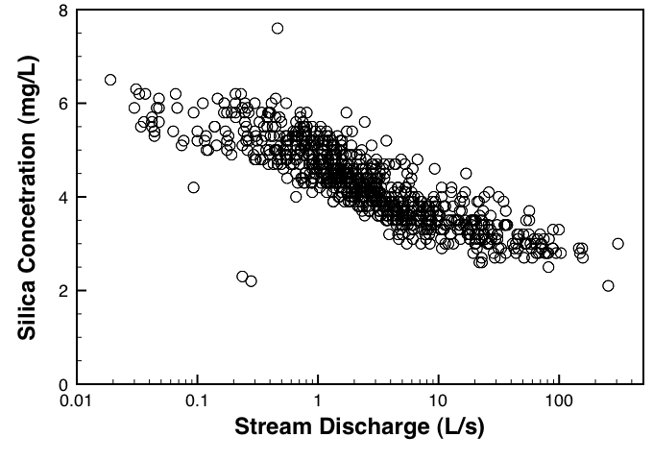

Slide 13
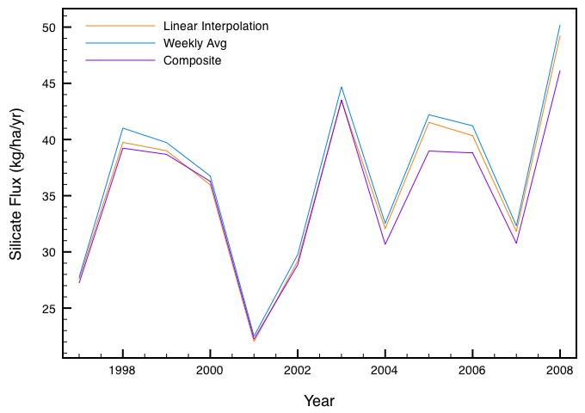
-1.9%
-3.7%
Notes:
Some systematic differences. Interpolation is 1.9% lower than weekly average. Composite is 3.7 lower than the weekly average.

Slide 14
Model Parameter Uncertainty

Slide 15
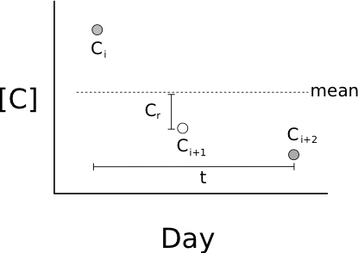

Slide 16
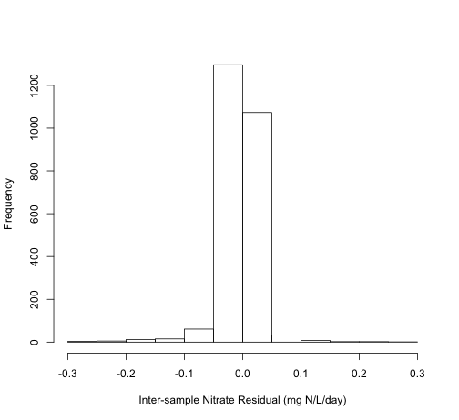

Slide 17
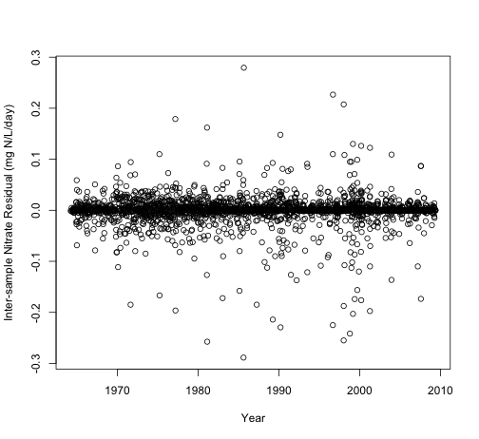

Slide 18
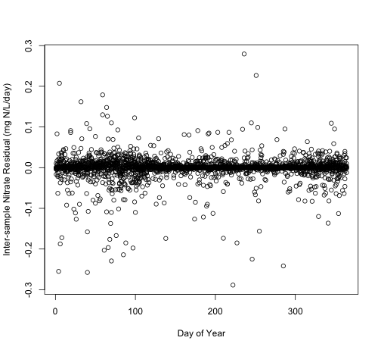

Slide 19
Steps in Flux Calculation
For every gap between samples:
Calculate mean concentration
Determine the inter-sample residuals based on season and date
Add a bootstrapped residual to the mean
Calculate annual flux

Slide 20
Nitrate

Slide 21
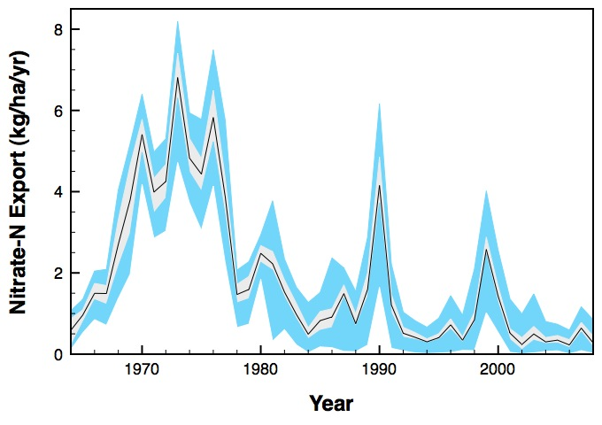

Slide 22
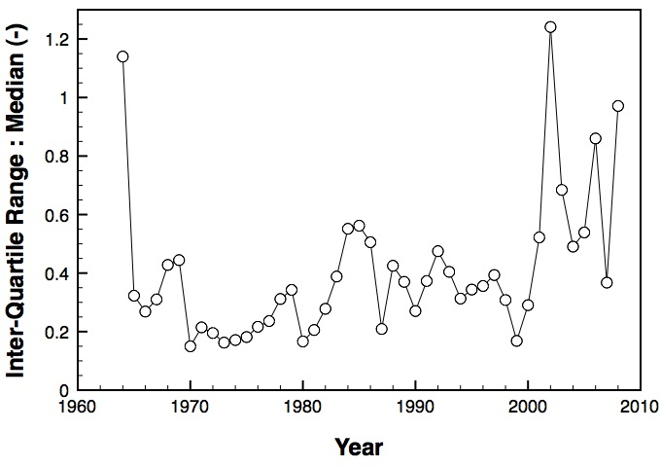

Slide 23
Silica

Slide 24
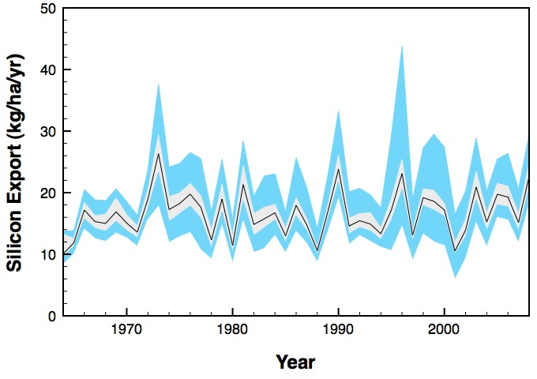

Slide 25
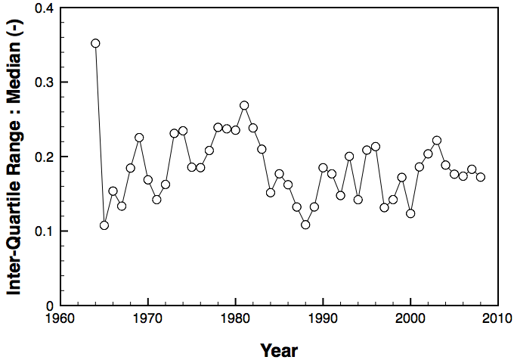

Slide 26
Summary
Nitrate
Uncertainty in model selection: 3%
Uncertainty in inter-sample mean: 17%
Silicon
Uncertainty in inter-sample mean: 9%
Maybe novel information in IQR:Median

Slide 27
Next: More sources in streamwater, finalize precipitation, and propagate to net hydrologic flux.

Slide 28

http://quantifyinguncertainty.org/

Slide 30
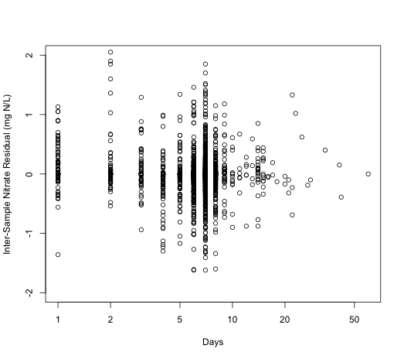

Slide 31
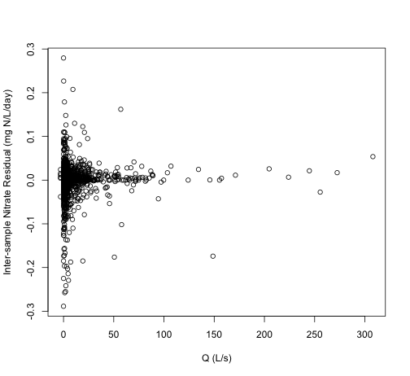

Slide 32
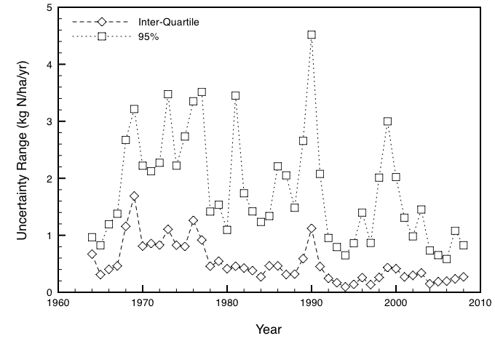

Slide 33
Atmospheric Inputs
UNCERTAINTY
Natural Variability
Knowledge Uncertainty
Spatial Variability
Measurement Error
Temporal Variability
Model Error
Modified from Harmon et al. (2007)

Slide 34
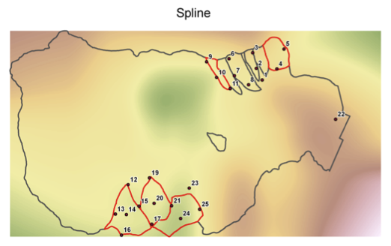
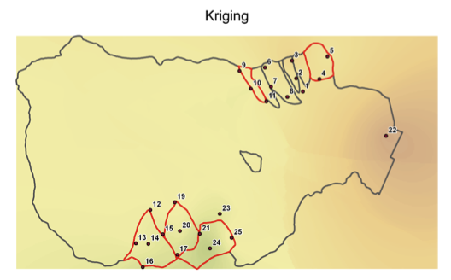
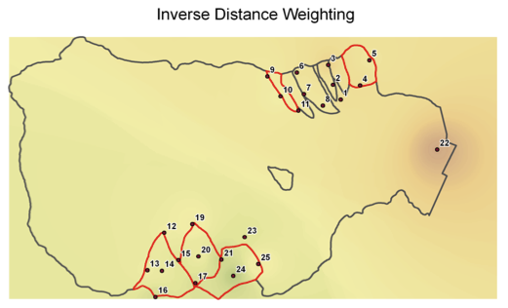
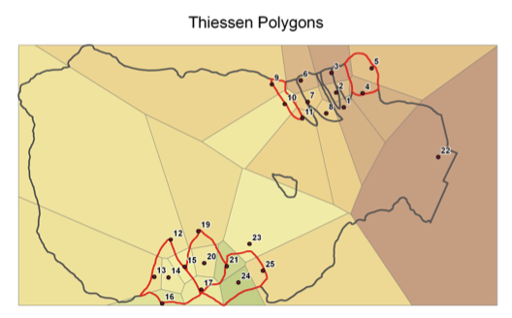
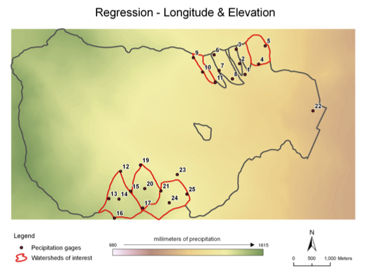
Alternative spatial models for precipitation in the Hubbard Brook Valley
Notes:
These are 5 models of precipitation in the HB valley, using built-in models in ARC GIS. We can see that each is interpolating between the rain gauges differently.

Slide 35
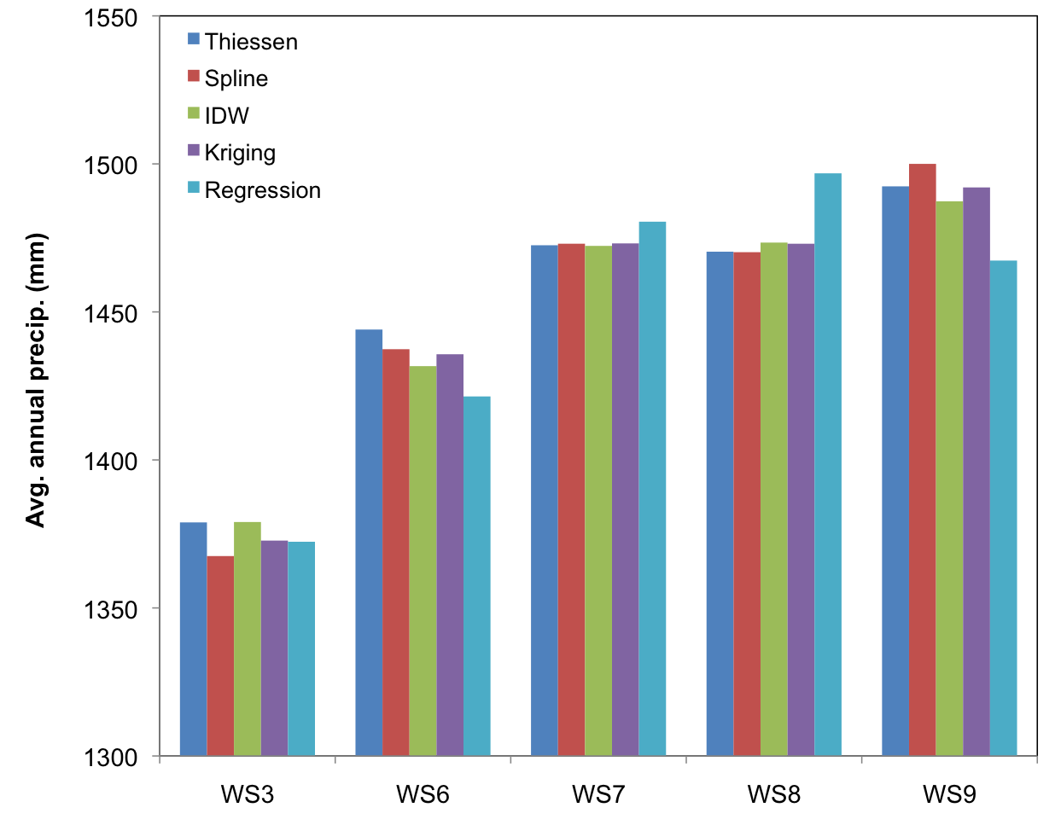
Alternative spatial models for precipitation in the Hubbard Brook Valley
Coefficient of variation between models
0.77%
0.83%
0.24%
0.58%
0.36%
Notes:
When we compare the estimates of the different models for the whole valley, we see that there is low variation between the models. Next, we will be working on how to estimate the uncertainty not just between the models, but also within each model.

