Slide 1
Uncertainty Workshop – addressing experimental design, standardization, and modeling
Module 2. Quantify uncertainty and uncertainty budgets
H. LOESCHER, J CSAVINA
Notes:
Differs from NEON Engagement Strategy (Gene Kelly) although overlap in practice

Slide 2
Overview
Epistemology and the Philosophy of science
2nd Law of Thermodynamics
Signal to Noise
Importance of Uncertainty
  3 Examples
Communicating Uncertainty
Notes:
“uncertainty” is not sexy

Slide 3
How do we know what we know?
Epistemology – branch of philosophy concerned with the theory and meaning of knowledge
What are the necessary and sufficient conditions of knowledge?
What are its sources?
What is its structure, and what are its limits?
Epistemon; whose name is Greek for scientist.
Belief structures - exterior v interior forms of knowledge,
perception v experience etc.
Sources of Knowledge and Justification
a Priori Justification an Empirical Testing of the Physical (Biological) world = direct access to knowledge
see plato.stanford.edu/entries/epistemology/
Notes:
S is justified a priori in believing that p if and only if S's justification for believing that p does not depend on any experience.

Slide 4
How do we know what we know?
Science =
a system of acquiring knowledge and its associated body of knowledge.
scientific method =
formulation of a hypothesis,
observational/experimental design to test the validity of the hypothesis.
observation of a phenomenon,
test/validate/reject/predict of future outcomes or other phenomena,
Reproducibility
Basic Assumption: the basic laws of the nature are unchangeable
where, DS is the total entropy of a closed system, s is the entropy from individual entities within the system (e.g., activation energy), T is the temperature entering the system, t is time, Q is the heat flow into the system, Si is the sum of the rate of entropy production, and Pdiss is the rate of dissipation energy.
Notes:
This system uses observation and experimentation to describe and explain natural phenomena.
S is justified a priori in believing that p if and only if S's justification for believing that p does not depend on any experience.

Slide 5
Second Law of Thermodynamics
where, DS is the total entropy of a closed system, s is the entropy from individual entities within the system (e.g., activation energy), T is the temperature entering the system, t is time, Q is the heat flow into the system, S_{i} is the sum of the rate of entropy production, and P_{diss} is the rate of dissipation energy.
Distribution of energy = signal : nosie
Holds true for physical phenomena (abiotic processes):
  electro magnetic spectrum
Holds true for biotic processes:
  enzymatic activation
* * Exceptions: behavior, fecundity
where, DS is the total entropy of a closed system, s is the entropy from individual entities within the system (e.g., activation energy), T is the temperature entering the system, t is time, Q is the heat flow into the system, Si is the sum of the rate of entropy production, and Pdiss is the rate of dissipation energy.
Notes:
This system uses observation and experimentation to describe and explain natural phenomena.
S is justified a priori in believing that p if and only if S's justification for believing that p does not depend on any experience.

Slide 6
‘Signal’ and ‘Noise’
Signal =
Mean or central tendency of a phenomena
Source is assumed to be a single phenomena
May be a combination of multiple phenomenon
Assumed ‘Truth’ is contained in the signal
Noise =
Cannot measure ‘Truth’ onto itself, always shave ‘noise’
‘Noise’ is inherent in any measurement or observation
Estimates the controls on the ‘signal’
Many sources to ’noise’: random, multiple systematic, non-stationarity
Places the limits and constraints on data re-use
Signal:Noise =
Informs experimental/observational design
a priori parameterization of Bayesian approaches

Slide 7
Importance of Uncertainty
Statistically Defensible Research (PI based research)
Measure by which Reproducibility can be Evaluated
Comparative Science / Justification for Network Science
Data re-use, model information/parameterization, synthesis studies
Reporting Actionable Science / Decision-space
Interoperability
Ecological Forecasting / Bayesian Modeling / Data Assimilation

Slide 8
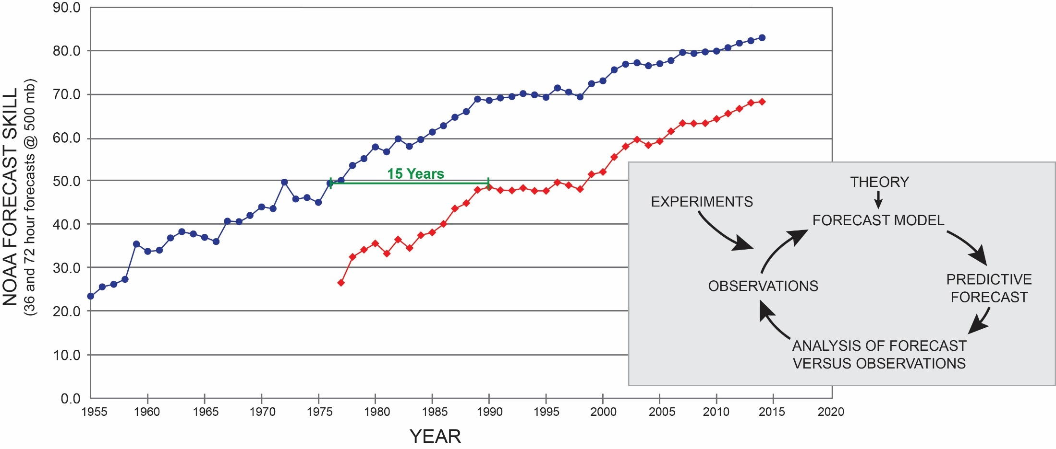
Ecological Forecasting
Improvements in NOAA weather forecasts come from repeated comparison between data and forecasts
Loescher, H. W., E. Kelly, and R. Lea, 2016. National Ecological Observatory Network: Beginnings, Programmatic and Scientific Challenges, and Ecological Forecasting. In: Terrestrial Ecosystem Research Infrastructures: Challenges, New developments and Perspectives. Eds. A. Chabbi, H.W. Loescher. CRC Press Taylor & Francis Group. (in copy edit)

Slide 9
Integration of Networks
Infrastructure
Onsite Experience
Site-specific Understanding
Notes:
Each type of research has its unique strengths.
What has been lacking in the past, is the consistent long term observations at the Continental scale
All are needed to advance ecology

Slide 10
Interoperabilty
1.
Aligning Science Questions and Hypotheses, Requirements, Mission Statements
Mapping Questions to ‘what must be done’
Defines Joint Science Scope / Knowledge Gaps
define interfaces among respective Infrastructures
2.
Traceability of Measurements
Use of Recognized Standards
Traceability to Recognized Standards, or First Principles
Known and managed signal:noise
Managing QA/QC
Uncertainty budgets
3.
Algorithms/Procedures
What is the algorithm or procedural process to create a data product?
Provides “consistent and compatible” data
Managed through intercomparisons
What are their relative uncertainties?
4.
Informatics
Standards – Data / Metadata formats
Persistent Identifiers / Open-source
Discovery tools / Portals
Ontologies, semantics and controlled vocabularies
Notes:
We saw in several of the talks the societal need to ”reduce uncertainty”, ”provide actionble data”,

Slide 11
Communicating Uncertainty
Becomes a scale problem
PI – based Research
Clearly having the the correct statistical approach (signal : noise)
Using Internationally accepted approaches reporting (ISO, GUM, etc.)
Observatory and Network Science
Clear, consistent reporting / International standards for reporting
Identification of the sources of the ‘noise’
Provides the constraints for data re-use
Actionable Science
Scientists do not know how to communicate uncertainty to non-experts
Uncertainty means different things to governments > municipalities > individuals
Public needs to be educated (responsibly fall on all parties)
Without clear consistent messaging, uncertainty reverts back to a belief system
Notes:
Use the example of the IPCC dis-service to the public

Slide 12


