Slide 1
Module 3: Monte Carlo Error Propagation
Oswaldo Carrillo
Ruth Yanai
The State University of New York

Slide 2
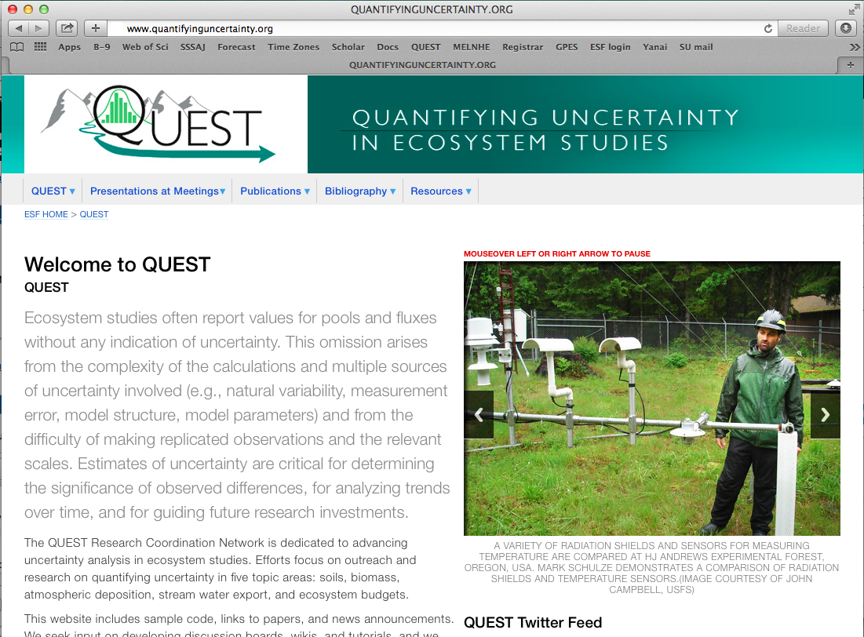


Join QUEST!
Visit our website: www.quantifyinguncertainty.org
  Download papers and presentations
  Share sample code
  Stay updated with QUEST News
Join our mailing list (quantifyinguncertainty@gmail.com)
Write papers for special issues in Ecosphere and SSSAJ
Follow us on Twitter @QUEST_RCN
Notes:
I don’t think I’ve told you anything new about weathering or the effects of harvesting on cation depletion. But I hope I’ve piqued your interest in uncertainty analysis

Slide 3
Classification of Sources of Uncertainty
UNCERTAINTY
Natural Variability
Knowledge Uncertainty
Spatial Variability
Measurement Error
Temporal Variability
Model Error
Adapted from Harmon et al. (2007)
Notes:
Could improve here

Slide 4
Exercise in Excel of Monte Carlo Error Propagation
Objective
  We want to propagate the several sources of error in the biomass average estimation of a type of forest
Inputs
  Measurement error
  Allomentric equations parameters
  Sampling error

Slide 5
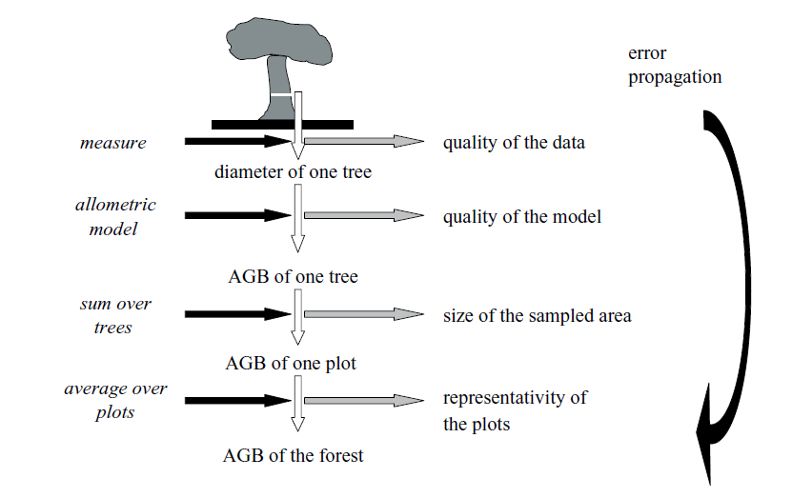
Sources of uncertainties in biomass estimation
Sources of errors in estimating biomass of forest
(Chave, 2004)
In the context of national Green House Gases (GHG) inventory for the forest sector, the estimation of carbon stocks and carbon stock changes of Above Ground Biomass (AGB) needs a quantification of different sources of uncertainties and its correct propagation according to the Guidelines of Good Practice of the Inter-Government Panel for Climate Change (IPCC).
So, a complete uncertainties analysis for AGB needs in first place the quantification of the uncertainties of each source and then the propagation of these.

Slide 6
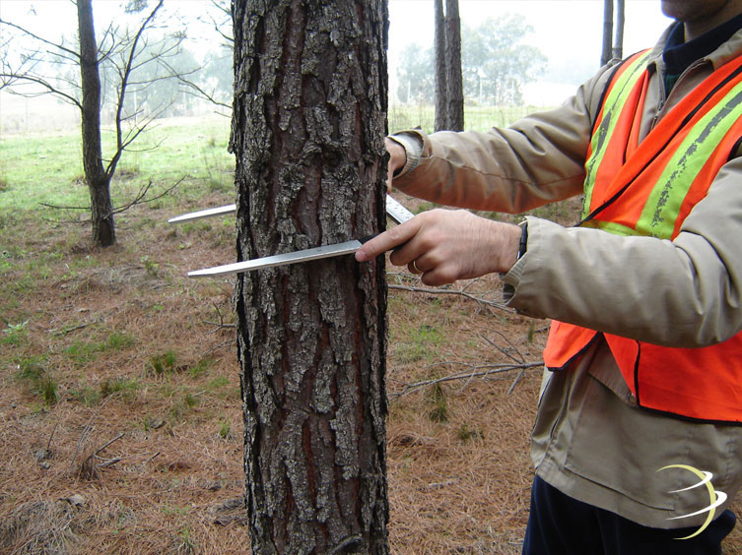
Sources of uncertainties in biomass estimation
Measurement error
  The AGB is typically estimated in indirectly through the Diameter at Breast Height (DBH).
  DBH measurement is subject to different sources of error like:
  The one associated to the errors in the instrument of measurement,
  to the measuring process, and
  to the skill of the team, among others
  it is possible to measure the same trees 2 times (with different teams) and then quantify the differences between the two measurements of DBH.

Slide 7
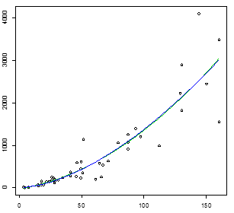
Sources of uncertainties in biomass estimation
Errors in allometric models
  Models are a representation of reality and in the case of allometric models these try to estimate the AGB through a biometric variable like the DBH, Height among others.
  With a different sample, the the model will change slightly because the model is being built only with a sample and not with the whole population.
  Thus the biomass estimations are obtained through models that are subject to model error.

Slide 8
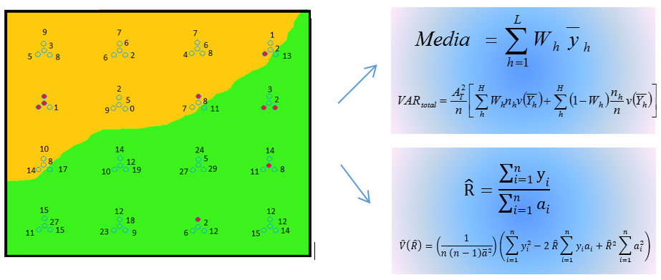
Sources of uncertainties in biomass estimation
Sampling error
  When we obtain an estimate of biomass through trees measured in different plots, there is a source of error associated to the natural variability between different stocks of biomass at a plot level.
  This source of error is called sampling error and is the source of uncertainty that is most often quantified.
  The way to estimate sampling error depends on the sampling design.

Slide 9
The Monte Carlo method
  There are analytical solutions to simple cases of error propagation. For example, the variance of a sum is the sum of the variances of the individual terms, if the terms can be assumed to be independent.
  In the case of forest biomass, however, the calculations are too complex to be solved analytically. Instead, we propagated uncertainties for the errors in measurement and the allometric model in a nested way. In other words, first some variations are generated from DBH through measurement errors and these random values of DBH are used in the allometric models.

Slide 10
Process to propagate uncertainties in Excel
Process to obtain the measurement error
Process to obtain the parameters of models.
Process to propagate uncertainties of the measurement errors and the allometric models.

Slide 11
Process to propagate uncertainties in Excel
Process to obtain the measurement error
  Let's suppose we have a set of trees measured by different teams at different times. Taking into account that information we proceed as follows:
  First we capture in an excel column the DBH measured by Team 1
  Then in another excel column we capture DBH measured by Team 2.
  After that, we get the difference between the measurements and
  Finally, we obtain the standard deviation of the differences
DBH_team1 | DBH_team2 | Diference_DBH
24.90 | 24.89 | 0.01
9.20 | 9.27 | -0.07
11.00 | 11.04 | -0.04
11.70 | 11.73 | -0.03
23.30 | 23.29 | 0.01
8.70 | 8.73 | -0.03
11.20 | 11.22 | -0.02
sd_diferece_DBH 0.05

Slide 12

Process to propagate uncertainties in Excel
Process to obtain the model parameters
  First, let’s suppose we have data from a destructive sample of 48 trees that were cut down and weighed. In the first column, starting from row 14, we show the IDs of 48 trees that were cut down, in column B the DBH (cm) of each of the sampled trees and in column C the measured biomass from each of the trees (kg).
With this information, we proceed to run a regression:
B=exp^(a + b*ln(DBH))
We can simplify this model in this form:
ln(B)= a + b*ln(DBH)
A | B | C
Id_tree | DBH | Biomass_kg
1 | 19.09 | 68.0
2 | 31 | 179.4
3 | 21.64 | 139.2
4 | 40.87 | 369.4
5 | 28.17 | 213.3

Slide 13
Process to propagate uncertainties in Excel
Process to obtain the parameters model
In that case, to fit this model, its necessary to obtain the natural logarithm of biomass and the DBH shown in columns D and E.
A | B | C | D | E
Id_tree | DBH | Biomass_kg | ln(Biomass_kg) | ln(DBH)
1 | 19.09 | 68.0 | 4.2 | 2.95
2 | 31 | 179.4 | 5.2 | 3.43
3 | 21.64 | 139.2 | 4.9 | 3.07
4 | 40.87 | 369.4 | 5.9 | 3.71
5 | 28.17 | 213.3 | 5.4 | 3.34

Slide 14
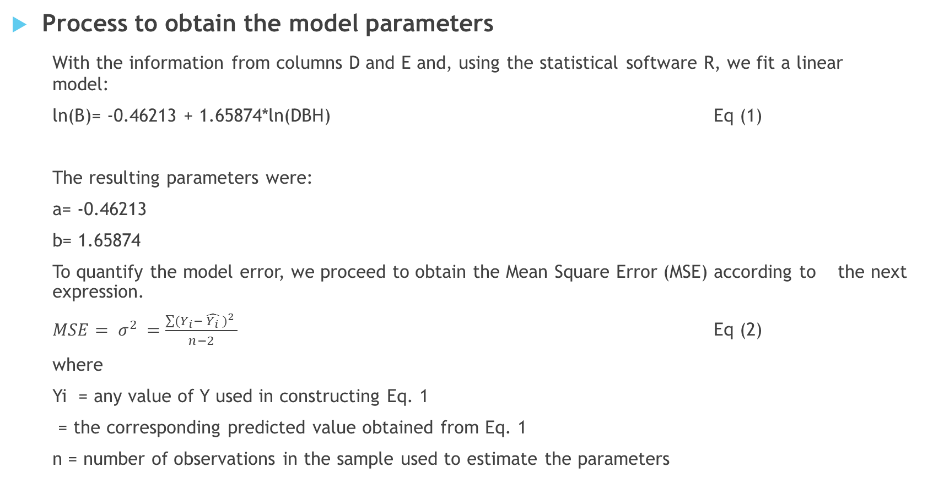
Process to propagate uncertainties in Excel
Process to obtain the model parameters
With the information from columns D and E and, using the statistical software R, we fit a linear model:
ln(B)= -0.46213 + 1.65874*ln(DBH) Eq (1)
The resulting parameters were:
a= -0.46213
b= 1.65874
To quantify the model error, we proceed to obtain the Mean Square Error (MSE) according to the next expression.
$MSE= σ^{2 }=\frac{\sum{{(Y_{i}− \hat{Y_{i}} )}^{2 }}}{n−2}$ Eq (2)
where
Yi = any value of Y used in constructing Eq. 1
= the corresponding predicted value obtained from Eq. 1
n = number of observations in the sample used to estimate the parameters

Slide 15
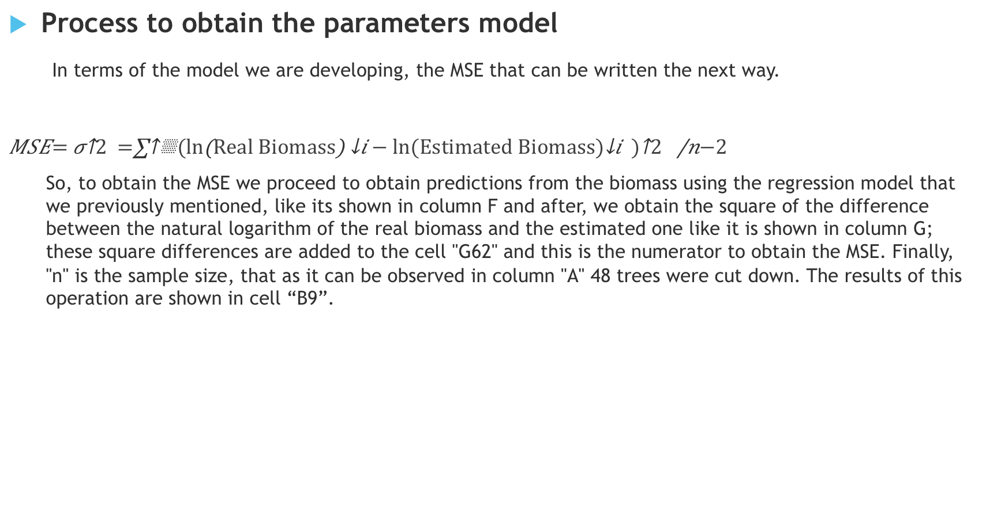
Process to propagate uncertainties in Excel
Process to obtain the parameters model
In terms of the model we are developing, the MSE that can be written the next way.
$$MSE= σ^{2 }=\frac{\sum{{({\ln\left(Real Biomass\right)}_{i}− {ln⁡(Estimated Biomass)}_{i} )}^{2 }}}{n−2}$$
  So, to obtain the MSE we proceed to obtain predictions from the biomass using the regression model that we previously mentioned, like its shown in column F and after, we obtain the square of the difference between the natural logarithm of the real biomass and the estimated one like it is shown in column G; these square differences are added to the cell "G62" and this is the numerator to obtain the MSE. Finally, "n" is the sample size, that as it can be observed in column "A" 48 trees were cut down. The results of this operation are shown in cell “B9”.
A | B | C | D | E | F | G
Id_tree | DBH | Biomass_kg | ln(Biomass_kg) | ln(DBH) | Estimated Biomass (Yi_est) | (Yi-Yi_est)^2
1 | 19.09 | 68.0 | 4.2 | 2.95 | 4.43 | 0.04439
2 | 31 | 179.4 | 5.2 | 3.43 | 5.23 | 0.00195
3 | 21.64 | 139.2 | 4.9 | 3.07 | 4.64 | 0.08871
4 | 40.87 | 369.4 | 5.9 | 3.71 | 5.69 | 0.04814
5 | 28.17 | 213.3 | 5.4 | 3.34 | 5.08 | 0.08261

Slide 16
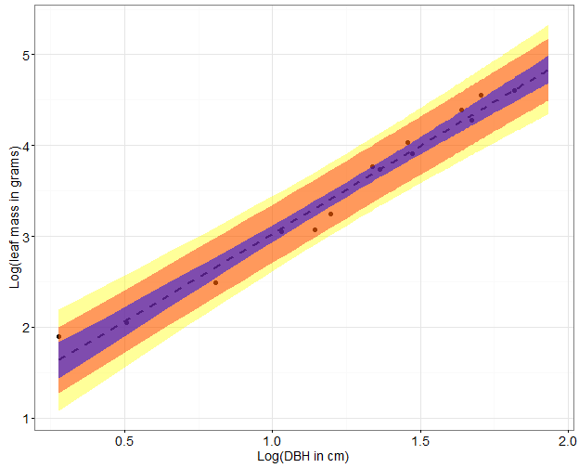
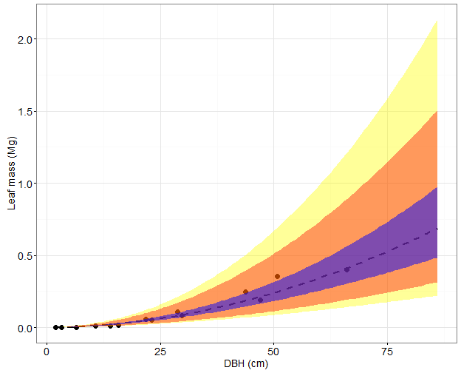

Process to propagate uncertainties in Excel
Process to obtain the parameters model
Now we have all the necessary information to get the:
Error in prediction of the mean (${Var\hat{Y}}_{0,mean}$):
${ Var\hat{Y}}_{0,mean}=σ^{2}\left(\frac{1}{n}+\frac{{(X_{0}−\overline{X)}}^{2}}{{\sum{\left(X_{i}−\overline{X}\right)}}^{2}}\right)$ (3)
Error in prediction of an individual (${Var\hat{Y}}_{0})$:
${ Var\hat{Y}}_{0}=σ^{2}\left(1+\frac{1}{n}+\frac{{(X_{0}−\overline{X)}}^{2}}{{\sum{\left(X_{i}−\overline{X}\right)}}^{2}}\right)$ (4)
We now have the $σ^{2 }=MSE$ y $n$; so now we only need to know:
$\overline{X}$ which is the average DBH of the sample used to develop the model
${\sum{\left(X_{i}−\overline{X}\right)}}^{2}$ which is the sum of the squared deviations of x.
It is worth mentioning, that to obtain $\overline{X}$ we simply need to obtain the average of the DBH from column "B" and this value is stored in the cell B10.

Slide 17
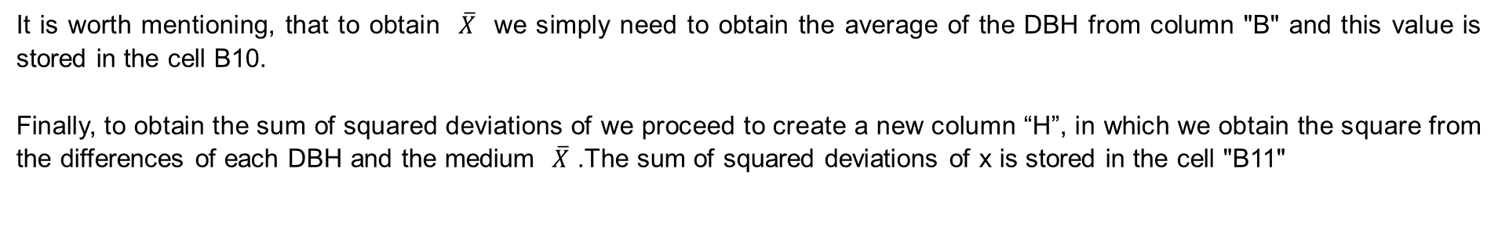
Process to propagate uncertainties in Excel
Process to obtain the parameters model
It is worth mentioning, that to obtain $\overline{X}$ we simply need to obtain the average of the DBH from column "B" and this value is stored in the cell B10.
Finally, to obtain the sum of squared deviations of we proceed to create a new column “H”, in which we obtain the square from the differences of each DBH and the medium $\overline{X}$ .The sum of squared deviations of x is stored in the cell "B11"
A | B | C | D | E | F | G | H
Id_tree | DBH | Biomass_kg | ln(Biomass_kg) | ln(DBH) | Estimated Biomass (Yi_est) | (Yi-Yi_est)^2 | (Xo-Xmean)^2
1 | 19.09 | 68.0 | 4.2 | 2.95 | 4.43 | 0.04439 | 2.64
2 | 31 | 179.4 | 5.2 | 3.43 | 5.23 | 0.00195 | 1.30
3 | 21.64 | 139.2 | 4.9 | 3.07 | 4.64 | 0.08871 | 2.25
4 | 40.87 | 369.4 | 5.9 | 3.71 | 5.69 | 0.04814 | 0.75
5 | 28.17 | 213.3 | 5.4 | 3.34 | 5.08 | 0.08261 | 1.53

Slide 18
Process to propagate uncertainties in Excel
Process to propagate uncertainties of the measurement errors and the allometric models
Once we have the error in measurement and the model parameters, these are sent to call on the tab "Biomass calculation" to propagate the uncertainties of measurement error and the allometric models.
This way, in the cell A7 we find the measurement error that we have just calculated, in the cells A13 and A18 the statistics of the adjusted model are indicated.
In one way, we create the switches shown in the blue cells with which each source of uncertainty can be turned on or off by changing the numbers in the blue boxes to " 1 " or " 0".

Slide 19
Process to propagate uncertainties in Excel
Process to propagate uncertainties of the measurement errors and the allometric models
So then, with all this information, it is possible to estimate the errors "PI" and "CI", however, to get this, first it is necessary to create the column "C" where the DBH with the error in measurement is included. Afterwards, this variable is transformed by applying the natural logarithm (as we can see in column “D”).
A | B | C | D
Plot | Tree diameter | DBH with measurement error | ln(DBH)
1.00 | 24.90 | 24.9 | 3.2
1.00 | 9.20 | 10.0 | 2.3
1.00 | 11.00 | 11.0 | 2.4
1.00 | 11.70 | 11.1 | 2.4
1.00 | 23.30 | 23.3 | 3.1

Slide 20
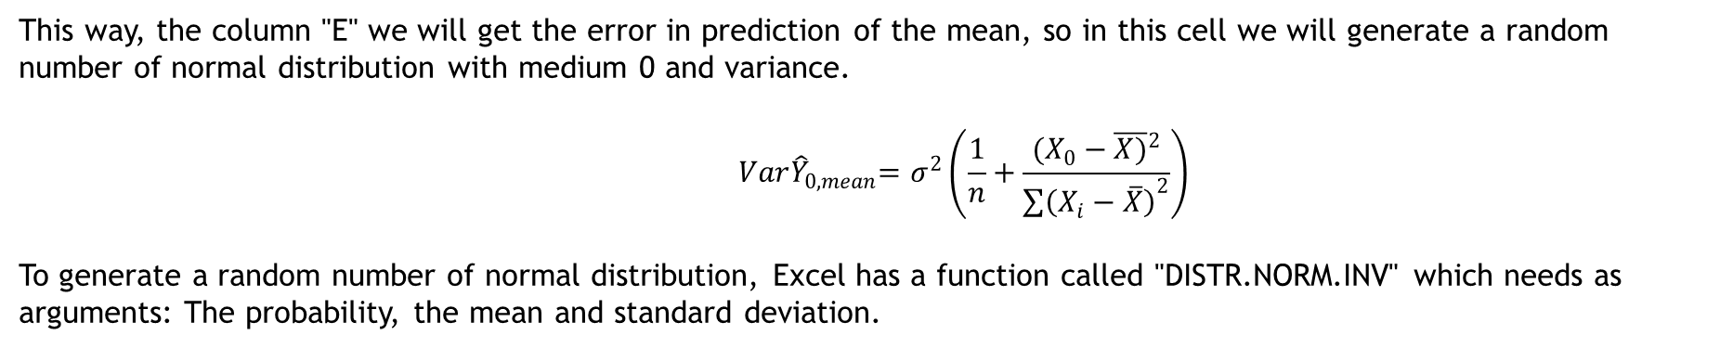
Process to propagate uncertainties in Excel
Process to propagate uncertainties of the measurement errors and the allometric models
This way, the column "E" we will get the error in prediction of the mean, so in this cell we will generate a random number of normal distribution with medium 0 and variance.
$${ Var\hat{Y}}_{0,mean}=σ^{2}\left(\frac{1}{n}+\frac{{(X_{0}−\overline{X)}}^{2}}{{\sum{\left(X_{i}−\overline{X}\right)}}^{2}}\right)$$
To generate a random number of normal distribution, Excel has a function called "DISTR.NORM.INV" which needs as arguments: The probability, the mean and standard deviation.
A | B | C | D | E
Plot | Tree diameter | DBH with measurement error | ln(DBH) | Error in prediction of the mean
1.00 | 24.90 | 24.9 | 3.2 | 0.0
1.00 | 9.20 | 9.2 | 2.2 | 0.1
1.00 | 11.00 | 11.8 | 2.5 | 0.1
1.00 | 11.70 | 11.3 | 2.4 | 0.2
1.00 | 23.30 | 23.4 | 3.2 | 0.0

Slide 21
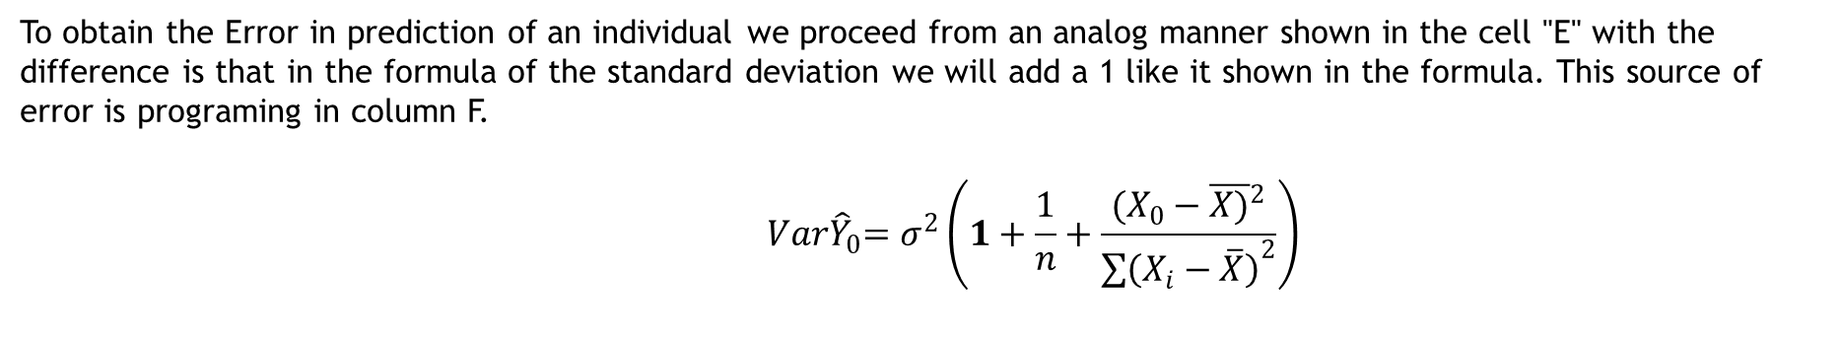
Process to propagate uncertainties in Excel
Process to propagate uncertainties of the measurement errors and the allometric models
To obtain the Error in prediction of an individual we proceed from an analog manner shown in the cell "E" with the difference is that in the formula of the standard deviation we will add a 1 like it shown in the formula. This source of error is programing in column F.
$${ Var\hat{Y}}_{0}=σ^{2}\left(1+\frac{1}{n}+\frac{{(X_{0}−\overline{X)}}^{2}}{{\sum{\left(X_{i}−\overline{X}\right)}}^{2}}\right)$$
A | B | C | D | E | F
Plot | Tree diameter | DBH with measurement error | ln(DBH) | Error in prediction of the mean | Error in prediction of an indivual
1.00 | 24.90 | 24.9 | 3.2 | 0.0 | 0.2
1.00 | 9.20 | 9.2 | 2.2 | 0.1 | 0.0
1.00 | 11.00 | 11.8 | 2.5 | 0.1 | 0.1
1.00 | 11.70 | 11.3 | 2.4 | 0.2 | -0.6
1.00 | 23.30 | 23.4 | 3.2 | 0.0 | 0.4

Slide 22
Process to propagate uncertainties in Excel
Process to propagate uncertainties of the measurement errors and the allometric models
Once both sources of error are estimated, in column “G” we estimate the natural logarithm of the biomass including the 2 sources of error and linking them to the switches indicated in the cells D19 and D23.
A | B | C | D | E | F | G
Plot | Tree diameter | DBH with measurement error | ln(DBH) | Error in prediction of the mean | Error in prediction of an indivual | ln(biomass1_2)
1.00 | 24.90 | 24.9 | 3.2 | 0.0 | 0.2 | 5.1
1.00 | 9.20 | 9.2 | 2.2 | 0.1 | 0.0 | 3.3
1.00 | 11.00 | 11.8 | 2.5 | 0.1 | 0.1 | 3.9
1.00 | 11.70 | 11.3 | 2.4 | 0.2 | -0.6 | 3.2
1.00 | 23.30 | 23.4 | 3.2 | 0.0 | 0.4 | 5.2

Slide 23
Process to propagate uncertainties in Excel
Process to propagate uncertainties of the measurement errors and the allometric models
Finally, because all these estimations have been obtained in the logarithmic scale, now it is only necessary to transform to the original units.
These estimations are a first iteration, so to propagate uncertainties at plot we use thousands of iterations with which we obtain confidence intervals including both the CI and the PI. While this is possible in Excel, this process is very slow, so this exercise will be made in R.
A | B | C | D | E | F | G | H
Plot | Tree diameter | DBH with measurement error | ln(DBH) | Error in prediction of the mean | Error in prediction of an indivual | ln(biomass1_2) | biomass (kg)
1.00 | 24.90 | 24.9 | 3.2 | 0.0 | 0.2 | 5.1 | 157.7
1.00 | 9.20 | 9.2 | 2.2 | 0.1 | 0.0 | 3.3 | 26.9
1.00 | 11.00 | 11.8 | 2.5 | 0.1 | 0.1 | 3.9 | 47.1
1.00 | 11.70 | 11.3 | 2.4 | 0.2 | -0.6 | 3.2 | 23.5
1.00 | 23.30 | 23.4 | 3.2 | 0.0 | 0.4 | 5.2 | 180.0

Slide 24
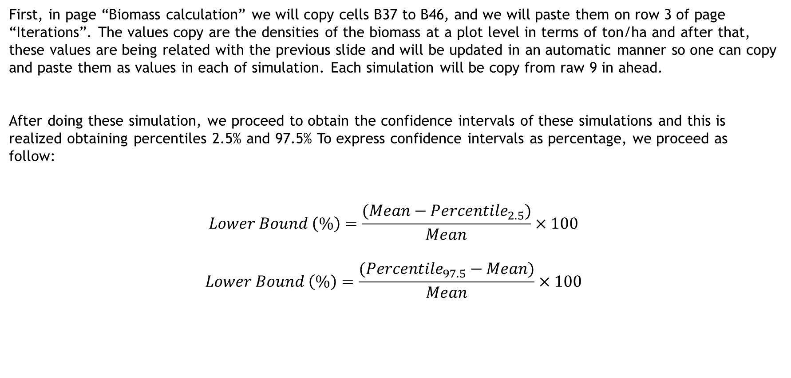
Process to propagate uncertainties in Excel
Process to propagate uncertainties at plot level
First, in page “Biomass calculation” we will copy cells B37 to B46, and we will paste them on row 3 of page “Iterations”. The values copy are the densities of the biomass at a plot level in terms of ton/ha and after that, these values are being related with the previous slide and will be updated in an automatic manner so one can copy and paste them as values in each of simulation. Each simulation will be copy from raw 9 in ahead.
After doing these simulation, we proceed to obtain the confidence intervals of these simulations and this is realized obtaining percentiles 2.5% and 97.5% To express confidence intervals as percentage, we proceed as follow:
$$Lower Bound \left(\%\right)=\frac{(Mean−{Percentile}_{2.5})}{Mean}×100$$
$$Lower Bound \left(\%\right)=\frac{({Percentile}_{97.5}−Mean)}{Mean}×100$$

Slide 25
Process to propagate uncertainties in R
Process to propagate uncertainties at plot level
The process shown above was also programed in R statistical software.
First, load library “doBy”.
Then indicate the address folder
In “Module 2” the parameters model are read
In “Module 3” are estimated the measurement error, Error in prediction of the mean, Error in prediction of an induvial and uncertainties are propagated at plot level. To do that, the script in R does the following:
  The number of simulations is defined
  Tree diameter with measurement error is estimated
  Logarithm of DBH (included measurement error) is obtained
  Error in prediction of the mean is estimated
  Error in prediction of an individual is estimated
  Logarithm of "Biomass estimation with sources of error" is estimated
  The logarithm of estimated biomass is transformed to its real scale
  Estimations of uncertainties at plot level are obtained.
Finally, results are shown and saved.

Slide 26
Thanks

