Slide 1
Quantifying Uncertainty in Belowground Carbon Turnover
Ruth D. Yanai
State University of New York
College of Environmental Science and Forestry Syracuse NY 13210, USA
Notes:
COST Action, Bordeaux, May 14, 2013

Slide 2

QUANTIFYING UNCERTAINTY
IN ECOSYSTEM STUDIES
Quantifying uncertainty in ecosystem budgets
Precipitation (evaluating monitoring intensity)
Streamflow (filling gaps with minimal uncertainty)
Forest biomass (identifying the greatest sources of uncertainty)
Soil stores, belowground carbon turnover (detectable differences)
Notes:
I’m going to talk about uncertainty in ecosystem studies, and not just in belowground parts. Because, to be honest, we have made a lot more progress in other parts of the system.
In each of these areas, I will illustrate applications of uncertainty analysis that can be applied to any area.

Slide 3
Types of uncertainty commonly encountered in ecosystem studies
UNCERTAINTY
Natural Variability
Knowledge Uncertainty
Spatial Variability
Measurement Error
Temporal Variability
Model Error
Adapted from Harmon et al. (2007)
Notes:
Natural variability is what we most often report with sampling error. We can’t reduce natural variability, but we can describe it with more confidence.
Model selection error, most often overlooked.

Slide 4
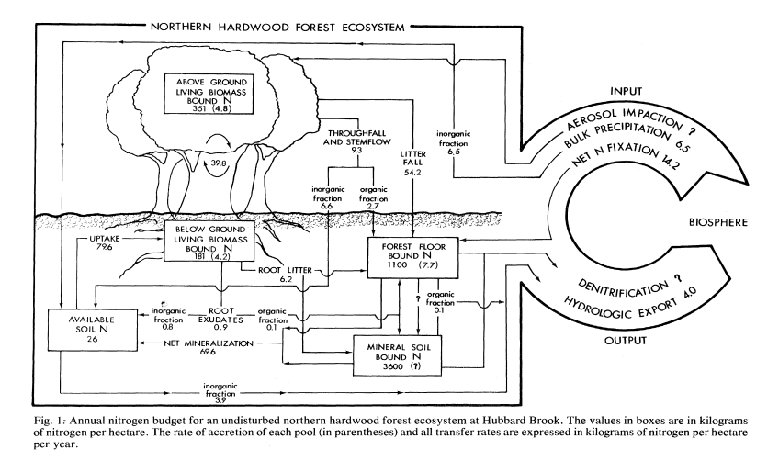
How can we assign confidence in ecosystem nutrient fluxes?
Bormann et al. (1977) Science
Notes:
The same principles apply to C budgets
This was the first N budget for HB, published in 1977. Say that it’s an impressive achievement. Quantifying all the pools, and all the sources and sinks. They didn’t add up, there was an imbalance between the sources and sinks…

Slide 5
The N budget for Hubbard Brook published
in 1977 was “missing” 14.2 kg/ha/yr
Bormann et al. (1977) Science
Notes:
There was 14.2 kg/ha/yr missing.
How can we assign confidence to a budget closure term?

Slide 6
The N budget for Hubbard Brook published
in 1977 was “missing” 14.2 kg/ha/yr
14.2 ± ?? kg/ha/yr
Net N gas exchange = sinks – sources =
precipitation N input
+ hydrologic export
+ N accretion in living biomass
+ N accretion in the forest floor
± gain or loss in soil N stores

Slide 7
The N budget for Hubbard Brook published
in 1977 was “missing” 14.2 kg/ha/yr
14.2 ± ?? kg/ha/yr
Net N gas exchange = sinks – sources =
precipitation N input
+ hydrologic export
+ N accretion in living biomass
+ N accretion in the forest floor
± gain or loss in soil N stores

Slide 8
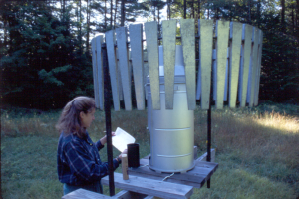
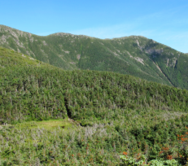
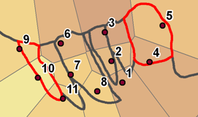
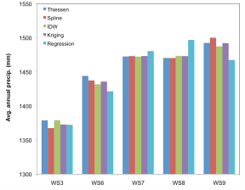
Measurement Uncertainty
Sampling Uncertainty
Spatial and Temporal Variability
Across catchments:
3%
Across years:
14%
Undercatch: 3.5%
Model Uncertainty
Error within models
Error between models
Volume = f(elevation, aspect): 3.4 mm
Model selection: <1%
Notes:
For each of these terms in the budget, I have a diagram illustrating the sources of uncertainty.
Some of these are very preliminary (I estimated sampling uncertainty last night!)

Slide 9
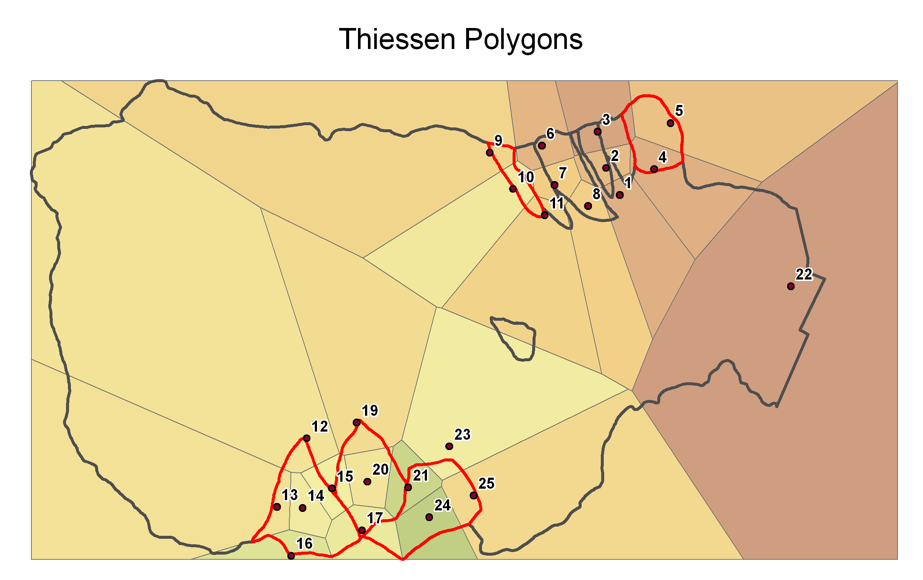
Notes:
Opportunity to talk about sampling intensity
Watershed areas: 13 to 75 ha,
25 collectors is a lot. Too much?

Slide 10
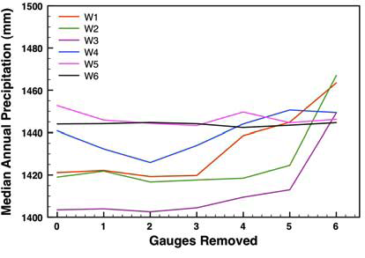
We tested the effect of sampling intensity by sequentially omitting individual precipitation gauges.
Estimates of annual precipitation volume varied little until five or more of the eleven precipitation gauges were ignored.
Notes:
Mark Green did this.

Slide 11
The N budget for Hubbard Brook published
in 1977 was “missing” 14.2 kg/ha/yr
14.2 ± ?? kg/ha/yr
Net N gas exchange = sinks – sources =
precipitation N input (± 1.3)
+ hydrologic export
+ N accretion in living biomass
+ N accretion in the forest floor
± gain or loss in soil N stores

Slide 12
The N budget for Hubbard Brook published
in 1977 was “missing” 14.2 kg/ha/yr
14.2 ± ?? kg/ha/yr
Net N gas exchange = sinks – sources =
precipitation N input (± 1.3)
+ hydrologic export
+ N accretion in living biomass
+ N accretion in the forest floor
± gain or loss in soil N stores

Slide 13
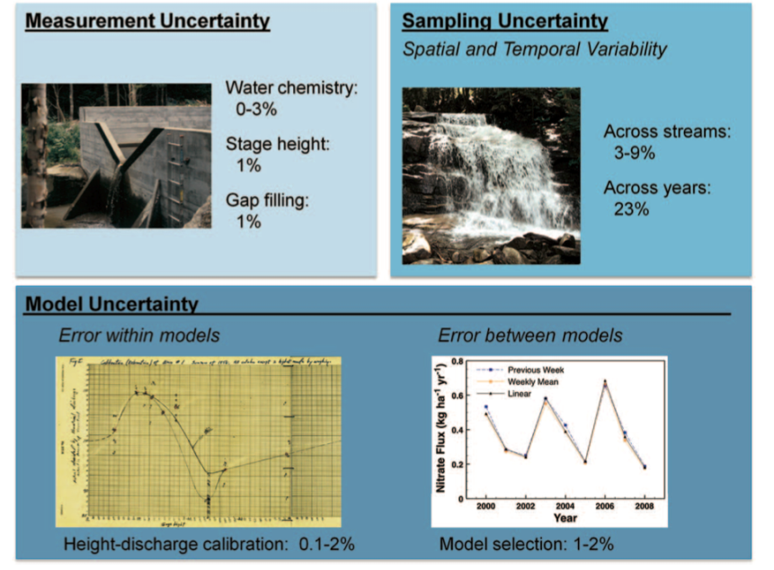
Notes:
Figure 7. Sources of uncertainty in stream export of nutrients, illustrated with values for streams at the Hubbard Brook Experimental Forest, except for uncertainty due to gaps of 1-2 weeks in stream discharge at Wakayama, Japan (Tokuchi, Fukushima, and Matsuzaki, personal communication). Uncertainty in stage height is the effect on annual flux of the uncertainty in weekly readings. Sampling uncertainty describes the range in runoff variability for 2000-2009. The height-discharge relationship is calibrated only at low flow; uncertainty at high flows may be very large. Model selection error is for the long-term average export of calcium and nitrate.
From Yanai et al, 2012, Journal of Forestry.
Also rather preliminary. More detailed paper in preparation for Hydrologic Processes.

Slide 14
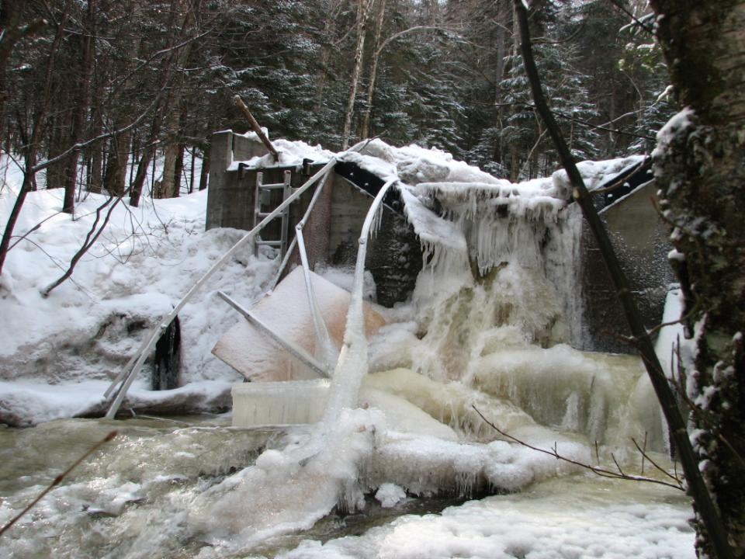
Don Buso HBES
Notes:
The weir cover that protects the basin heater was demolished by an ice-flow that bulldozed virtually the entire stream channel above the gauging station basin on 6 March 2011. The ice flow was produced by a rain-on-snow event and the presence of a thick ice layer on the stream, which allowed the frozen slurry to run down the hillslope un-checked, scouring the channel on the way to the weir. There is a boulder the size of table in the basin. The weir data were missing for about 3 weeks, until the ice could be removed from the V-notch and the floats re-calibrated to the notch height. During that period data from nearby W8 and W7 were used to model the flows in W9. The regression model is based on 15 years of continuous, parallel discharge measurements. Severe incidents of this sort are rare: this is the second time I have seen this in 37 years. --Don Buso

Slide 15
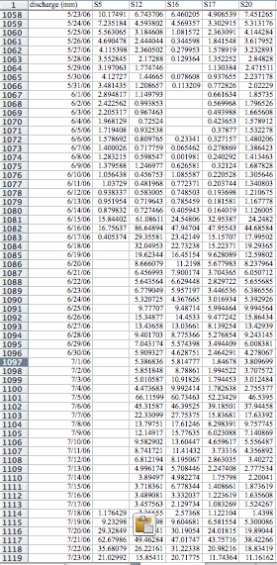
Gaps in the discharge record are filled by comparison to other streams at the site, using linear regression.
Notes:
In preparation, Hydrological Processes.
Eiji Matsuzaki did this.

Slide 16
Cross-validation: Create fake gaps and compare observed and predicted discharge
Gaps of 1-3 days: <0.5%
Gaps of 1-2 weeks: ~1%
2-3 months: 7-8%
Notes:
At Gomadansan, Japan, gaps of Gaps of 1-3 days resulted in less than 0.5% error in the annual estimate of flow (Figure 6). Gaps of 1-2 weeks gave an average error of 1% of annual flow. Longer gaps still resulted in <2% error, except for two long gaps of 2 or 3 months that gave errors of 7-8% (Figure 6).

Slide 17
The N budget for Hubbard Brook published
in 1977 was “missing” 14.2 kg/ha/yr
14.2 ± ?? kg/ha/yr
Net N gas exchange = sinks – sources =
precipitation N input (± 1.3)
+ hydrologic export (± 0.5)
+ N accretion in living biomass
+ N accretion in the forest floor
± gain or loss in soil N stores
Notes:
I put in 0.5, based on the current low values of N export (0.8 kg/ha/yr) and the variation across replicate streams.
This is not a very certain number, stay tuned

Slide 18
The N budget for Hubbard Brook published
in 1977 was “missing” 14.2 kg/ha/yr
14.2 ± ?? kg/ha/yr
Net N gas exchange = sinks – sources =
precipitation N input (± 1.3)
+ hydrologic export (± 0.5)
+ N accretion in living biomass
+ N accretion in the forest floor
± gain or loss in soil N stores
Notes:
Biomass is a much more complicated calculation, involving allometric equations for many tree species, many tissue types, nutrient concentrations

Slide 19
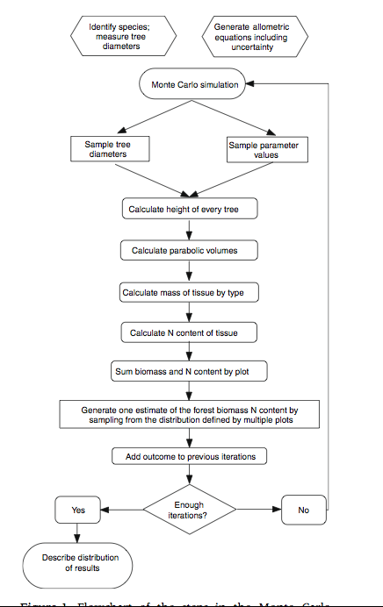
Monte Carlo Simulation
Monte Carlo simulations use random sampling of the distribution of the inputs to a calculation. After many iterations, the distribution of the output is analyzed.
Yanai, Battles, Richardson, Rastetter, Wood, and Blodgett (2010) Ecosystems
Notes:
Rather than do anything analytical (like a Gaussian approach)

Slide 20
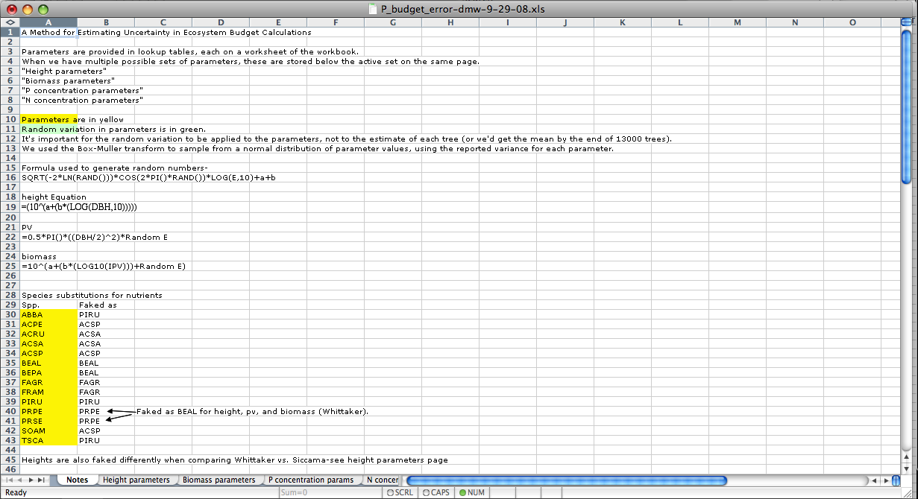
A Monte-Carlo approach could be implemented using specialized software or almost any programming language.
Here we used a spreadsheet model.

Slide 21
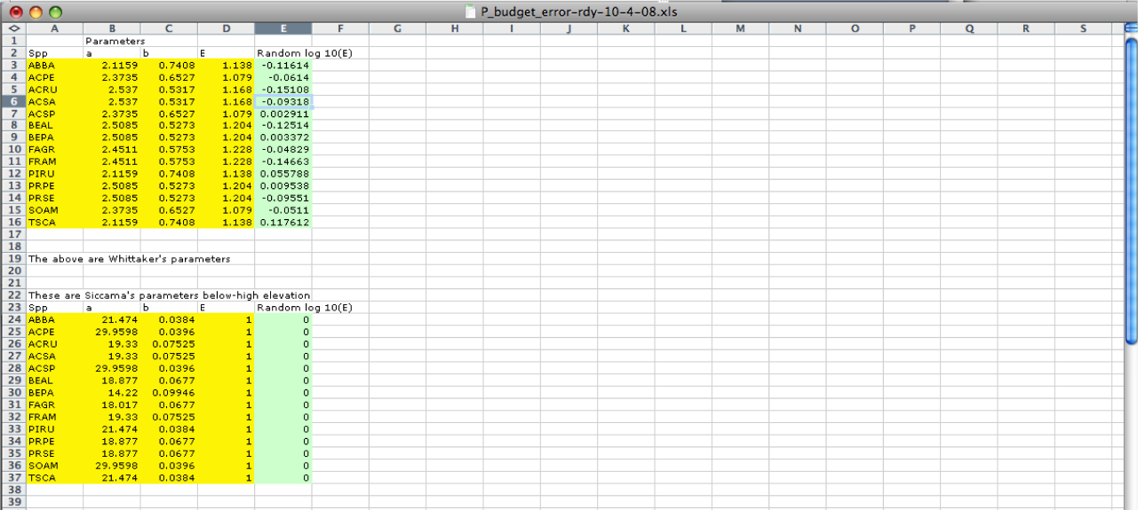
Height Parameters
***IMPORTANT***
Random selection of parameter values
happens HERE, not separately for each tree
Lookup
Lookup
Lookup
    Height = 10^(a + b*log(Diameter) + log(E))

Slide 22
If the errors were sampled individually for each tree, they would average out to zero by the time you added
up a few thousand trees

Slide 23
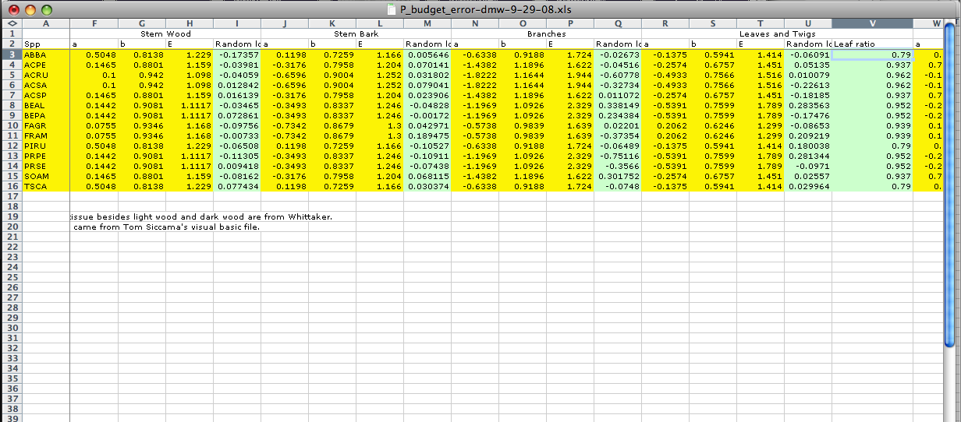
Biomass Parameters
Lookup
Lookup
Lookup
    Biomass = 10^(a + b*log(PV) + log(E))
    PV = 1/2 r² * Height

Slide 24
Biomass Parameters
Lookup
Lookup
Lookup
    Biomass = 10^(a + b*log(PV) + log(E))
    PV = 1/2 r² * Height

Slide 25
Biomass Parameters
Lookup
Lookup
Lookup
    Biomass = 10^(a + b*log(PV) + log(E))
    PV = 1/2 r² * Height

Slide 26
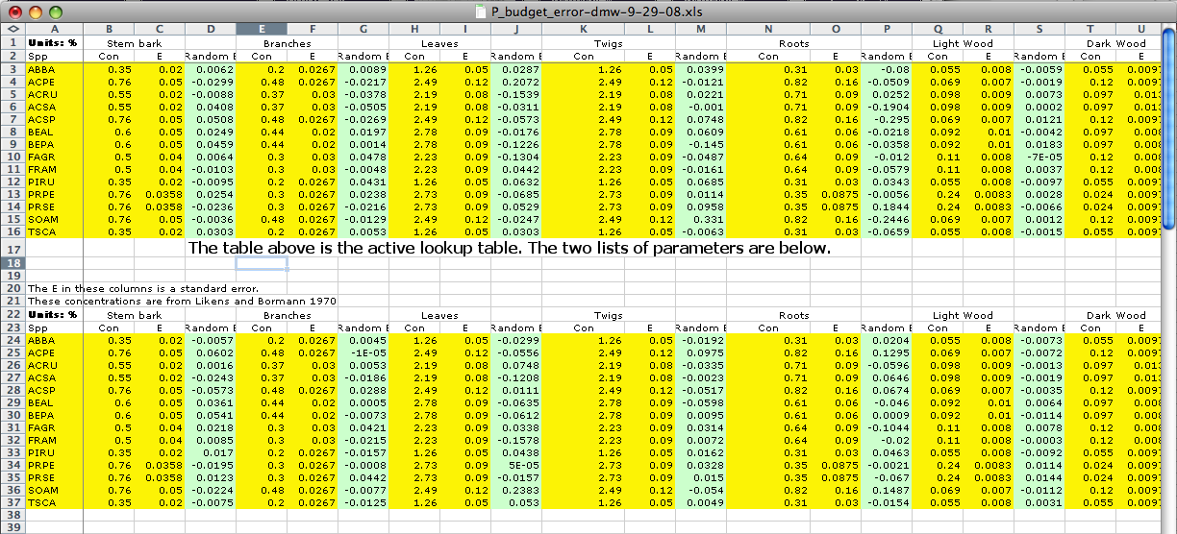
Concentration Parameters
Lookup
Lookup
    Concentration = constant + error

Slide 27
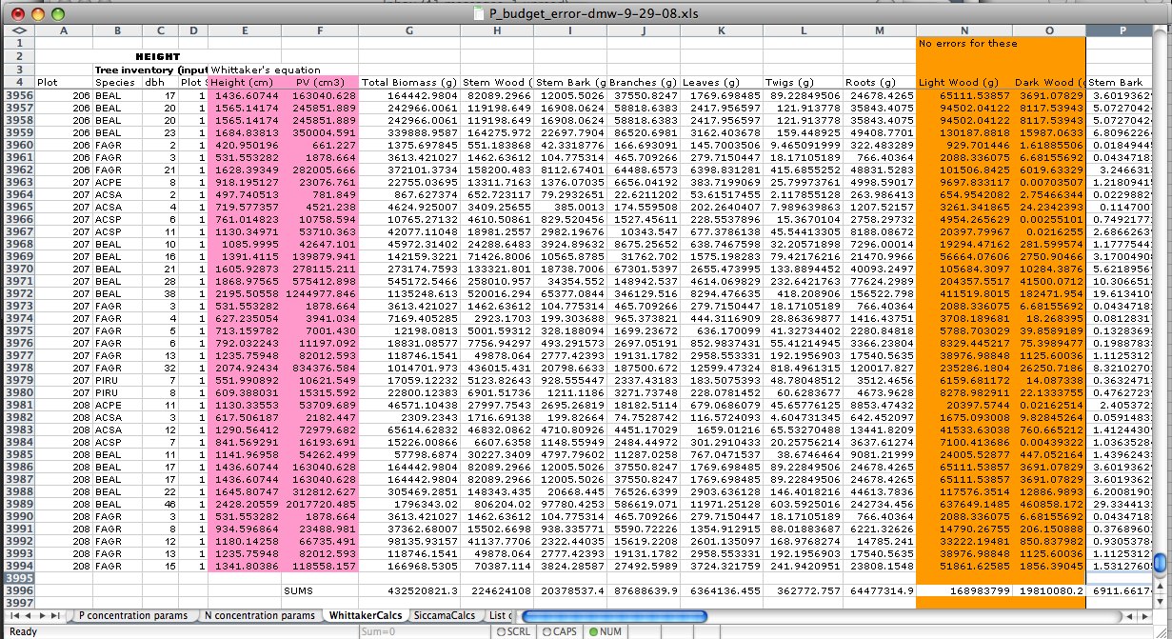
COPY THIS ROW-->

Slide 28
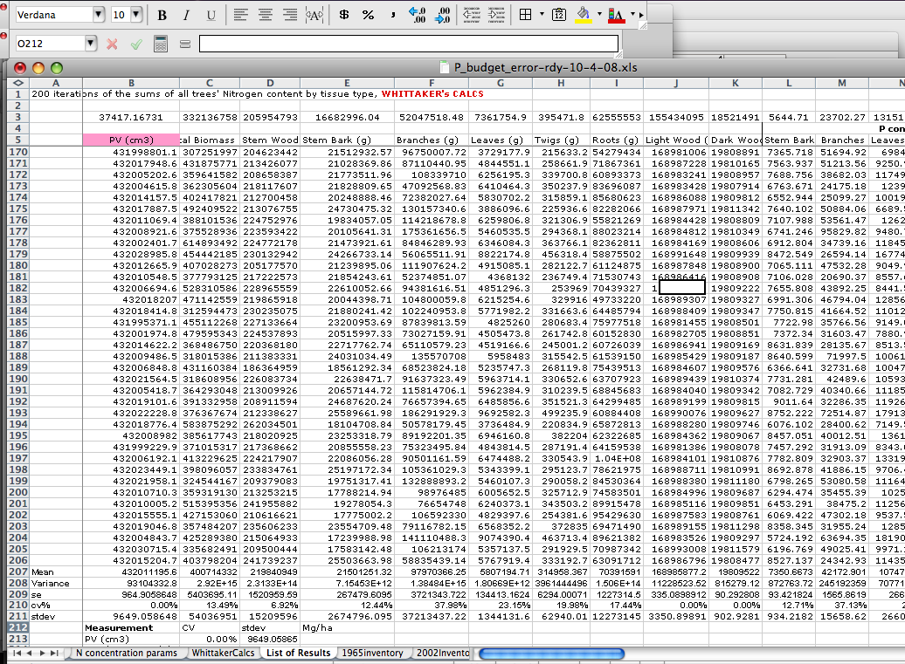
Paste Values button
After enough interations, analyze
your results

Slide 29
Biomass of thirteen stands
of different ages
C1 C2 C3 C4 C5 C6 HB-Mid JB-Mid C7 C8 C9 HB- Old JB-Old
Young Mid-Age Old
Notes:
Carrie Rose Levine did this, in R.

Slide 30
Coefficient of variation (standard deviation / mean)
of error in allometric equations
3% 2% 4% 4% 5%
4% 4% 3% 3% 3%
3% 7% 3%
C1 C2 C3 C4 C5 C6 HB-Mid JB-Mid C7 C8 C9 HB- Old JB-Old
Young Mid-Age Old

Slide 31
CV across plots within stands (spatial variation)
Is greater than the uncertainty in the equations
16% 10% 19% 3% 11%
3% 2% 4% 4% 5%
12% 12% 18% 13% 14%
4% 4% 3% 3% 3%
6% 15% 11%
3% 7% 3%
C1 C2 C3 C4 C5 C6 HB-Mid JB-Mid C7 C8 C9 HB- Old JB-Old
Young Mid-Age Old

Slide 32
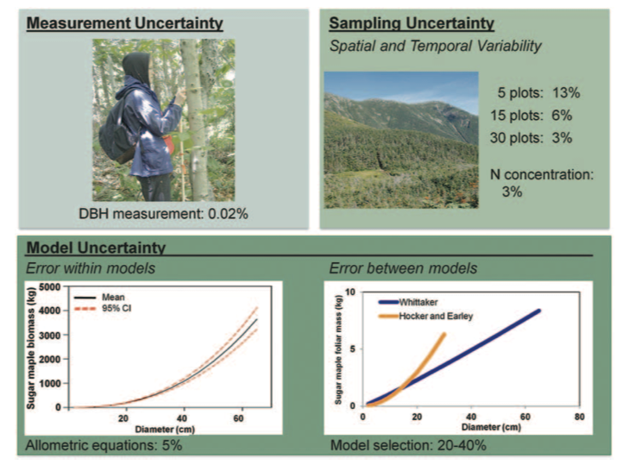
Notes:
Journal of Forestry, 2012.

Slide 33
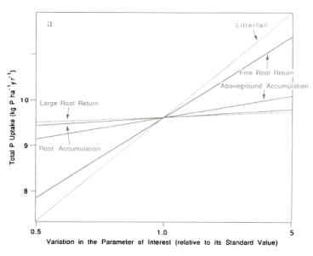
“What is the greatest source of uncertainty in my answer?”
Better than the sensitivity estimates that vary everything by the same amount--they don’t all vary by the same amount!
Notes:
Example from Yanai 1992, Biogeochemistry.

Slide 34
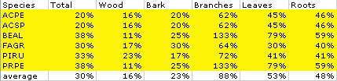
“What is the greatest source of uncertainty to my answer?”
Better than the uncertainty in the parameter estimates--we can tolerate a large uncertainty in an unimportant parameter.
Notes:
You don’t want to rely on the confidence in your equations, because some equations are more important than others

Slide 35
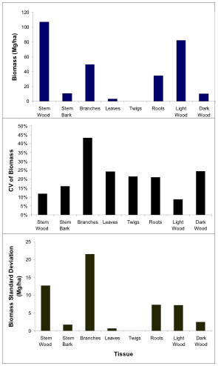
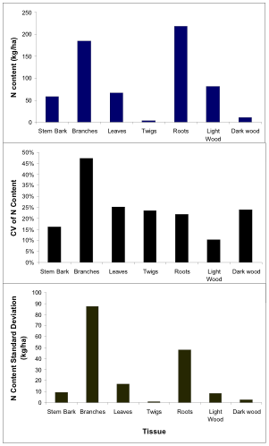
Notes:
Yanai et al. 2010 Ecosystems (unpublished graph)

Slide 36
The N budget for Hubbard Brook published
in 1977 was “missing” 14.2 kg/ha/yr
14.2 ± ?? kg/ha/yr
Net N gas exchange = sinks – sources =
precipitation N input (± 1.3)
+ hydrologic export (± 0.5)
+ N accretion in living biomass (± 1)
+ N accretion in the forest floor
± gain or loss in soil N stores
Notes:
Divide by 5 years, we get plus or minus 1. This value I’m very confident of. It ranges from .5 to .9, depending on the period

Slide 37
The N budget for Hubbard Brook published
in 1977 was “missing” 14.2 kg/ha/yr
14.2 ± ?? kg/ha/yr
Net N gas exchange = sinks – sources =
precipitation N input (± 1.3)
+ hydrologic export (± 0.5)
+ N accretion in living biomass (± 1)
+ N accretion in the forest floor
± gain or loss in soil N stores

Slide 38
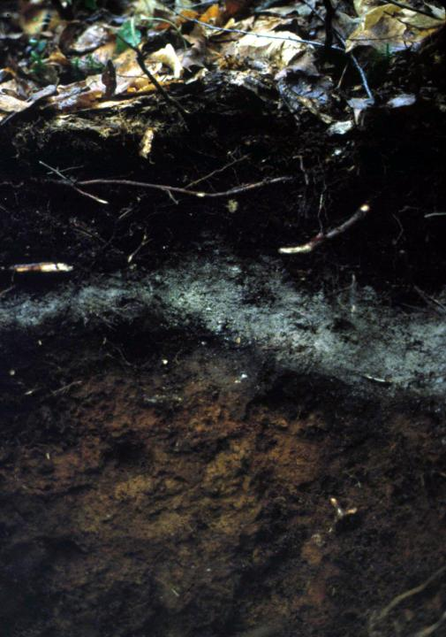

Oi
Oe
Forest
Floor
Oa
E
Bh
Mineral
Soil
Bs
Notes:
US Soil Taxonomy, O horizons, Spodosol

Slide 39
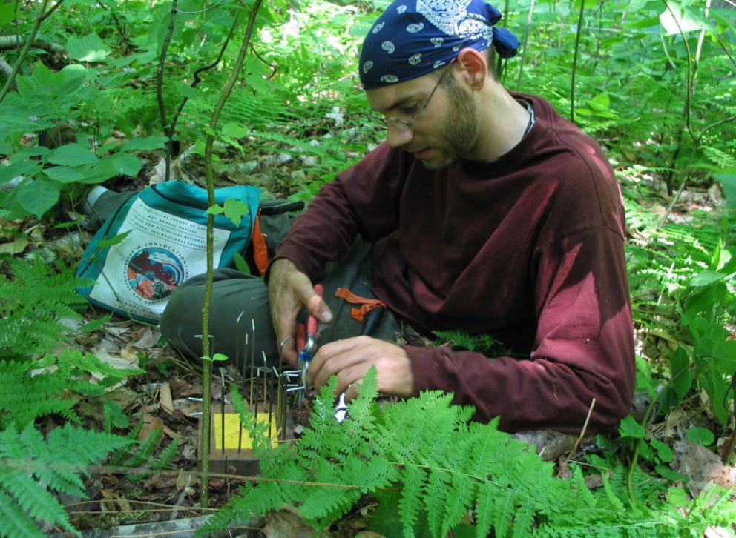
10 points are sampled along each of 5 transects in 13 stands.

Slide 40
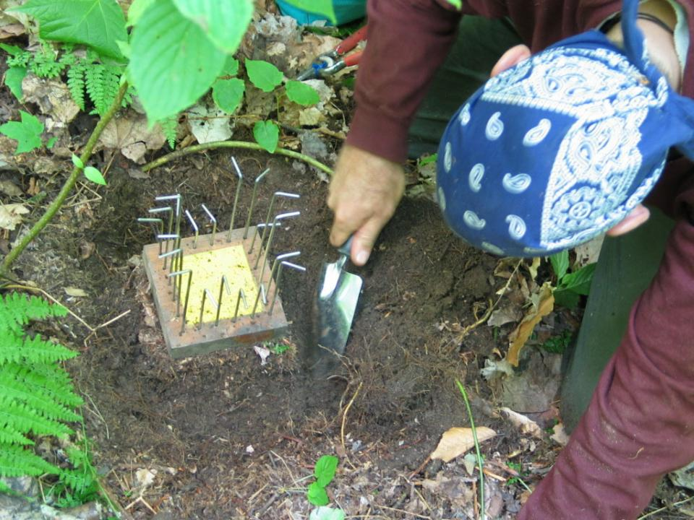
Excavation of a forest floor block (10 x 10 cm)

Slide 41
Pin block is trimmed to size. Horizons are easy to see.

Slide 42
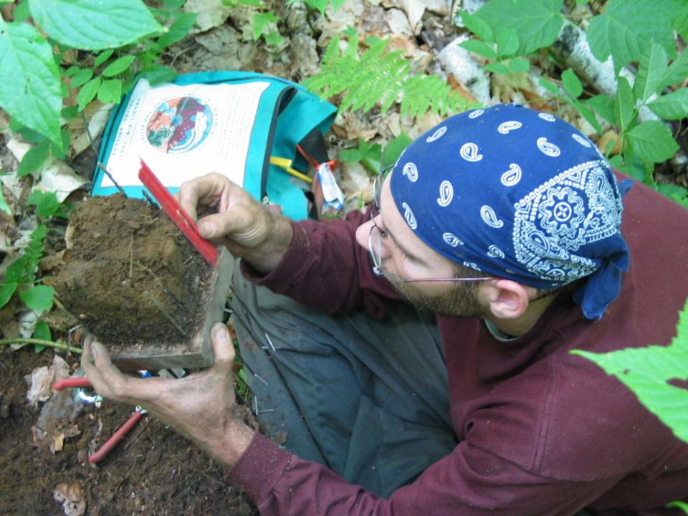
Horizon depths are measured on four faces
Oe, Oi, Oa and A (if present) horizons are bagged separately
In the lab, samples are dried, sieved, and a subsample oven-dried for mass and chemical analysis.

Slide 43
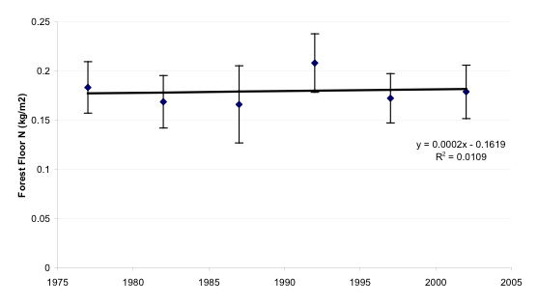
Nitrogen in the Forest Floor
Hubbard Brook Experimental Forest

Slide 44
Nitrogen in the Forest Floor
Hubbard Brook Experimental Forest
The change is insignificant (P = 0.84).
The uncertainty in the slope is ± 22 kg/ha/yr.

Slide 45
The N budget for Hubbard Brook published
in 1977 was “missing” 14.2 kg/ha/yr
14.2 ± ?? kg/ha/yr
Net N gas exchange = sinks – sources =
precipitation N input (± 1.3)
+ hydrologic export (± 0.5)
+ N accretion in living biomass (± 1)
+ N accretion in the forest floor (± 22)
± gain or loss in soil N stores
Notes:
We blew the budget. An order of magnitude higher than the other uncertainties.
One conclusion is that we should draw the black box to exclude the soil: We have confidence that there was a missing source (and now there is a missing sink)

Slide 46
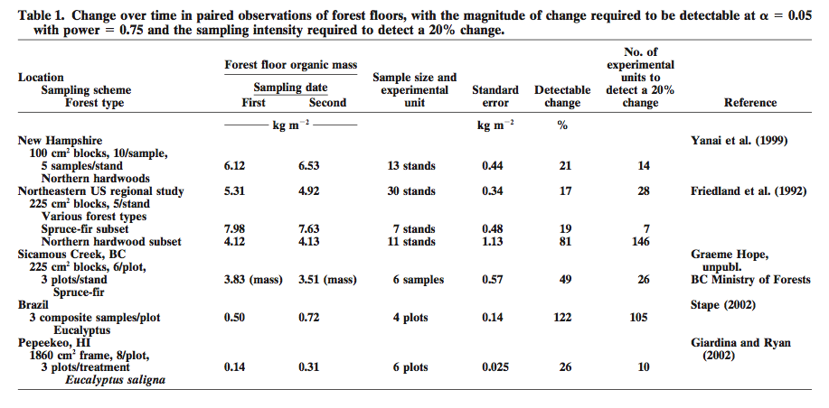
Studies of soil change over time often fail to detect a difference.
We should always report how large a difference is detectable.
Yanai et al. (2003) SSSAJ

Slide 47
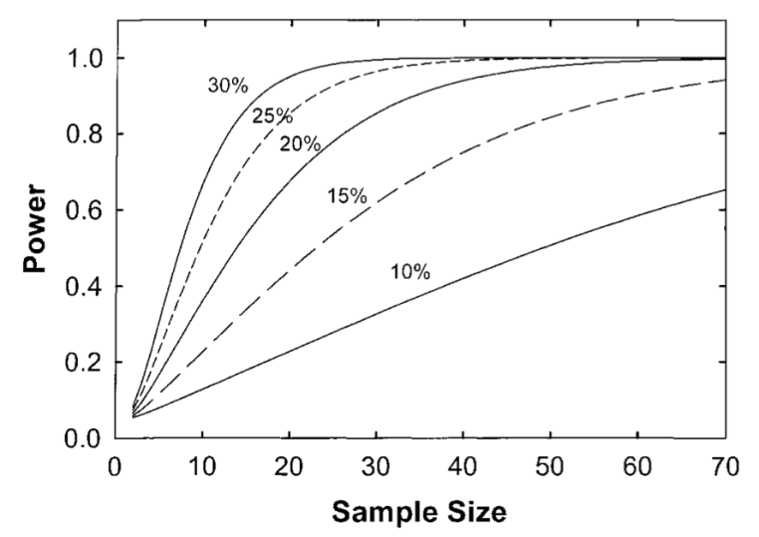
Power analysis can be used to determine the difference detectable with known confidence
Notes:
Power to detect different magnitudes of change in forest floor organic mass for various sample sizes, using the variance of paired differences measured in a regional study of 30 stands (Friedland et al., 1992)

Slide 48
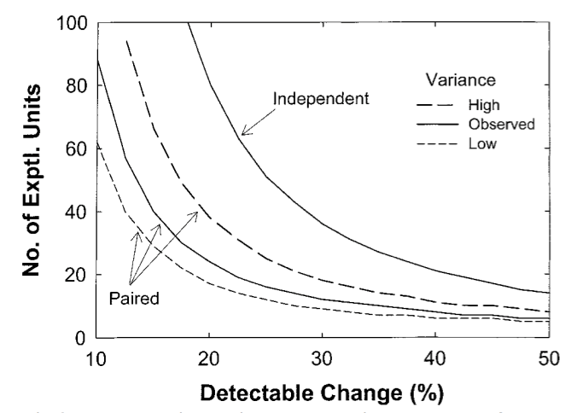
Sampling the same experimental units over time permits detection of smaller changes
Notes:
The sample size required to detect a given % change with power = 0.75. The three curves represent different levels of variability derived from Friendland et al. (1992), w upper and lower bounds of the 95% CI for the SD of the differences.

Slide 49
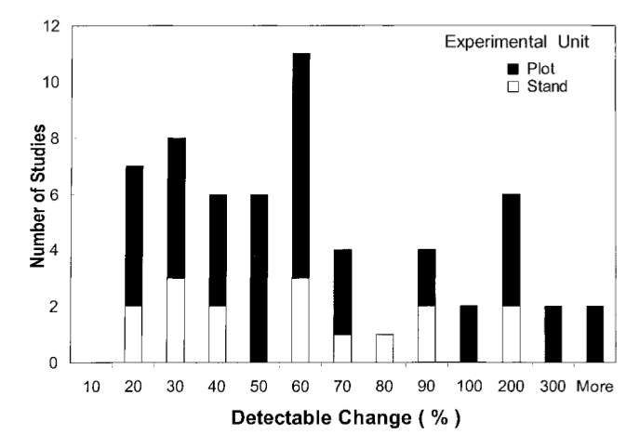
In this analysis of forest floor studies,
few could detect small changes
Yanai et al. (2003) SSSAJ
Notes:
Frequency distribution of detectable change in 21 studies (some are represented more than once, paired an independent or plots vs. stands)

Slide 50
The N budget for Hubbard Brook published
in 1977 was “missing” 14.2 kg/ha/yr
14.2 ± ?? kg/ha/yr
Net N gas exchange = sinks – sources =
precipitation N input (± 1.3)
+ hydrologic export (± 0.5)
+ N accretion in living biomass (± 1)
+ N accretion in the forest floor (± 22)
± gain or loss in soil N stores
Notes:
This is going to be even worse

Slide 51
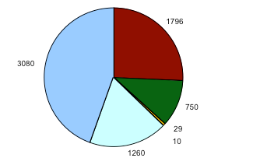
Nitrogen Pools (kg/ha)
Hubbard Brook Experimental Forest
Mineral Soil
10 cm-C
Forest Floor
Live Vegetation
Dead Vegetation
Mineral Soil
0-10 cm
Coarse Woody Debris

Slide 52
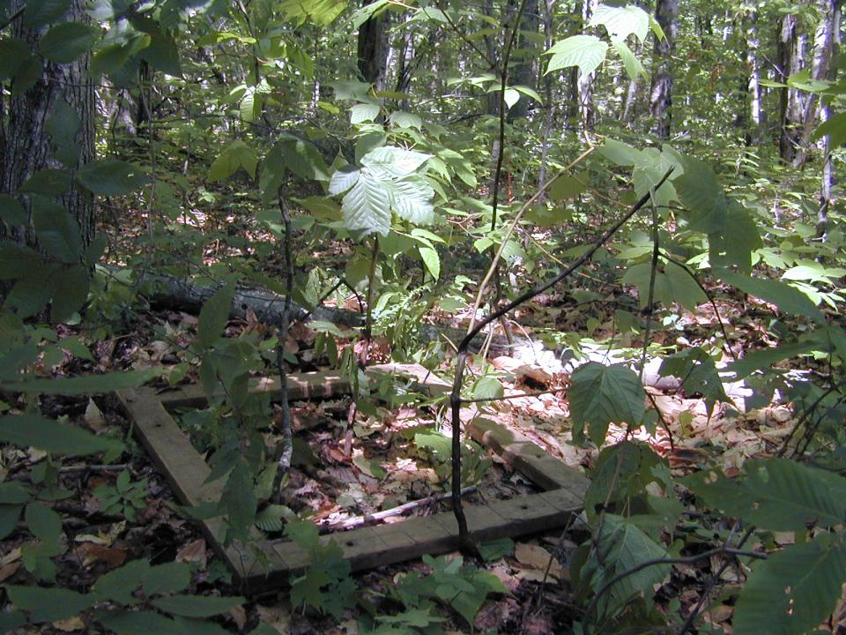
Quantitative Soil Pits
0.5 m² frame

Slide 53
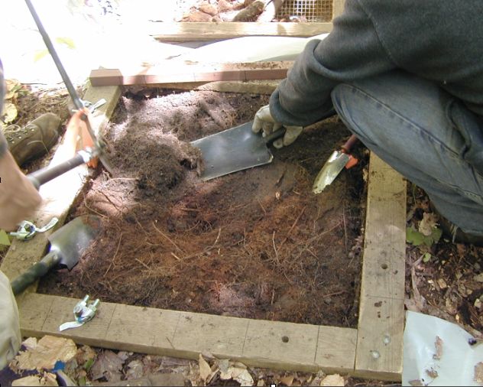
Excavate Forest Floor by horizon
Mineral Soil by depth increment

Slide 54
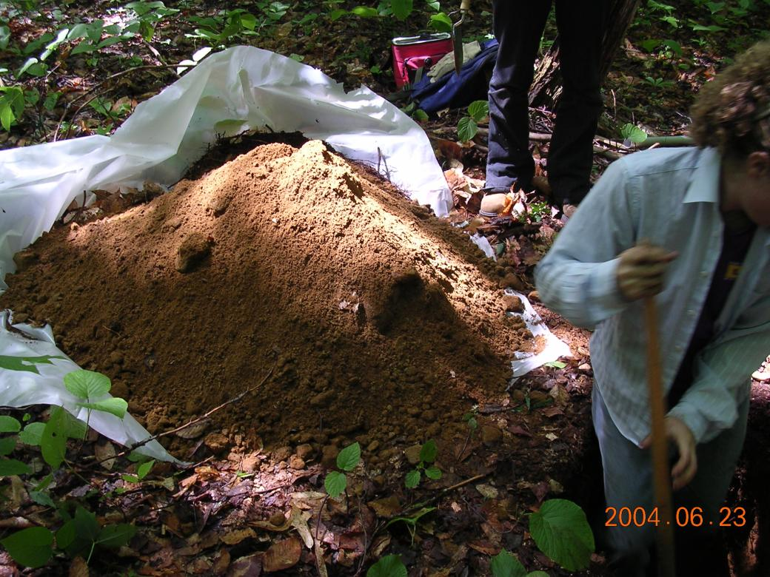
Sieve and weigh in the field
Subsample for laboratory analysis

Slide 55
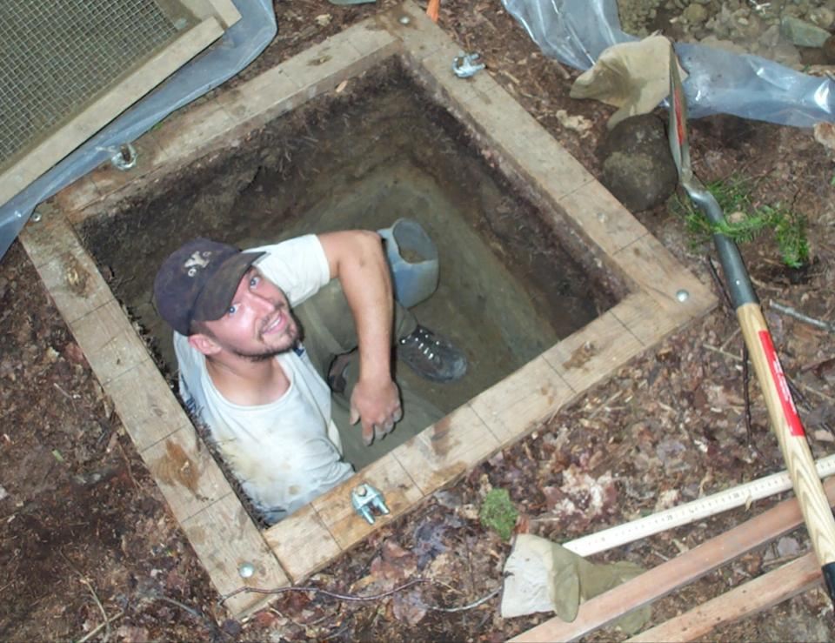
In some studies, we excavate in the C horizon!

Slide 56
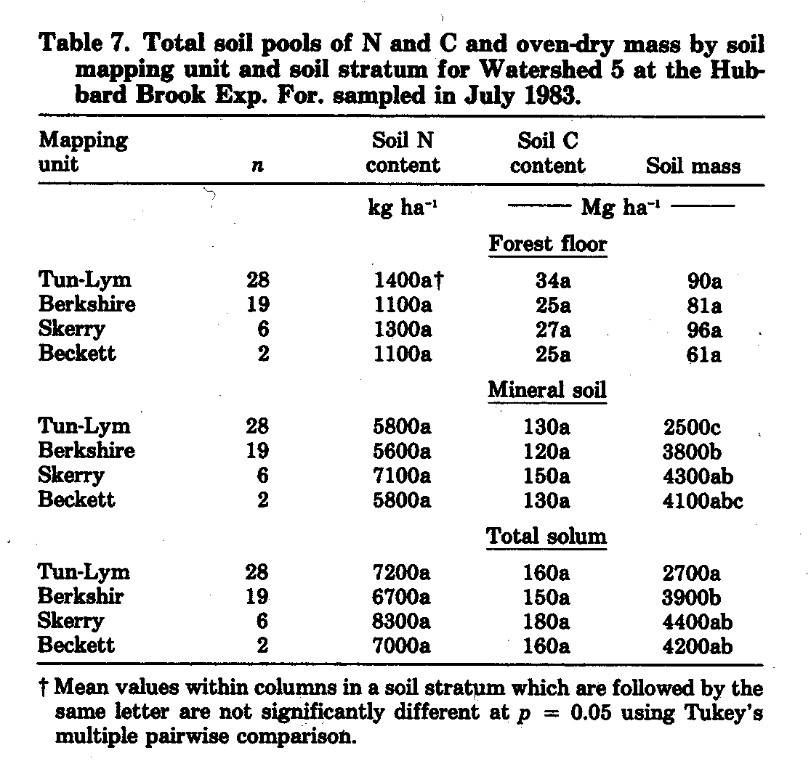
We can’t detect a difference of 730 kg N/ha in the mineral soil.
Huntington et al. (1988)
From 1983 to 1998, 15 years post-harvest, there was an insignificant decline of 54 ± 53 kg N ha⁻¹ y⁻¹

Slide 57
The N budget for Hubbard Brook published
in 1977 was “missing” 14.2 kg/ha/yr
14.2 ± ?? kg/ha/yr
Net N gas exchange = sinks – sources =
precipitation N input (± 1.3)
+ hydrologic export (± 0.5)
+ N accretion in living biomass (± 1)
+ N accretion in the forest floor (± 22)
± gain or loss in soil N stores (± 53)

Slide 58
The N budget for Hubbard Brook published
in 1977 was “missing” 14.2 kg/ha/yr
14.2 ± 57 kg/ha/yr
Net N gas exchange = sinks – sources =
precipitation N input (± 1.3)
+ hydrologic export (± 0.5)
+ N accretion in living biomass (± 1)
+ N accretion in the forest floor (± 22)
± gain or loss in soil N stores (± 53)
Notes:
Without the soil, it’s 1.7

Slide 59
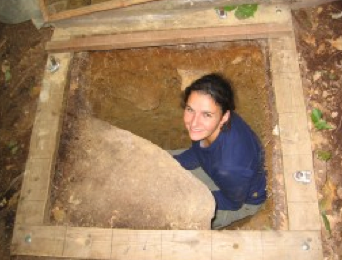
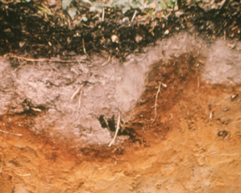
Measurement Uncertainty
Sampling Uncertainty
Spatial Variability
Model Uncertainty y
Error within models
Error between models
Excludes areas not sampled: rock area 5%, stem area: 1%
Measurement uncertainty and spatial variation make it difficult to estimate soil carbon and nutrient contents precisely

Slide 60
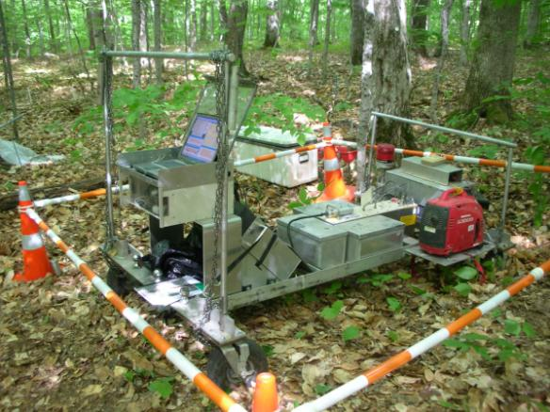
Non-Destructive Evaluation of Soils
Neutrons generated by nuclear fusion of ²H and ³H interact with nuclei in the soil via inelastic neutron scattering and thermal neutron capture.
Notes:
The INS prototype includes a neutron generator, an array of three NaI detectors, and electronics for nuclear spectroscopy.
A miniature sealed-tube accelerator produces 14 MeV neutrons. Inelastic neutron scattering occurs when fast neutrons are captured by a carbon nucleus in the soil and reemitted at lower energy along with gamma rays of characteristic energy (4.43 MeV).
The gamma radiation is measured by spectroscopy, which indicates the number of carbon atoms detected. Other elements can be detected by gamma radiation at other characteristic energy levels.

Slide 61
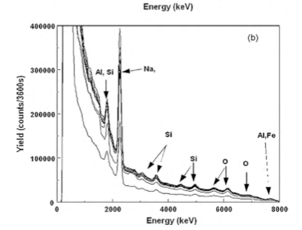
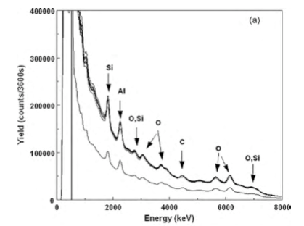
TNC
INS
Agreement with soil pits: 4.2 vs. 5.4 kg C m⁻².
Detectable difference: 5%
Time for collection: 1 hour
Improvements are needed in portability and sampling geometry.
Wielopolski et al. (2010) FEM
Notes:
(a) INS and (b) TNC spectra acquired for 1 h at Bartlett Experimental Forest. The lowest line was counted for 0.5 h, due to a computer error.
However, results are not readily reproducible due to the uneven topography of the forest floor, which affects the geometry of the area sampled by the INS approach.
The prototype INS system is difficult to transport in the field. A more portable system is under development.

Slide 62
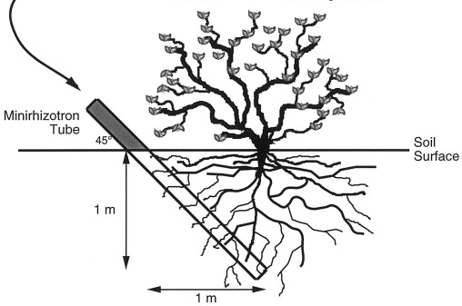
Minirhizotron Estimates of Root Production and Turnover
Notes:
I was hoping to have more to say about

Slide 63
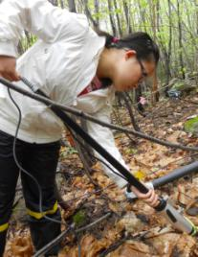

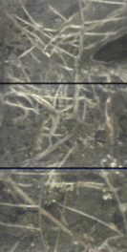
Measurement Uncertainty
Sampling Uncertainty
Spatial Variability
?
Model Uncertainty Root Production vs. Root Lifespan: 45%
Sequential Coring, mean vs. max: 30%
Park et al. (2003) Ecosystems
Brunner al. (2013) Plant Soil

Slide 64
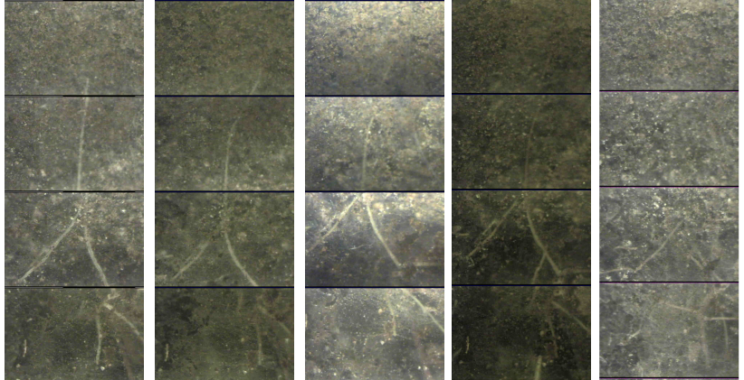
Subjectivity in image analysis could be assessed by multiple observers analyzing the same images

Slide 65
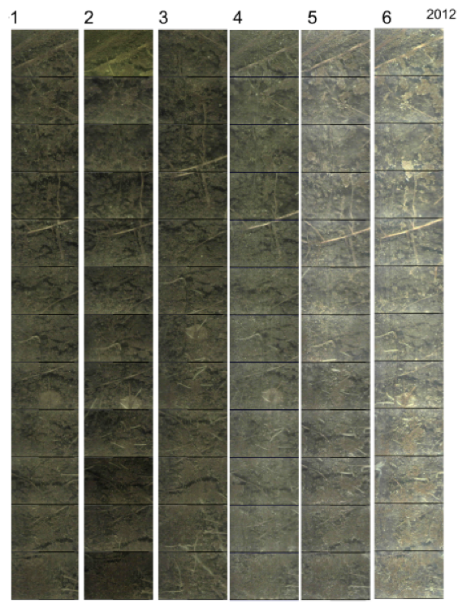

Slide 66
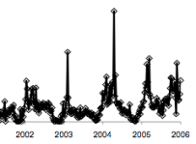

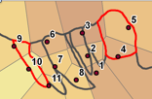
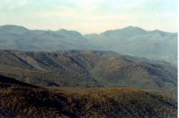





Sources of Uncertainty in Ecosystem Studies
Temporal Variation
Measurement
Spatial Variation
Streams
Precip
Spatial Variation
Model uncertainty
Model selection
Biomass
Spatial Variation
Measurement
Model selection
Root Turnover
Soils
Notes:
Why should we do this? Improve monitoring efficiency, know where to direct effort to improve measurements, and estabilsh confidence when you compare values to one another.

Slide 67
The Value of Uncertainty Analysis
Quantify uncertainty in our results
Uncertainty in regression
Monte Carlo sampling
Detectable differences
Identify ways to reduce uncertainty
Devote effort to the greatest unknowns
Improve efficiency of monitoring efforts

Slide 68
References
Yanai, R.D., C.R. Levine, M.B. Green, and J.L. Campbell. 2012. Quantifying uncertainty in forest nutrient budgets, J. For. 110: 448-456
Yanai, R.D., J.J. Battles, A.D. Richardson, E.B. Rastetter, D.M. Wood, and C. Blodgett. 2010. Estimating uncertainty in ecosystem budget calculations. Ecosystems 13: 239-248
Wielopolski, L, R.D. Yanai, C.R. Levine, S. Mitra, and M.A Vadeboncoeur. 2010. Rapid, non-destructive carbon analysis of forest soils using neutron-induced gamma-ray spectroscopy. For. Ecol. Manag. 260: 1132-1137
Park, B.B., R.D. Yanai, T.J. Fahey, T.G. Siccama, S.W. Bailey, J.B. Shanley, and N.L. Cleavitt. 2008. Fine root dynamics and forest production across a calcium gradient in northern hardwood and conifer ecosystems. Ecosystems 11:325-341
Yanai, R.D., S.V. Stehman, M.A. Arthur, C.E. Prescott, A.J. Friedland, T.G. Siccama, and D. Binkley. 2003. Detecting change in forest floor carbon. Soil Sci. Soc. Am. J. 67:1583-1593
My web site: www.esf.edu/faculty/yanai (Download any papers)

Slide 69
QUANTIFYING UNCERTAINTY
IN ECOSYSTEM STUDIES
Be a part of QUEST!
Find more information at: www.quantifyinguncertainty.org
  Read papers, share sample code, stay updated with QUEST News
  Email us at quantifyinguncertainty@gmail.com
  Follow us on LinkedIn and Twitter: @QUEST_RCN
Notes:
RCN funded for 5 years starting this year. We just started Tweeting last week!

