Slide 1
Measurement Uncertainty Workshop ILTER Open Science Meeting 2016 October 11, 2016
Presenter: Janae Csavina
Contributors: Joshua Roberti and Hank Loescher

Slide 2
Introduction NEON
NEON – National Ecological Observatory Network
National Science Foundation – USA government funding
Gathers and synthesizes data on natural resources and biodiversity
Climate Change, Land Use Change, Invasive Species

Slide 3
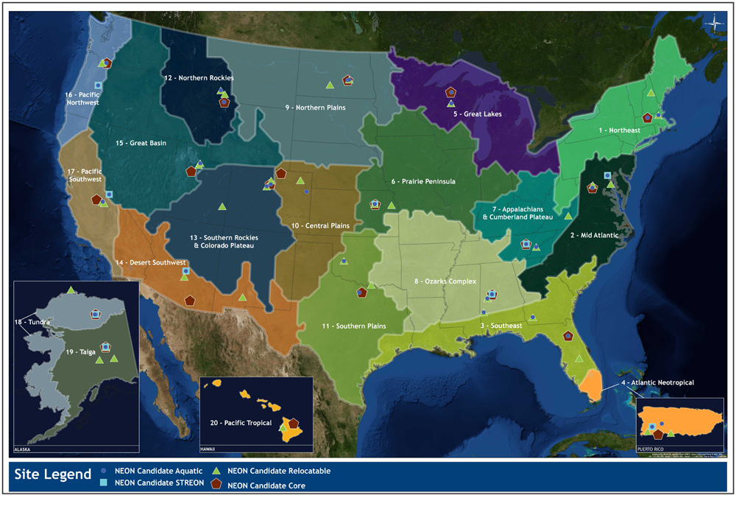
Introduction NEON

Slide 4
Introduction
Calibration, Validation and Audit Laboratory (CVAL)
NEON’s in-house metrology lab
Regular (annual) sensor calibrations to the same standards
Sensor state of health
Drift analysis
Technology changes
Personal Background
Chemical and Environmental Engineer who has evolved into a Quality Engineer
Experience in environmental sensor based measurements and quality systems
Uncertainty assessment development for both lab and data products

Slide 5
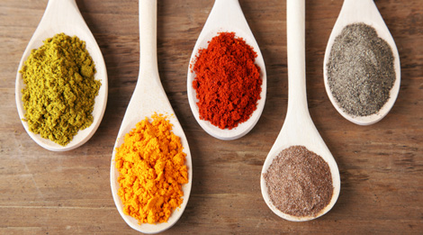
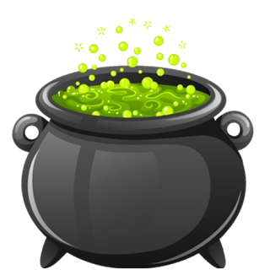
Measurement Definition and Recipe
Measurement – determining the quantity of something
Key ingredients:
Measurement Quantity
Measurement Traceability
Measurement Uncertainty
Quantity
Traceability
Uncertainty

Slide 6
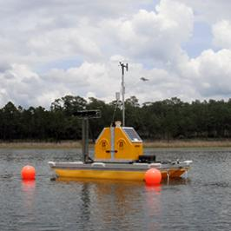
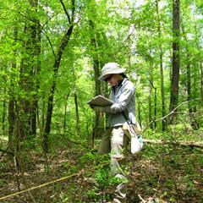
Quantity
Measurement System Examples
Sensors left in the field with data acquisition system
Sensors with human influence (hand held, airborne, etc.)
Observation based measurement by humans

Slide 7
Traceability
With Traceability
Measurement is traceable to an accepted standard
An estimation can be made for how well the measurement relates to the “true value”
Sensor based measurements
Regular Calibration
Measurements in the date range in which the calibration facility guarantees quality
Traceable to an international or national standard (the SI, WRC, ISO, ASTM)
Observation based measurements
Standardized Measurement Method
Regular Training on Method
True Value
relate
Measurement
Without Traceability
True Value
?
Measurement

Slide 8
Uncertainty
Uncertainty is an estimate of the dispersion of values that could be reasonably attributed to the measurement (provides an estimate for how well the measurement represents the true value).
Necessity for science today
Allows for comparison or use of different types of sensors to be compared or used in a model for the same property.
Differentiating between trends and “noise”
Accounts for measurements over time.
Technology changes
Sensor degradation
Drift
With Traceability
True Value
uncertainty
relates
Measurement

Slide 9
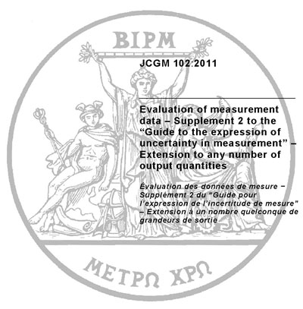
Uncertainty Assessment Standardized
Must be estimated with a standardized assessment (everyone needs to quantify uncertainty in the same manner)
Evaluation of measurement data – Guide to the expression of uncertainty in measurement (ISO 1995; JCGM 2008)
Governing metrology bodies such as International Standards Organization (ISO) created a Working Group called the Joint Committee for Guides in Metrology (JCGM), made up of individuals nominated by their member organizations to create an internationally accepted standard for assessing uncertainty.

Slide 10
Uncertainty Evaluation
2 approaches to evaluating uncertainty:
Type A evaluated by statistical methods.
Experimental approach
Experimental variance of independent observations which differ in value because of random variations.
Type B evaluated by other means.
Estimates obtained using available published knowledge such as manufacturer’s specs, calibration certificates, reference data from handbooks, etc.

Slide 11
Measurement Uncertainty Recipe
Basic recipe for measurement uncertainty components:
Assumptions made for workshop materials
All uncertainties are normally distributed (no systematic errors)
All uncertainties are independent (uncorrelated)
$$u_{c}(y)={\left[\sum_{i=1}^{n}{u^{2}(y_{i})}\right]}^{1/2}$$

Slide 12
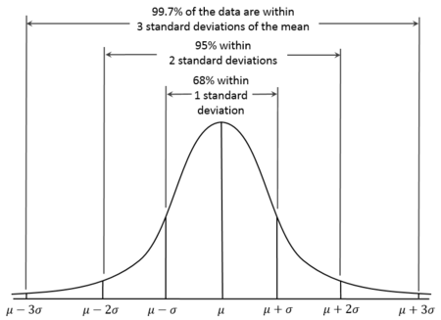
Uncertainty Components
Traceable Method or Sensor Calibration
Traceable Method or Sensor Calibration
Type B evaluation (typically)
Calibration or method uncertainty already quantified
GREAT! Make sure to use unexpanded uncertainty.
Calibration or method quotes an accuracy
Research what is meant by accuracy
Sometimes accuracy means almost all values can be attributed, in which case:
Tolerance may be used as the quality parameter
Assume a rectangular distribution meaning the value is equally likely to fall anywhere in between
Method or
Calibration
Uncertainty

Slide 13
Uncertainty Components
Measurement Variation
Repeatability
Measurement Variation
Repeatability
Single measurement represent the reported result (no averaging)
Type A evaluation in repeatable conditions
Standard deviation
Multiple measurements are averaged for the reported result
Type A evaluation
Standard deviation of the mean

Slide 14
Uncertainty Components
Other Contributing Factors
Too many to capture in this workshop and specific to different applications, but here are some examples:
Data acquisition system for analogue signals
Temperature sensor measured in resistance
Drift
Temperature
Calibration
Sensor degradation
Sensor

Slide 15
Measurement Uncertainty Recipe
Basic recipe for measurement uncertainty components:
$$u_{c}=\sqrt{{u_{calibration}}^{2}+{u_{repeatability}}^{2}+{u_{DAQ}}^{2}}$$

Slide 16
Expanding and Stating Uncertainty
Expanding: Assuming normal distribution, u_{c}(y) is only at ~68% confidence level.
Expand with expansion factor (k_{p}) with p being the level of confidence desired for the uncertainty estimate (typically 95%)
$$u_{p}=k_{p}∗u_{c}$$
Stating: Measurement is 30 seconds and the time is plus or minus 1 second at a 95 percent confidence level. The result can be written as:
30 s ± 1 s, at a level of confidence of 95%
Y = 30 s and U₉₅ = 1 s
This states that we are 95% sure that the time measurement is between 29 and 31 seconds.

Slide 17
Disclaimer
At the end of the day, uncertainty is an estimation; however, without it, a measurement is meaningless.
" ... as far as the propositions of mathematics refer to reality, they are not certain; and as far as they are certain, they do not refer to reality.“ Albert Einstein, Geometry and Experience, Lecture before the Prussian Academy of Sciences, January 27, 1921
Uncertainty assessment is an evolving topic. Changes have occurred over the years. Additionally, the instructions in this workshop are not absolute. This workshop provides an overview of a basic measurement system, the user of these materials is encouraged to further their uncertainty knowledge to apply to different applications with some of the following materials:
JCGM. (2008). Evaluation of measurement data - Guide to the expression of uncertainty in measurement (GUM). Genève, Switzerland: International Organization for Standardization.

Slide 18
Proper Quality Terminology
Accuracy: is the closeness of the agreement between the result of a measurement and a true value of the measurand. “Accuracy” is a qualitative concept.
Calibration: comparison of an instrument against a reference or standard, to adjust for any errors in the values indicated by the instrument. In some cases, calibration assigns a relationship between the output of an instrument to a desired input quantity (or measurement); for example, calibration of a resistance thermometer relates its output (in Ω) to temperature (in °C).
Error: deviation from the true value.
Interval: margin within which the ‘true value’ being measured can be said to lie, with a given level of confidence.
Level of confidence: the number (e.g. 95 %) expressing the degree of confidence in a result.
Precision: a term meaning ‘fineness of discrimination’ but often misused to mean ‘accuracy’ or ‘uncertainty’. Its use should be avoided if possible.
Repeatability: closeness of the agreement between repeated measurements of the same property under the same conditions.
Tolerance: the upper and lower limits of the interval of variability.
Uncertainty: an estimate associated with the result of a measurement, that characterizes the dispersion of the values that could reasonably be attributed to the measurand.
JCGM. (2012). International vocabulary of metrology - Basic and general concepts and associated terms. Geneva: ISO Copyright Office.

Slide 19
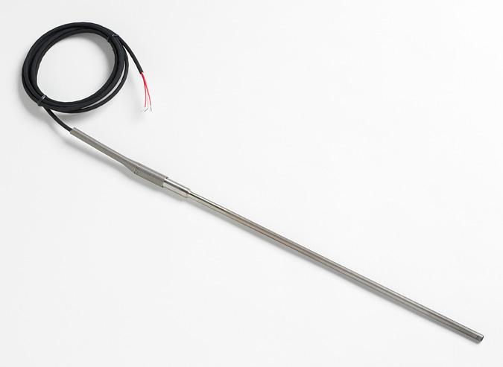
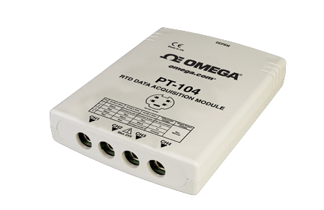
Exercises – Single Aspirated Temperature Sensor Measurement

Slide 20
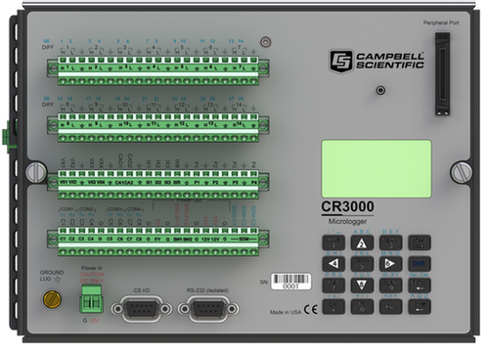
Exercises – Single Aspirated Temperature Sensor Measurement

Slide 21
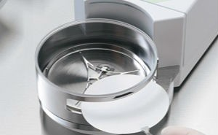
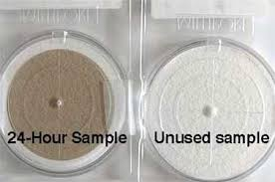
Exercises – PM₁₀ Particulate Sampling

Slide 22
Workshop materials: http://www.esf.edu/quest/workshop.htm
Janae Csavina: jcsavina@battelleecology.org

