Slide 1
Measurement Uncertainty Workshop
ILTER Open Science Meeting 2016
October 11, 2016
Presenter: Janae Csavina
Contributors: Joshua Roberti and Hank Loescher

Slide 2

Introduction
Janae Csavina – Quality Engineer in NEON’s CVAL
  CVAL = Calibration, Validation, and Audit Laboratory (Metrology Lab)
  Personal Background: Chemical and Environmental Engineer with experience in quality systems and environmental sensor based measurements.
NEON – National Ecological Observatory Network
  National Science Foundation – USA government funding
  Gathers and synthesizes data on natural resources and biodiversity
    Climate Change, Land Use Change, Invasive Species

Slide 3

Introduction

Slide 4
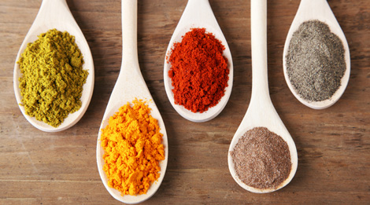
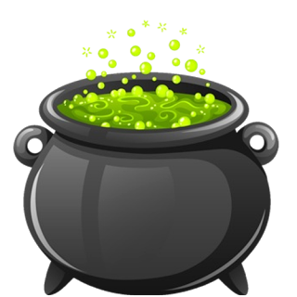
Measurement Definition and Recipe
Measurement – determining the quantity of something
  Key ingredients:
    Measurement Quantity
    Measurement Traceability
    Measurement Uncertainty
    Quantity
    Traceability
    Uncertainty

Slide 5
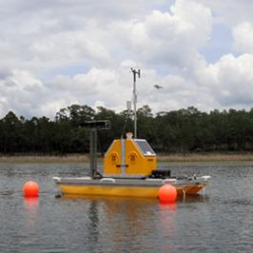


Quantity
Measurement System Examples
  Sensors left in the field with data acquisition system
  Sensors with human influence (hand held, airborne, etc.)
  Observation based measurement by humans

Slide 6
Traceability
With Traceability
Measurement is traceable to an accepted standard
  An estimation can be made for how well the measurement relates to the “true value”
    Sensor based measurements
      Regular Calibration
        Measurements in the date range in which the calibration facility guarantees quality
        Traceable to an international or national standard (the SI, WRC, ISO, ASTM)
    Observation based measurements
      Standardized Measurement Method
        Regular Training on Method
True Value
relate
Measurement
Without Traceability
True Value
?
Measurement

Slide 7
Uncertainty
Uncertainty is an estimate of the dispersion of values that could be reasonably attributed to the measurement (provides an estimate for how well the measurement represents the true value).
  Allows for comparison or use of different
  types of sensors to be compared or used in
  a model for the same measurement.
  Accounts for measurements over time.
    Technology changes
    Sensor degradation
    Drift
With Traceability
True Value
uncertainty
relates
Measurement

Slide 8
Proper Quality Terminology
  Uncertainty: an estimate associated with the result of a measurement, that characterizes the dispersion of the values that could reasonably be attributed to the measurand.
  Interval: margin within which the ‘true value’ being measured can be said to lie, with a given level of confidence.
  Level of confidence: the number (e.g. 95 %) expressing the degree of confidence in a result.
  Repeatability: closeness of the agreement between repeated measurements of the same property under the same conditions.
  Calibration: comparison of an instrument against a reference or standard, to adjust for any errors in the values indicated by the instrument. In some cases, calibration assigns a relationship between the output of an instrument to a desired input quantity (or measurement); for example, calibration of a resistance thermometer relates its output (in Ω) to temperature (in °C).
  Error: deviation from the true value.
  Accuracy: is the closeness of the agreement between the result of a measurement and a true value of the measurand. “Accuracy” is a qualitative concept.
  Tolerance: the upper and lower limits of the interval of variability.
  Precision: a term meaning ‘fineness of discrimination’ but often misused to mean ‘accuracy’ or ‘uncertainty’. Its use should be avoided if possible.

Slide 9
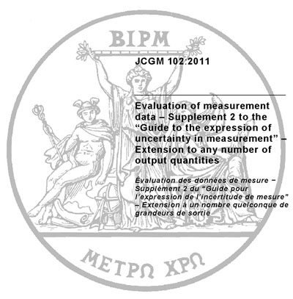
Uncertainty Assessment Standardized
Must be estimated with a standardized assessment (everyone needs to quantify uncertainty in the same manner)
  Evaluation of measurement data –
  Guide to the expression of uncertainty
  in measurement (ISO 1995; JCGM 2008)
    Governing metrology bodies such as
    International Standards Organization (ISO)
    created a Working Group called the Joint
    Committee for Guides in Metrology (JCGM),
    made up of individuals nominated by their
    member organizations to create an
    internationally accepted standard for
    assessing uncertainty.

Slide 10
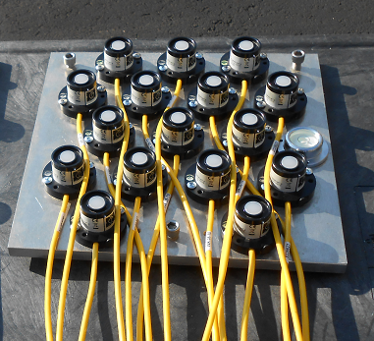
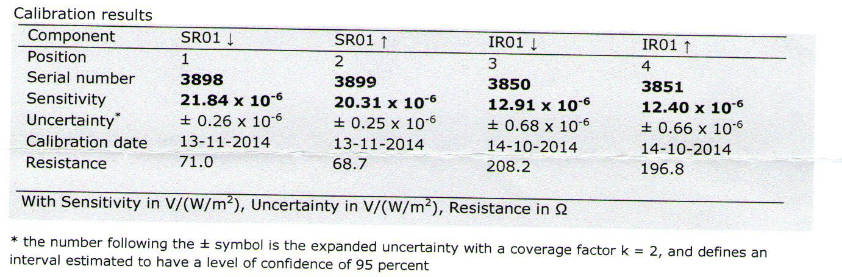
Uncertainty Evaluation
2 approaches to evaluating uncertainty:
  Type A evaluated by statistical methods.
    Experimental variance of independent observations
    which differ in value because of random variations.
  Type B evaluated by other means.
    Estimates obtained using available published knowledge such as manufacturer’s specs, calibration certificates, reference data from handbooks, etc.

Slide 11
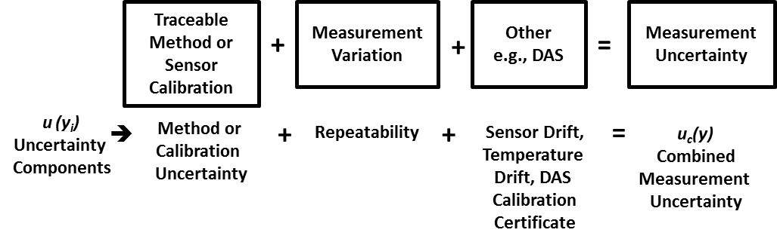
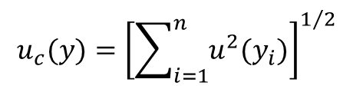
Measurement Uncertainty Recipe
Basic recipe for measurement uncertainty components:
  Assumptions made for workshop materials
    All uncertainties are normally distributed (no systematic errors)
    All uncertainties are independent (uncorrelated)
$$u_{c}(y)={\left[\sum_{i=1}^{n}{u^{2}(y_{i})}\right]}^{1/2}$$

Slide 12
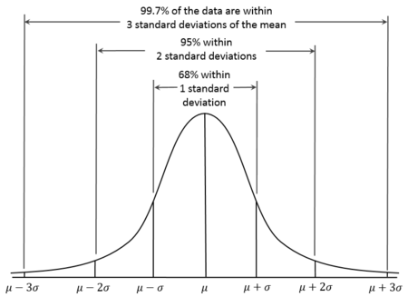


Uncertainty Components
Traceable Method or Sensor Calibration
Traceable Method or Sensor Calibration
  Type B evaluation (typically)
    Calibration or method uncertainty already quantified
        GREAT! Make sure to use unexpanded uncertainty.
    Calibration or method quotes an accuracy
        Research what is meant by accuracy
        Sometimes accuracy means almost all values
        can be attributed, in which case:
    Tolerance may be used as the quality parameter
        Assume a rectangular distribution meaning the value is equally likely to fall anywhere in between
Method or
Calibration
Uncertainty

Slide 13


Uncertainty Components
Measurement Variation
Repeatability
Measurement Variation
  Repeatability
    Single measurement represent the reported result (no averaging)
      Type A evaluation in repeatable conditions
        Standard deviation
    Multiple measurements are averaged for the reported result
      Type A evaluation
        Standard deviation of the mean

Slide 14
Uncertainty Components
Other Contributing Factors
  Too many to capture in this workshop and specific to different applications, but here are some examples:
    Data acquisition system for analogue signals
        Temperature sensor measured in resistance
    Drift
        Temperature
        Calibration
        Sensor degradation
        Sensor

Slide 15
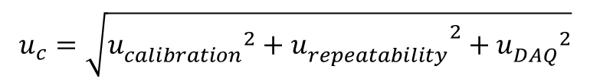
Measurement Uncertainty Recipe
Basic recipe for measurement uncertainty components:
$$u_{c}=\sqrt{{{{u_{calibration}^{}}^{2}+u}_{repeatability}^{}}^{2}+{u_{DAQ}^{}}^{2}}$$

Slide 16
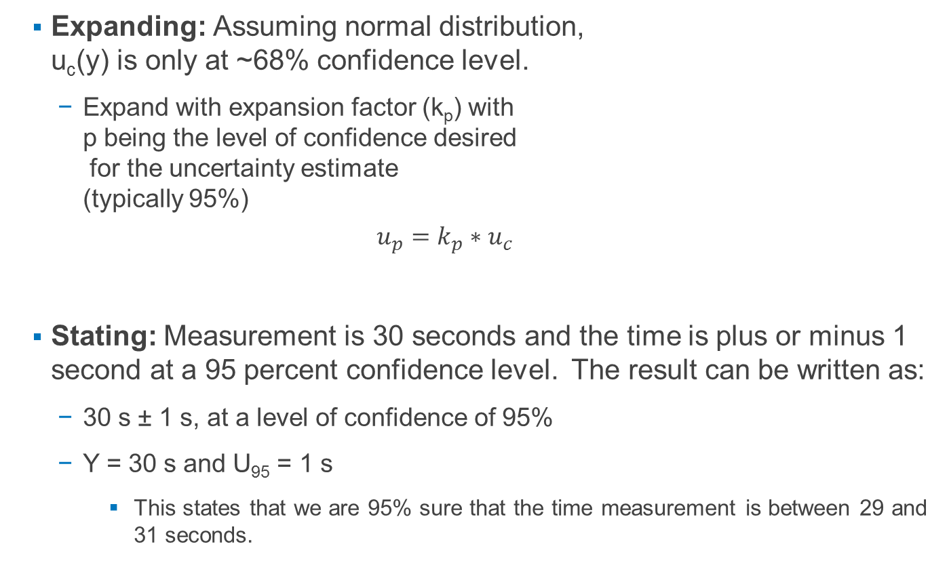
Expanding and Stating Uncertainty
  Expanding: Assuming normal distribution,
  u_{c}(y) is only at ~68% confidence level.
    Expand with expansion factor (k_{p}) with
    p being the level of confidence desired
    for the uncertainty estimate
    (typically 95%)
    $$u_{p}=k_{p}∗u_{c}$$
  Stating: Measurement is 30 seconds and the time is plus or minus 1 second at a 95 percent confidence level. The result can be written as:
    30 s ± 1 s, at a level of confidence of 95%
    Y = 30 s and U₉₅ = 1 s
        This states that we are 95% sure that the time measurement is between 29 and 31 seconds.

Slide 17
Disclaimer
  At the end of the day, uncertainty is an estimation; however, without it, a measurement is meaningless.
      " ... as far as the propositions of mathematics refer to reality, they are not certain; and as far as they are certain, they do not refer to reality.“ Albert Einstein, Geometry and Experience, Lecture before the Prussian Academy of Sciences, January 27, 1921
    Uncertainty assessment is an evolving topic. Changes have occurred over the years. Additionally, the instructions in this workshop are not absolute. This workshop provides an overview of a basic measurement system, the user of these materials is encouraged to further their uncertainty knowledge to apply to different applications with some of the following materials:
        JCGM. (2008). Evaluation of measurement data - Guide to the expression of uncertainty in measurement (GUM). Genève, Switzerland: International Organization for Standardization.
        JCGM. (2012). International vocabulary of metrology - Basic and general concepts and associated terms. Geneva: ISO Copyright Office.

